Slide 1
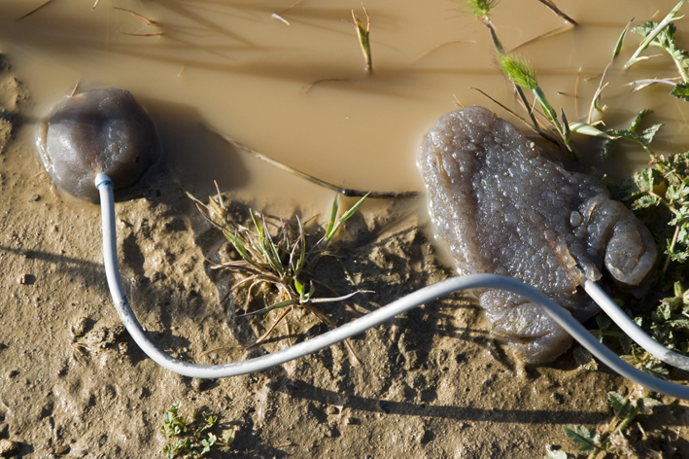
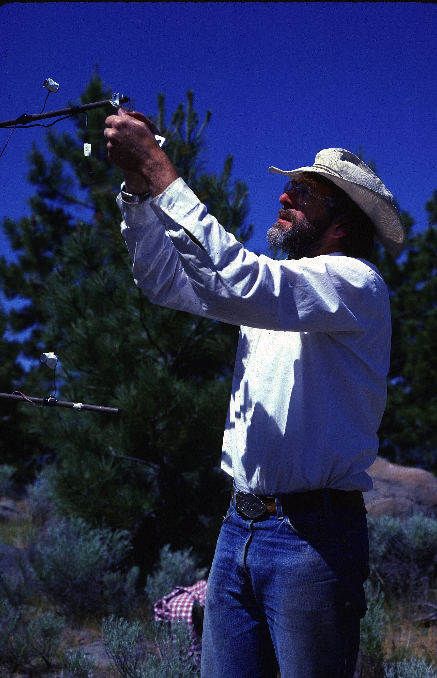

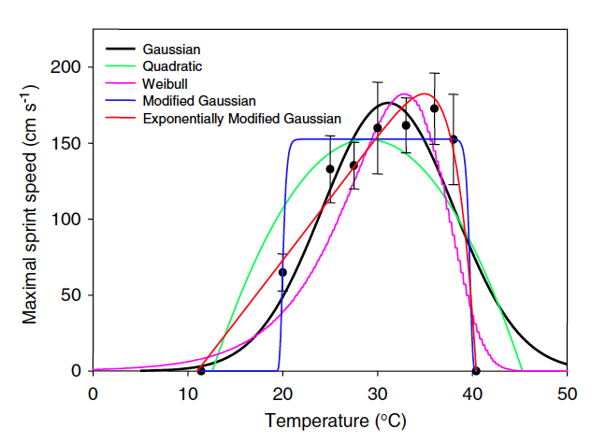
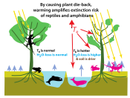
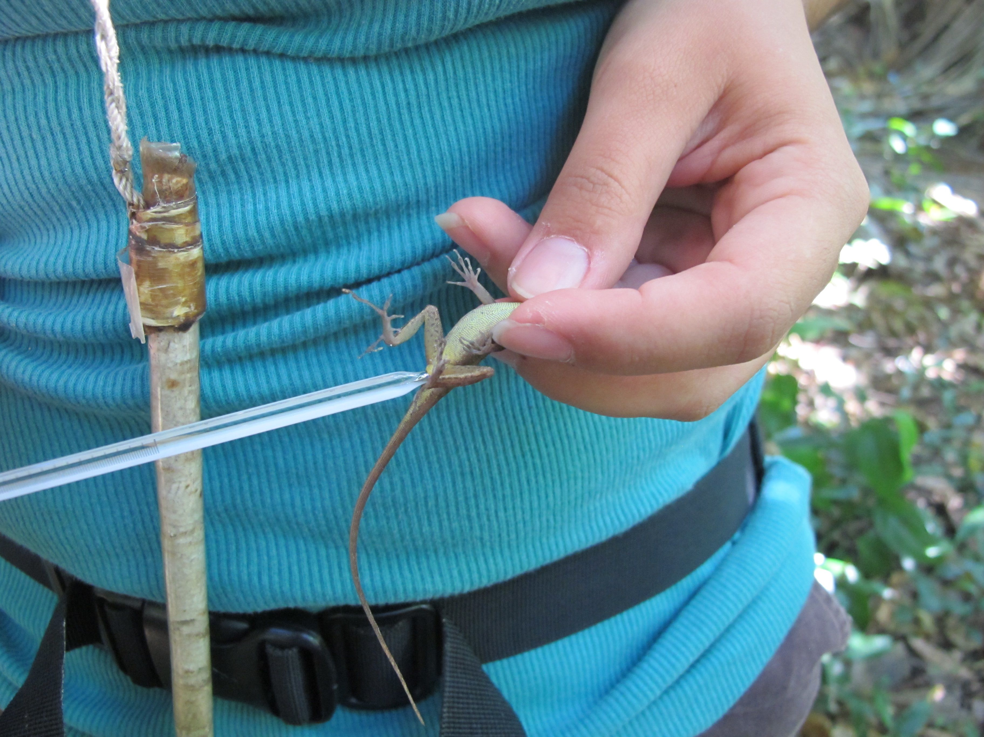
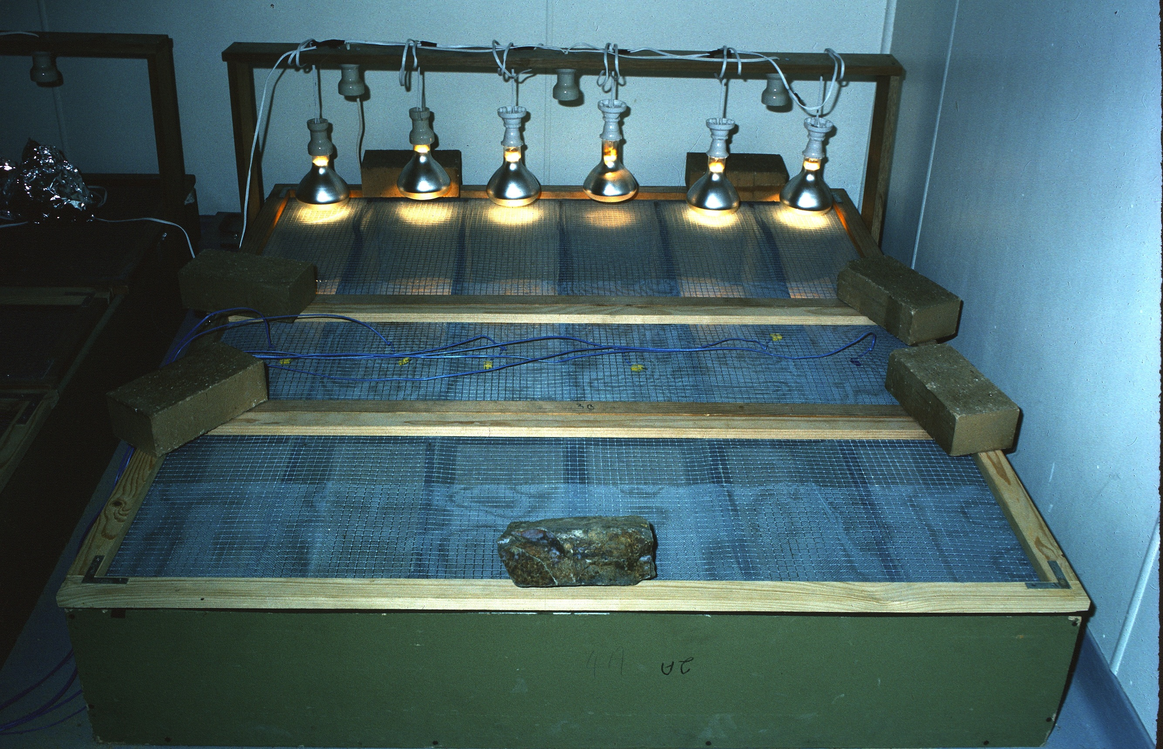
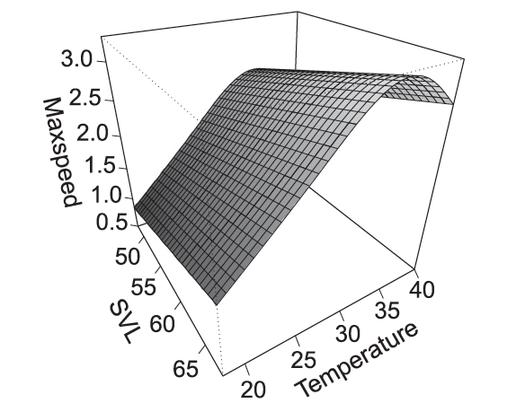
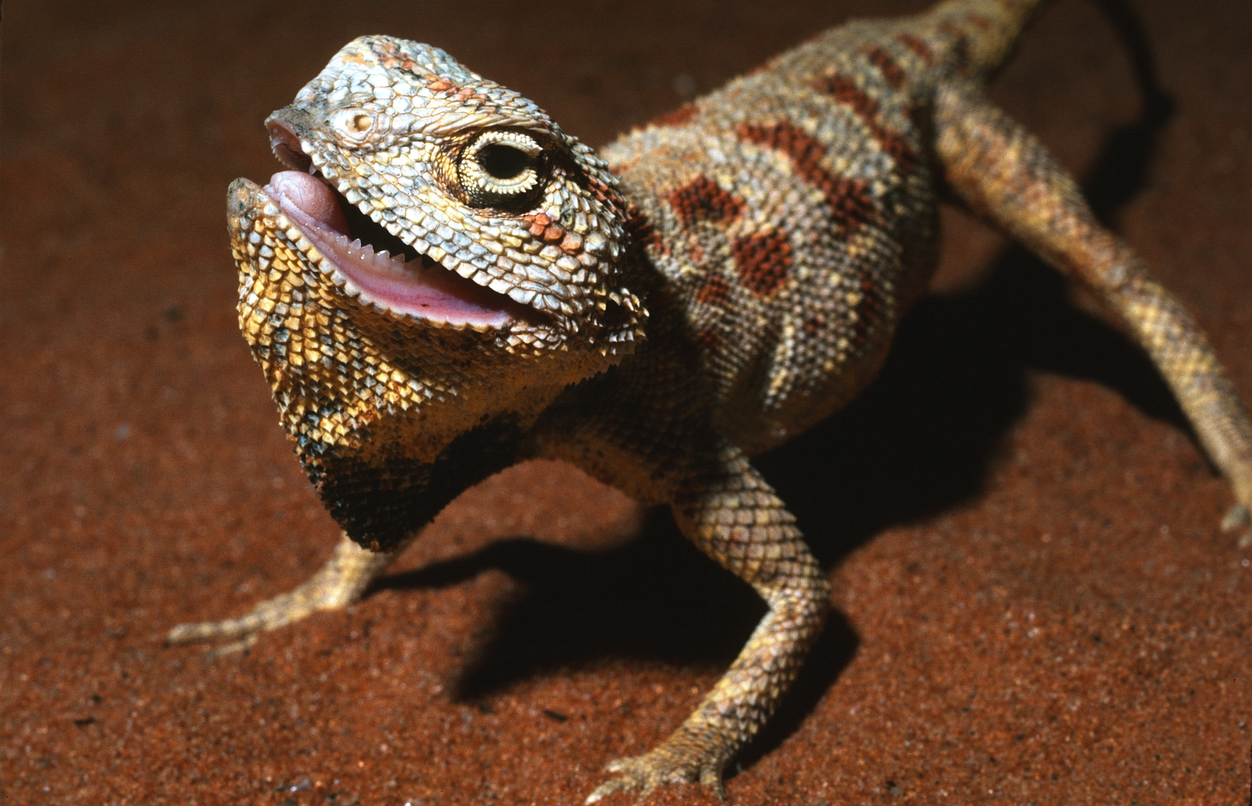
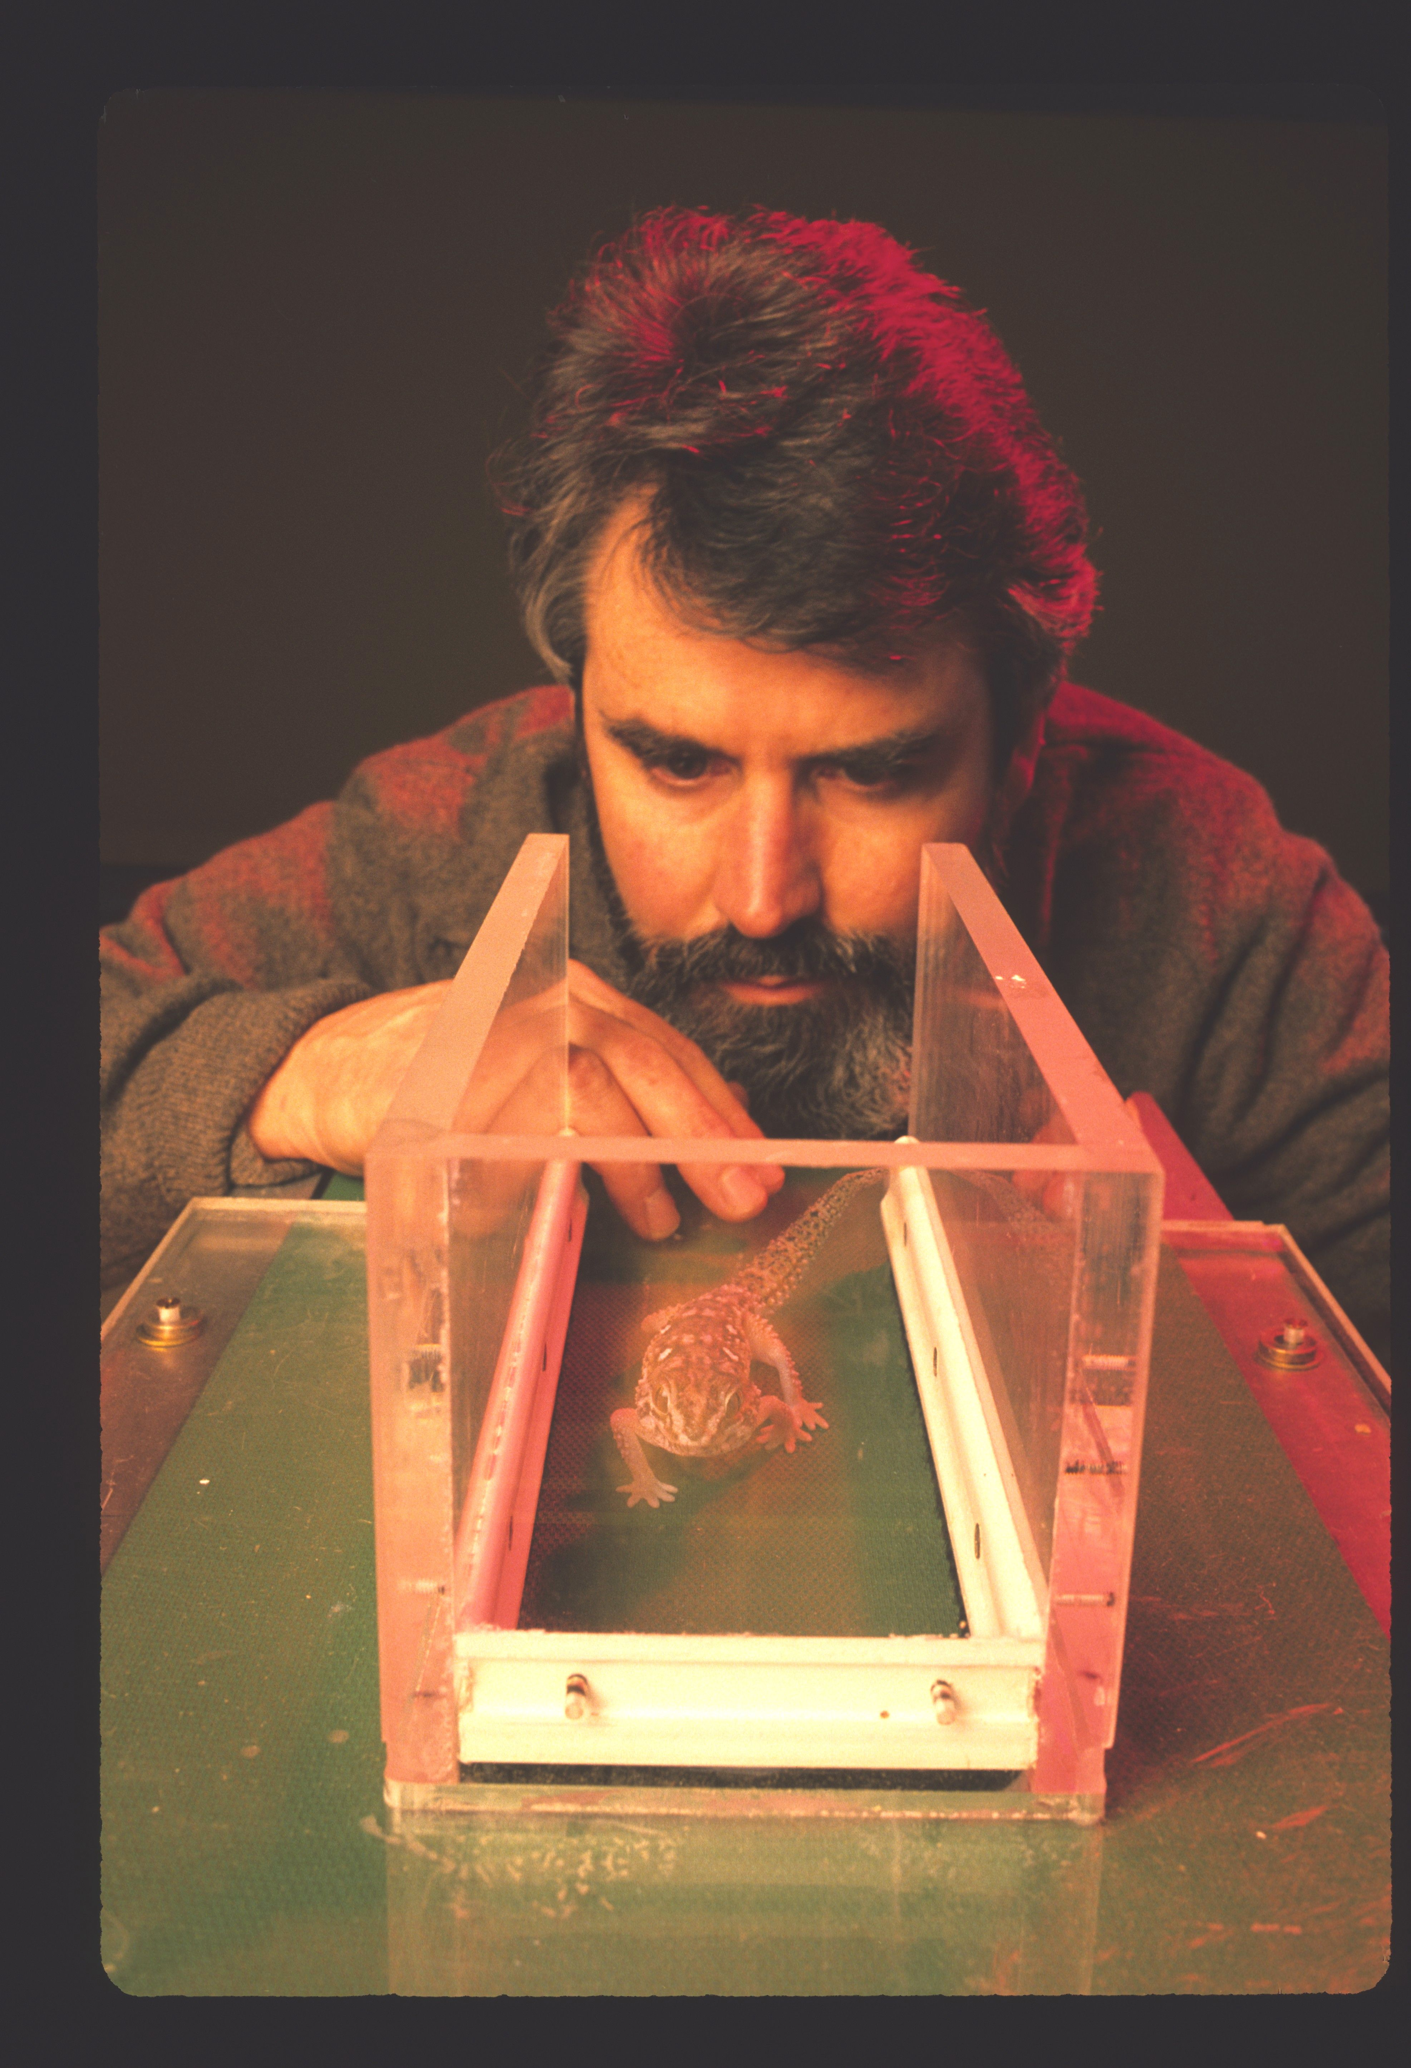
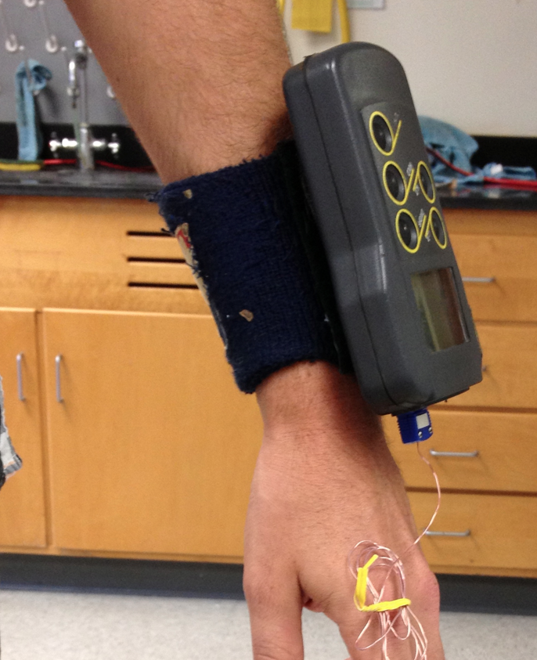
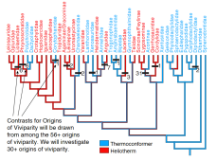
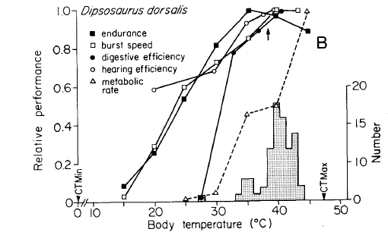
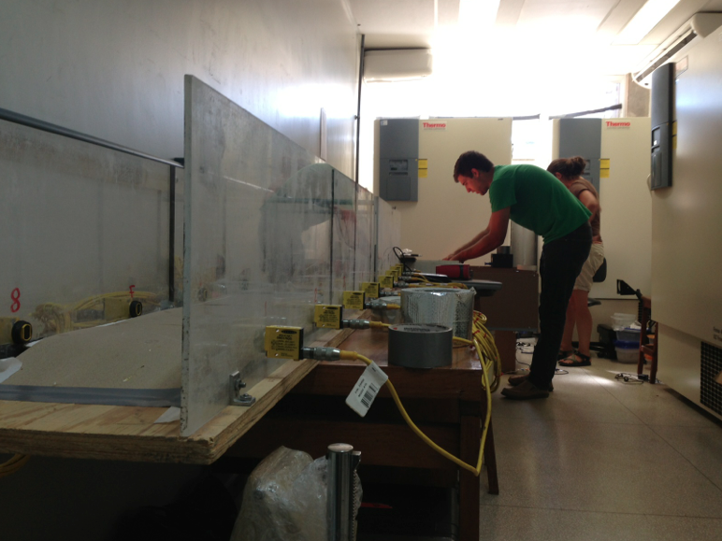
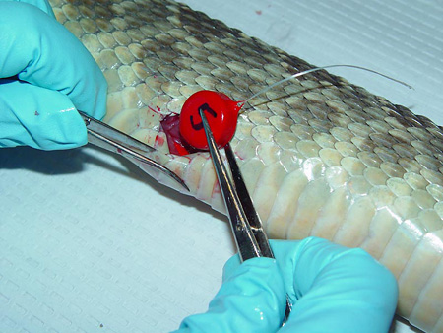
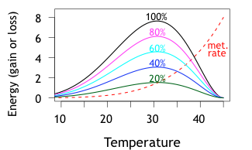
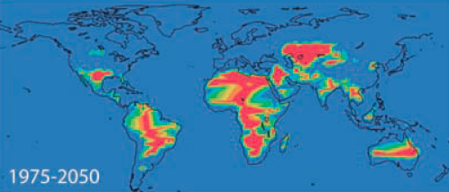
Measuring
Performance
& its Thermal Sensitivity

Slide 2
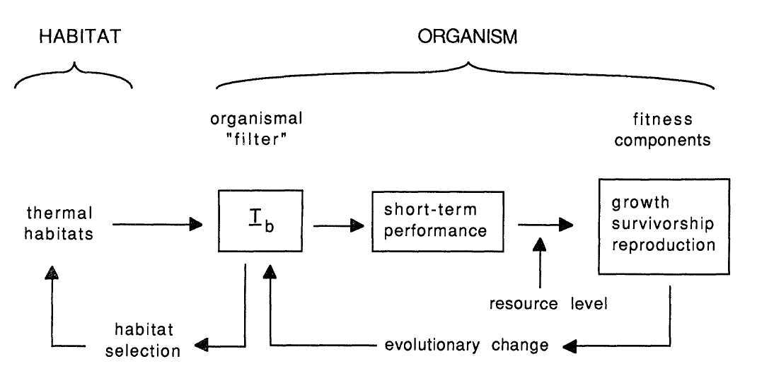
thermoregulation
morphology
thermoregulatory
behavior
T_{b}
Huey, Am Nat 1991

Slide 3
Measuring Organismal Performance & its Thermal Sensitivity
What traits are appropriate?
How can we measure them?
How does one measure their thermal sensitivity?

Slide 4
Sample performance measurements
Locomotion
acceleration, speed (~ “100 m dash”)
stamina (~ “marathon”)
distance run until fatigue
Feeding, digestion
bite force
prey capture rate/success
digestive efficiency

Slide 5
Sample performance measurements
Neural processing
learning rate, forgetting rate
hearing or visual sensitivity
Growth, reproduction (invertebrates)
development time (egg to hatching, to adult)
growth rate
egg laying rate
Ecological “fitness” measures (long-term measurements!)
r (intrinsic rate of population growth
R_{o} (net reproductive rate, N female offspring/generation)

Slide 6
Goals of Performance Studies
Estimate Individual Variation
Natural Selection
  Performance as a link between Morphology and Fitness
Adaptation
  Habitat Variation
  Substrate Variation
Life History Adaptations
  Cost of Reproduction

Slide 7
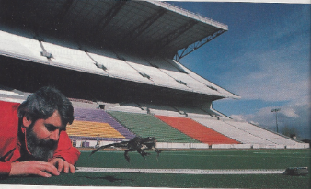
Measuring distance jumped – frogs, crickets

Slide 8
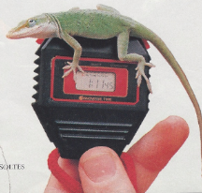
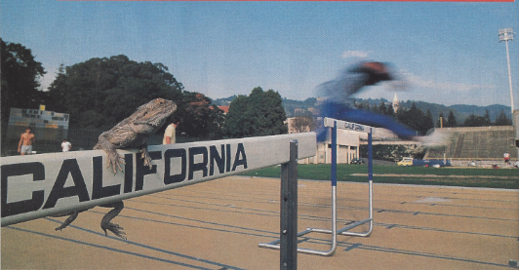
Measuring speed:
a racetrack (pista)

Slide 9
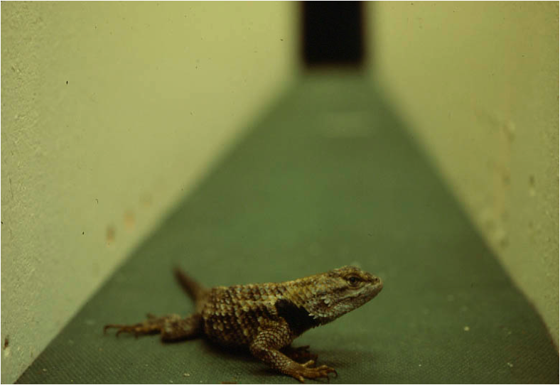

Slide 11
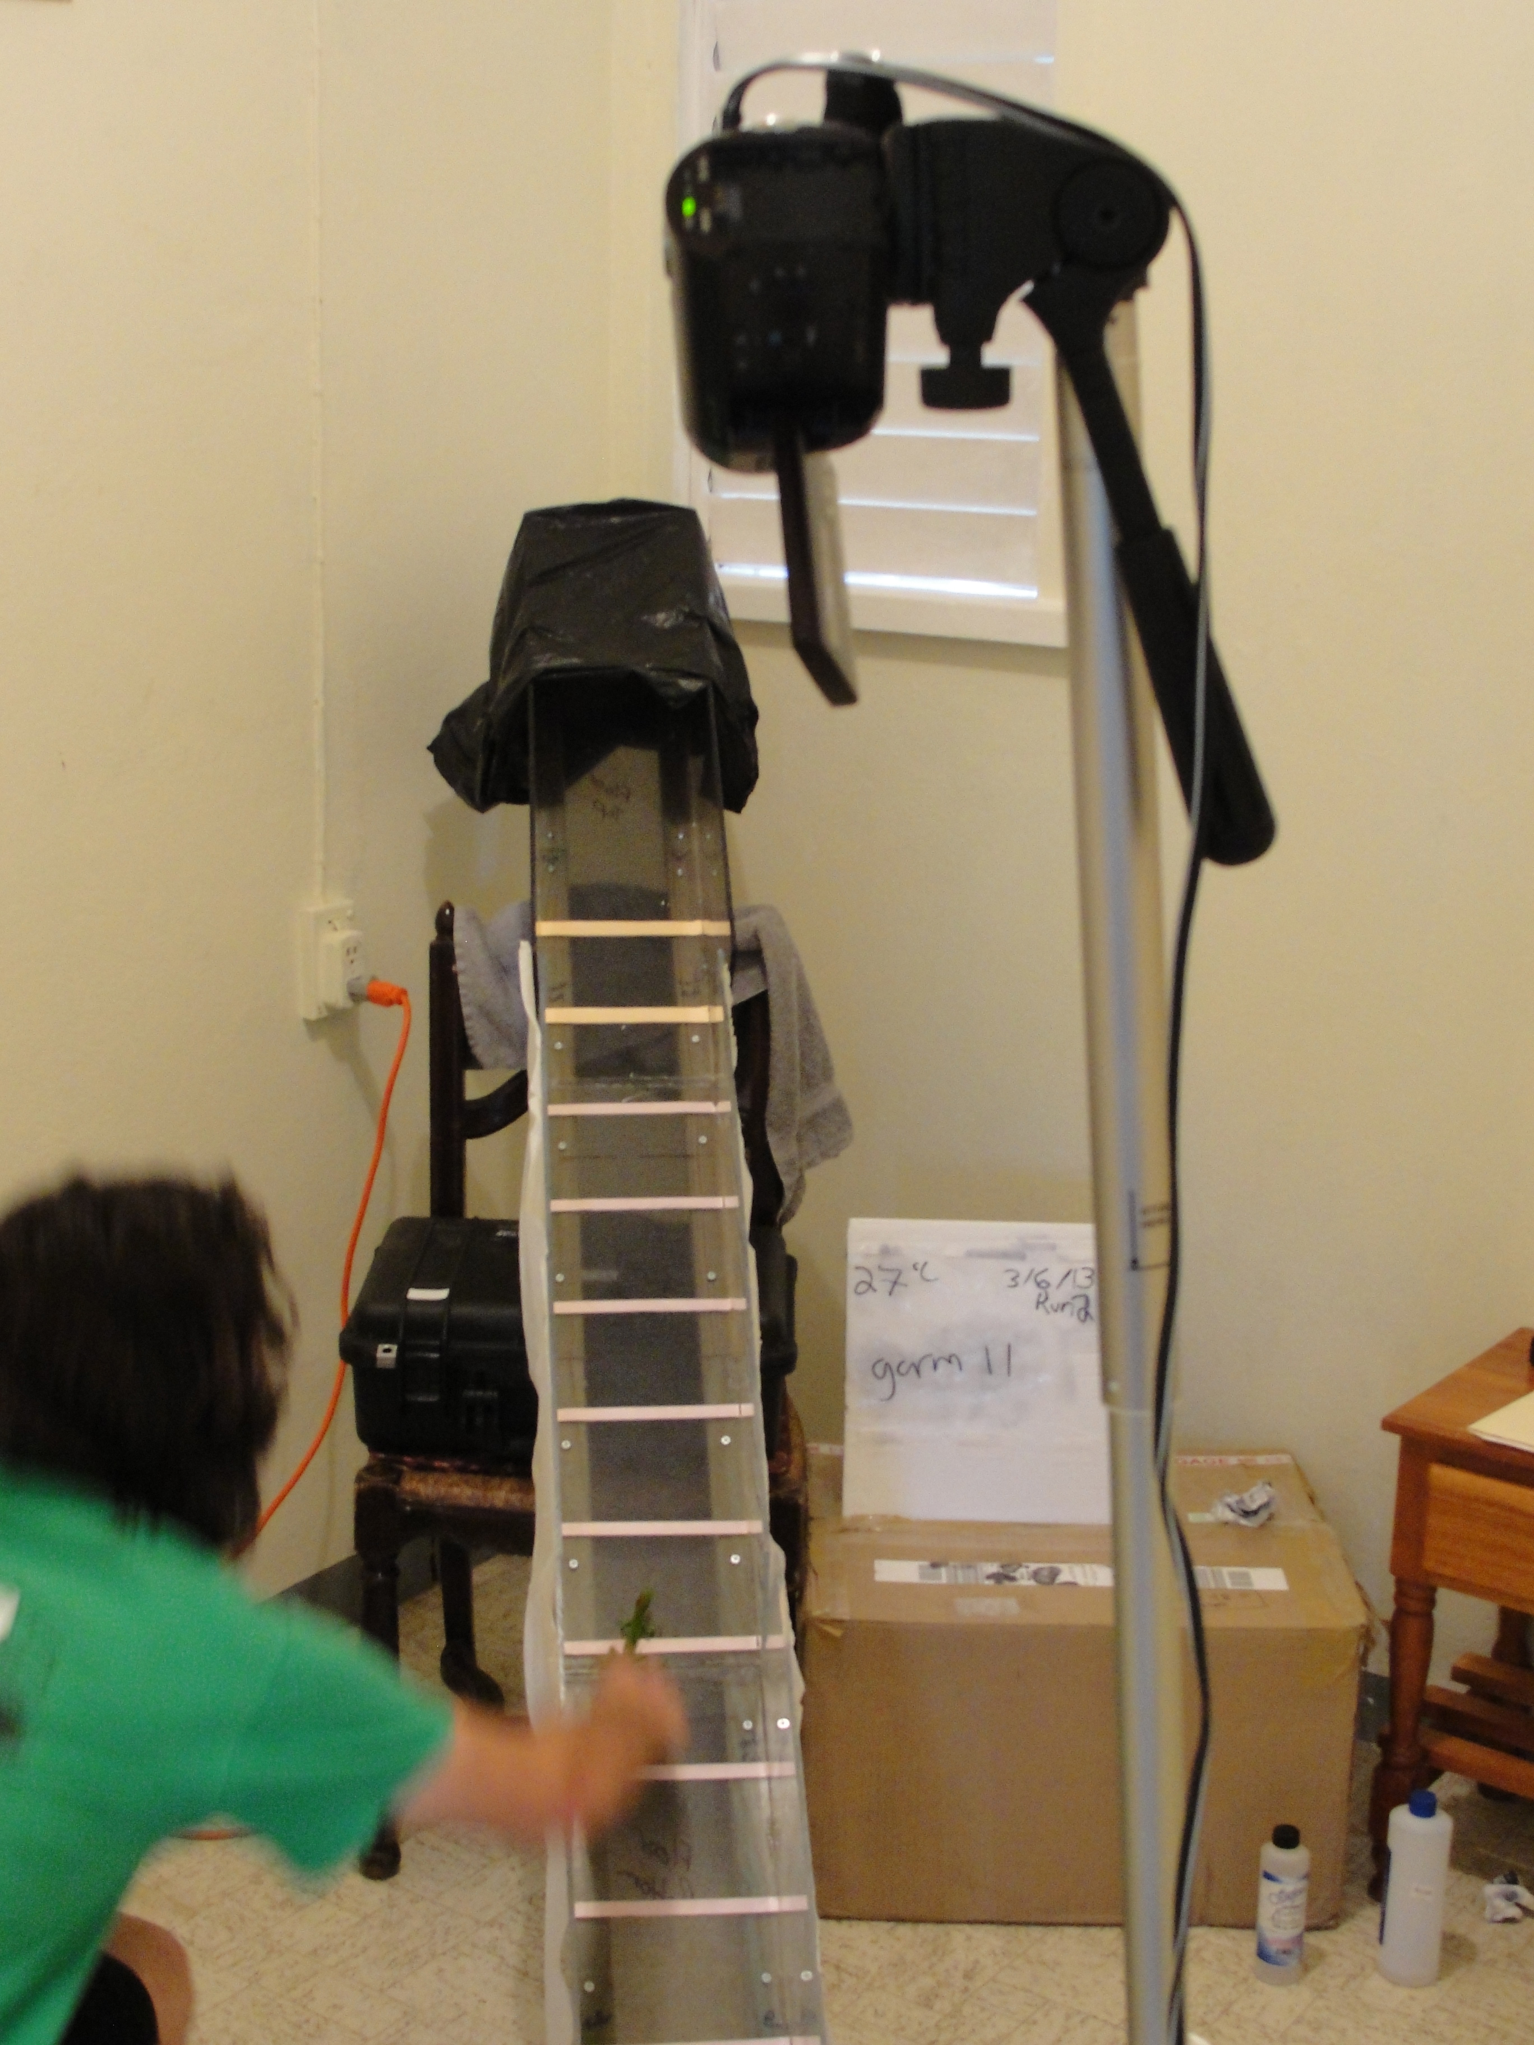
Or film running lizards and later digitize films
Alex Gunderson
chasing Anolis
Digitizing software:
http://www.unc.edu/~thedrick/software1.html

Slide 12
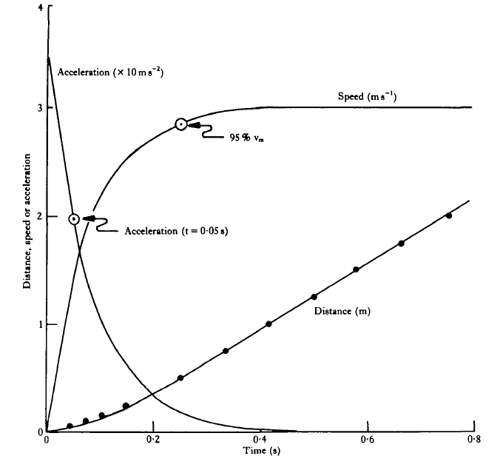
If film or if several photocells along the track,
can measure acceleration as well as maximal speed
Speed (m/s)
Distance, speed, or acceleration
Acceleration at t = 0.05 s
Distance
Time
Huey & Hertz, J exp Biol 1984

Slide 13
Protocols
Distancia
  25 cm
  50 cm
  1 m
Temperatura
Time of Day
Number of runs
  Number of times a lizard is sprinted, recovery time
  Control for behavioral motivation, injury or fatigue

Slide 14
Substrate Sensitivity
Choice of Substrate
  Sand (stride length and stride frequency)
  Cork
  Rubber
  Sandpaper
  Wooden dowel (for arboreal species)
Should be Ecologically Relevant
Note: some species hop on flat substrate, but will run up a slope (Anolis)

Slide 15
Measuring stamina
Need a treadmill (noria)
Pick a speed and measure
time until lizard exhausts
Must control temperature
Stamina
Measured elapsed time
until lizard is exhausted --
at specific speed

Slide 16
Endurance/Stamina/Resistencia
Need a treadmill
What belt speed?
What temperature(s)?
How determine fatigue (exhaustion)?

Slide 17
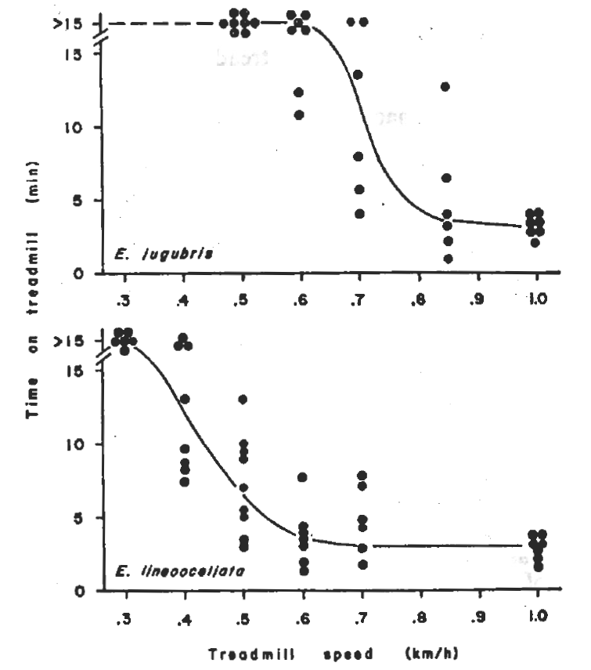
Stamina of two Kalahari lizards
a widely foraging lacertid
moves frequently
high stamina
Time to exhaustion (min)
normal foraging speed
a sit-and-wait lacertid
moves less frequently
low stamina
Treadmill speed (km/h)
Huey et al., Anim Behav 1984

Slide 18
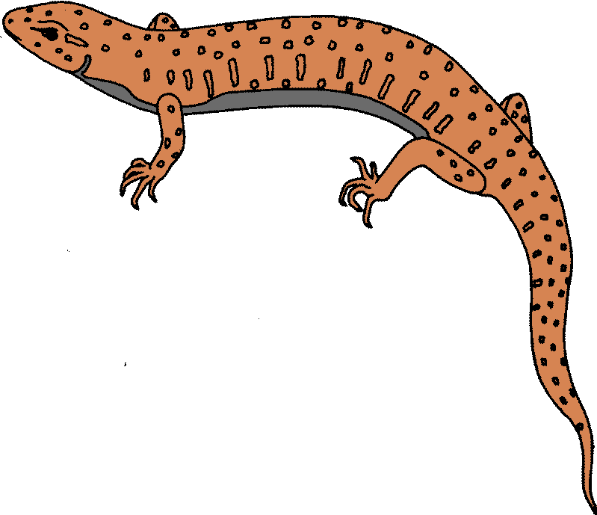
Another measure of locomotor performance
Distance Running Capacity
How far can an animal run in a fixed time or to exhaustion
A “donut-shaped” track – chase the lizard around the track
Bennett Animal Behav 1980

Slide 19
Behavioral Variation
Reversals
Stops
ZigZag

Slide 20
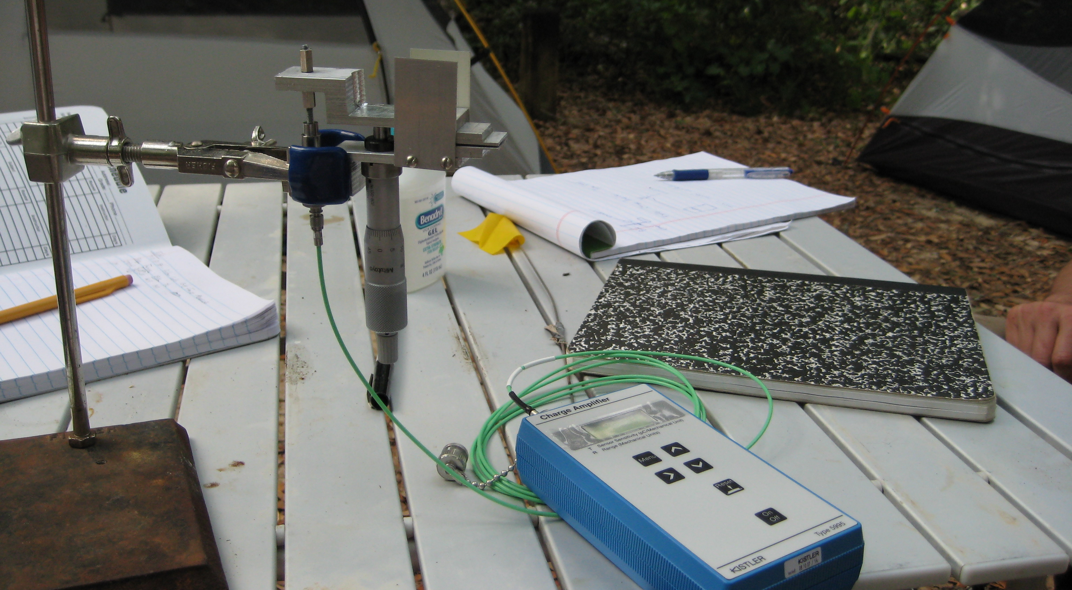
Measuring bite (force) performance la fuerza de mordida

Slide 21
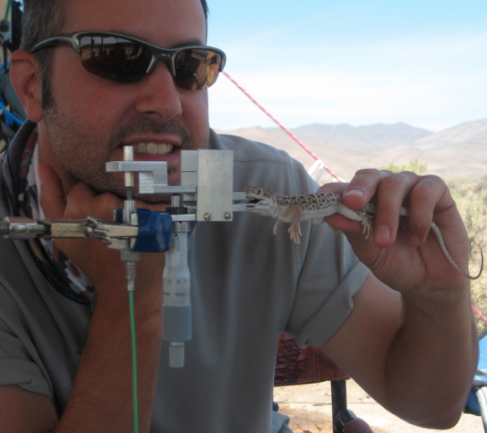
Lance McBrayer
Lance’s technique:
Catch lizard
Make it angry
Convince it to bite
the transducer

Slide 22
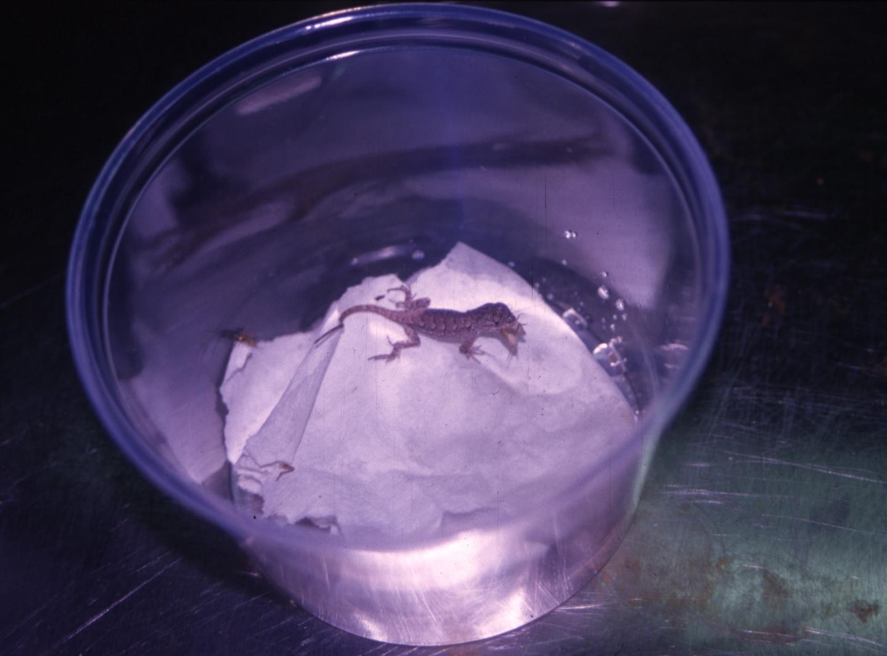
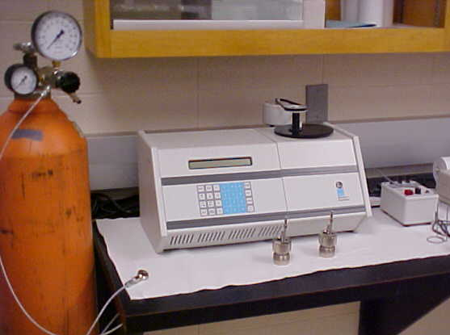
Performance traits – digestive efficiency
use a Bomb calorimeter
to measure energy content
of food and feces
courtesy Michael Angilletta

Slide 23
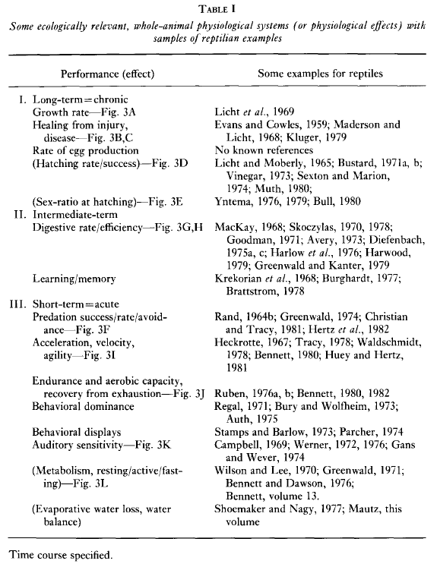
Huey 1982. Biology of the Reptilia

Slide 24
Thermal Sensitivity of Performance
Insights into responses to Climate Change

Slide 25
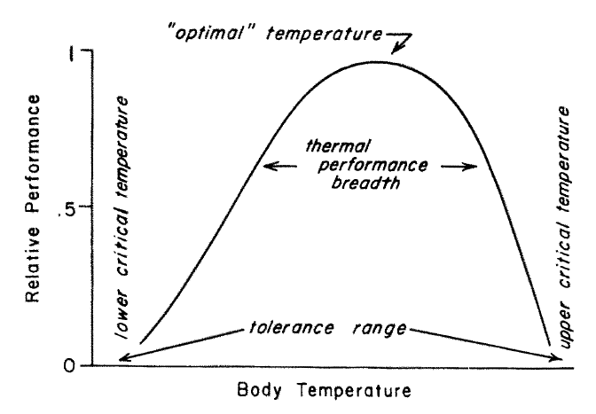
Thermal performance curve
Huey & Stevenson, Am Zool 1979

Slide 26
Why is thermal sensitivity
ecologically relevant?
Galapagos land iguana – T_{opt} sprinting 30° to 40°C
predation success of hawks on juvenile iguanas
predicted Tb sprint rate observed hawk success
< 32°C slow 67%
32° – 40°C slow to fast 46%
32° -> 40°C fast 19%
Christian & Tracy Oecologia 1981

Slide 27
How can one control Tb to measure thermal sensitivity?
      In the lab use an environmental chamber
      But in the field? Or in a remote site?

Slide 28
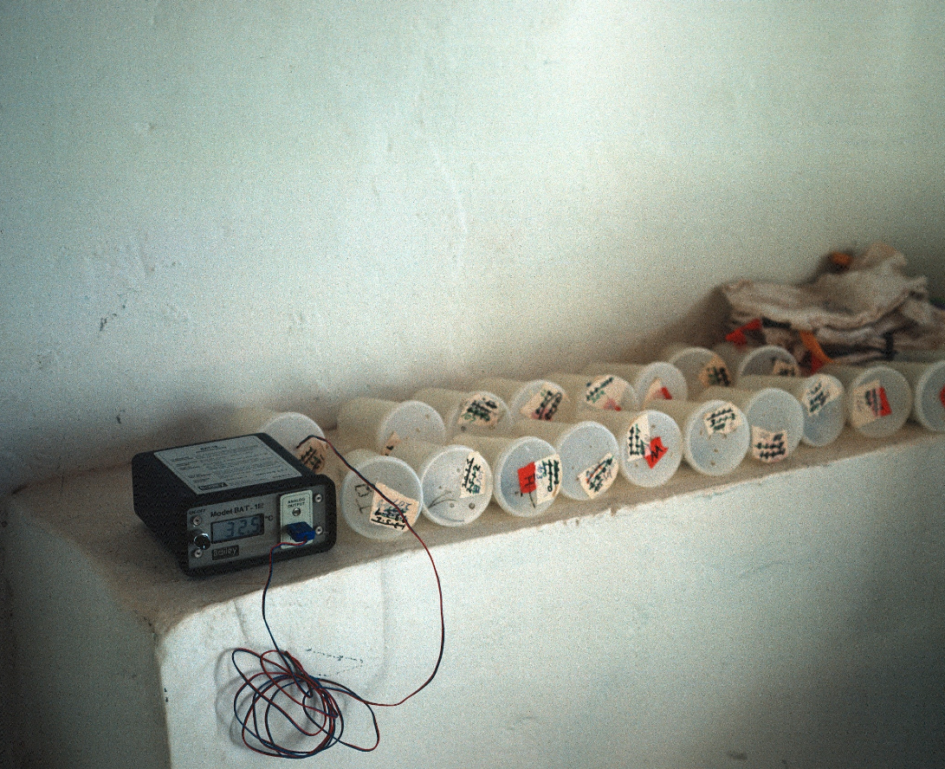
Quinta Barker, Big Bend National Park, Texas
in middle of summer, the house was 32+°C
sin aire acondicionado !
no need for electronic temperature control
Sceloporus merriami inside plastic cups

Slide 29
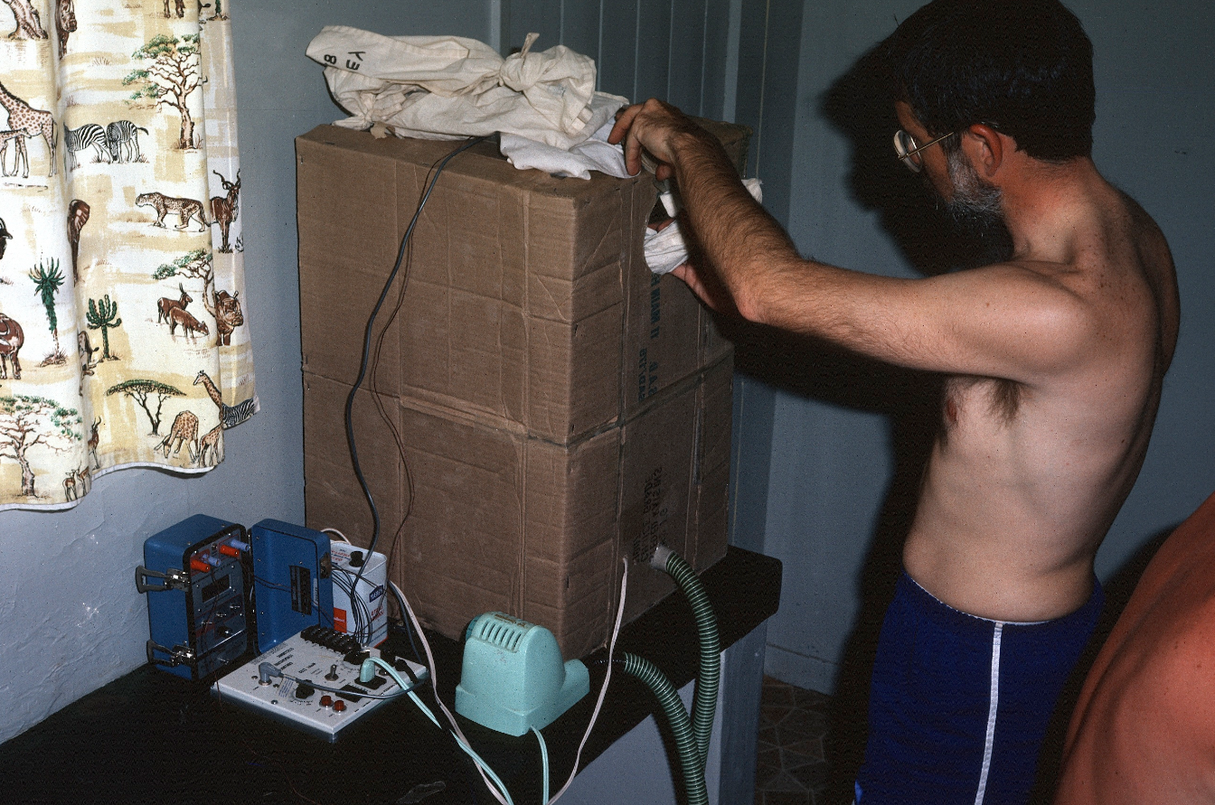
Al Bennett, Kalahari Desert, temperature control unit
air hose
hair drier
(blows hot air)
temperature
controller

Slide 30


ice chest or insulated cooler --
use as crude a water bath
32°C
32°C
insulation
glue cups to bottom of ice chest
add hot or cold water as needed to control temperature

Slide 31
cual las temperaturas which temperatures?
CT_{min} and CT_{max} set the “boundary” or limiting temperatures
Temperature intervals within those limits, often 5°C
But ideally smaller intervals near the optimum

Slide 32
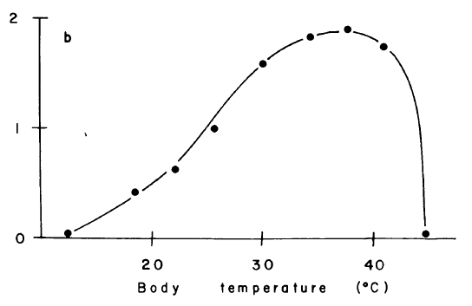
qué secuencia de temperaturas for performance measurements?
Maximum speed (m/s)
Stellagama stellio
Hertz, Huey, Nevo
Evol. 1983
CT_{min} 18, 23, 26, 30, 35, 38, 42 CT_{max}
?

Slide 33
No – use a semi-randomized sequence
Maximum speed (m/s)
Stellagama stellio
Hertz, Huey, Nevo
Evol. 1983
CT_{min} 30, 26, 38, 34 , 18, 42, 22, 30 CT_{max}
?
Notes:
Repeating the first temperature (30°C, above) enables one to detect lizards that have changed performance dramatically during the experiment,
Perhaps because of energy or change of motivation

Slide 34
Estimating Thermal Performance Curves
Convex Polygon
Regression models
GAMM
Template Mode of Variation
  Function Value Traits
  Polynomial Function
van Berkum Evol 1986

Slide 35
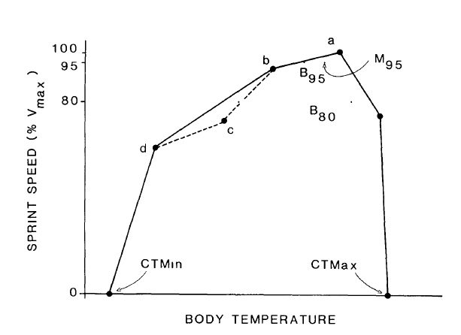
Estimating Thermal Performance Curves
Convex Polygon
Regression models
GAMM
Template Mode of Variation
  Function Value Traits
  Polynomial Function
van Berkum Evol 1986

Slide 36
Regression models
Angilletta J Therm Biol 2006

Slide 37
GAMMs
general additive mixed models (GAMMs)
Zajitschek, Zajitschek, Miles & Clobert
Biol J Linn Soc 2012
uses non-parametric
smoothing functions
can test for effects of
covariates (SVL) and also fixed
factors (sex, species).

Slide 38
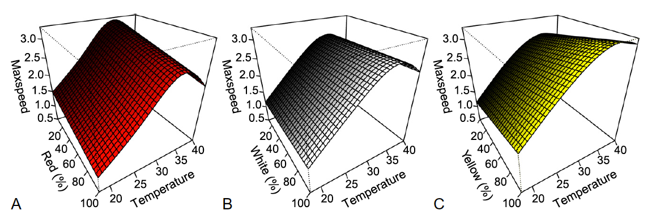
Thermal Performance in Podarcis
Red Morph
White Morph
Yellow Morph

Slide 39
Day 1
Lizard Census and Capture
10 – 15 lizards per performance trait
Day 2
Thermal Performance Curves
Variables Measured (all lizards):
T_{b}
T_{air}
T_{sub}
T_{pref}
Morphology
Sprint Speed – Measured at field T_{b}
Endurance
PHA (measure swelling prior to release)
Day 3 Day 4 Day 5 Day 6 Day 7 Day 8 Day 9
Temp 1 Temp 2 Temp 3 Temp 4 Temp 5 Temp 6 Temp 7
Day 9
Release on Day 3
Estimate CT_{min} and CT_{max}
Day 10
Release

Slide 40
Izem method?
TMV

Slide 41
Do different traits have the same thermal sensitivity?
Speed
Stamina
Hearing
Digestive efficiency
Growth
Reproduction
Performance
T_{b}
Performance
T_{b}

Slide 42
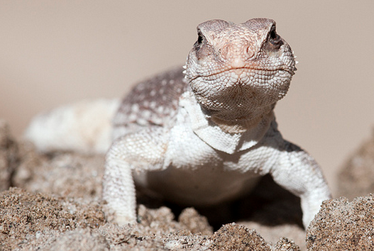
Huey, in Biology of the Reptilia, 1982

Slide 43
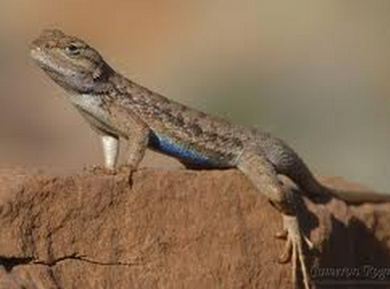
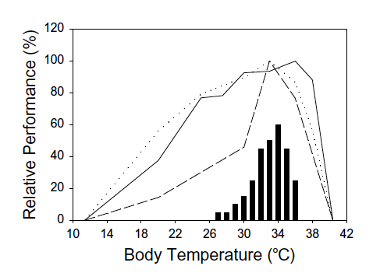
Sceloporus undulatus
speed
stamina
digestion
Angilletta et al., J. Thermal Biol. ‘02

Slide 44
Do other factors influence thermal sensitivity?
food ration
desiccation
age
sex
reproduction
stress
Performance
T_{b}
“Where there are main effects, there are interactions.”
Steve Stearns, pers. comm

Slide 45
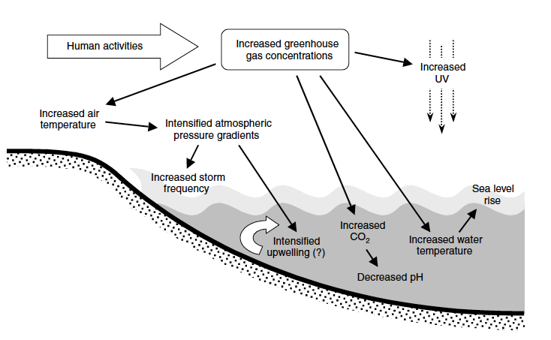
The many abiotic factors affected by climate change
Harley et al., Ecol Lett 2006

Slide 46
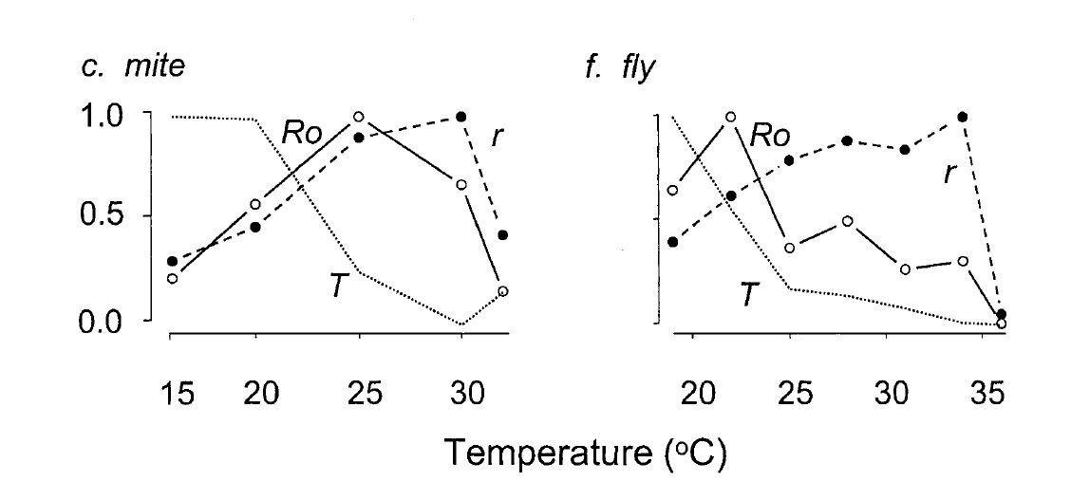
r = intrinsic rate of increase (population)
R_{o} = net reproductive rate (N female offspring/female)
T = generation time
Relative proportion
Huey & Berrigan, Am Nat 2001

Slide 47
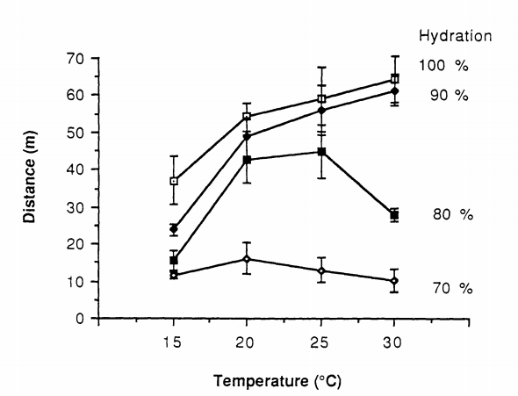
Bufo americanus
distance moved in 10 min of forced locomotion
Preest and Pough, Funct Ecol 1989

Slide 48
Complications with performance curves
food
quantity
climate
warming
organismal
performance
Notes:
Theme focuses on energetics and growth, an appropriate theme, given Ken’s classic contributions to animal energetics.
I became interested in thermal dependence of growth in early 70s, when I was a grad student and I read a paper in Am Zool, the forerunner to Integrative and Comparative Biology,

Slide 49
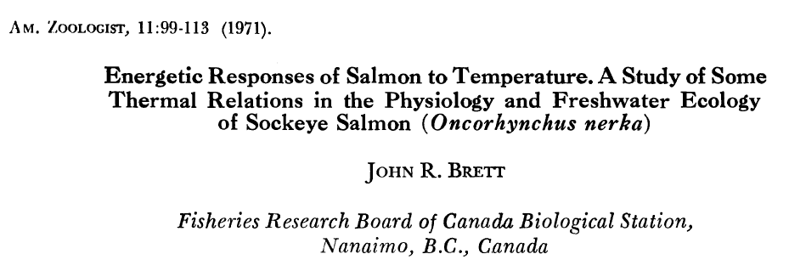
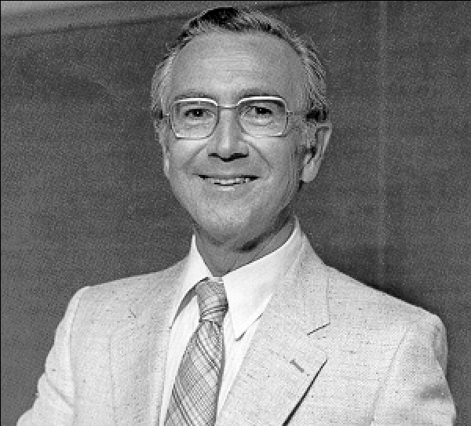
photo courtesy
Henrik Kreiberg
Notes:
of a symposium organized by Peter Hochachka for ASZ & APS, held at AIBS meetings in 1970. Speakers included Brett, Vance Tucker, James Heath, Peter Hochachka, & George Somero.
For me, this was one of those life-changing papers. Changed the way I think about thermal sensitivity.

Slide 50
Maximum growth rate at T_{opt} declines with food ration
excess
+ growth
Growth rate (% gain/day)
starved
- growth
Temperature (°C)
Brett, 1971, Am Zool

Slide 51
Highest T_{b} with positive growth declines with food ration
excess
+ growth
Growth rate (% gain/day)
starved
- growth
Temperature (°C)
Brett, 1971, Am Zool

Slide 52
Optimal T_{b} declines with food ration
excess
+ growth
Growth rate (% gain/day)
starved
- growth
Temperature (°C)
Brett, 1971, Am Zool

Slide 53
Hainsworth & Wolf, ’78
Huey, ‘82

Slide 54
Notes:
LOWER FOOD, ECTOTHERM BECOMES INTOLERANT OF HIGH TEMPERATURES (UPPER THERMAL LIMIT FOR GROWTH),
And TOPT DROPS
Leads to predictions about behavior.

Slide 55
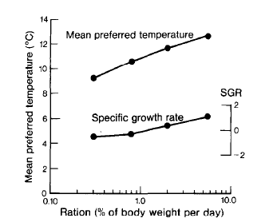
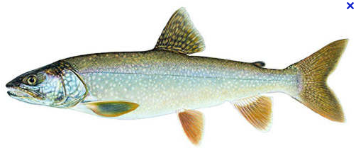
Lake charr (Salvelinus namaycush) have lower preferred body temperature on restricted ration
Mac, Env Biol Fish 1985

Slide 56
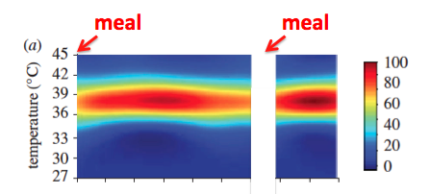
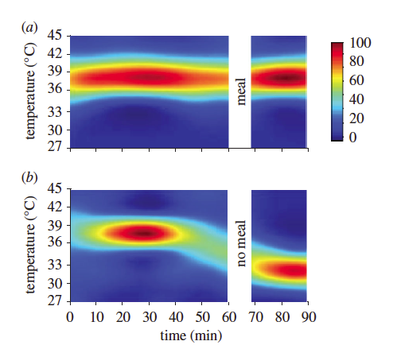
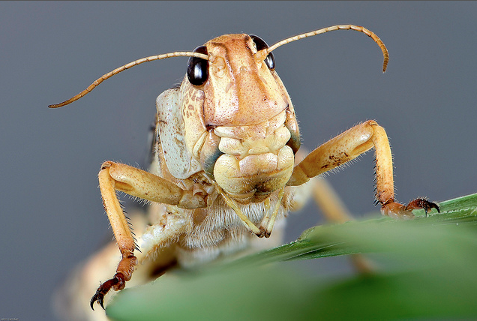

Locusts select lower T_{p} on reduced rations
meal
meal
meal
NO meal
Coggan et al.,
Proc R Soc B 2011
Notes:
SO IN RESPONSE TO LOWERED FOOD, TOPT DROPS, TP DROPS
Now let suppose that we impose climate warming on a system, and that food availablity declines, perhaps because prey species harmed by warming, or primary productivity down

Slide 57

Warming + declining food “Metabolic meltdown”
T_{p}
+ growth
T_{opt}
Net energy gain
- growth
T_{b}
T_{b}
Temperature (°C)

Slide 58
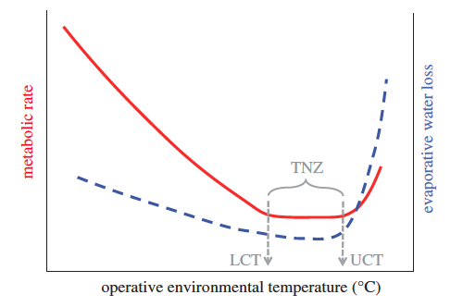
Thermal neutral zones
a “thermal performance breadth” for endotherms ?
thermal neutral
zone
Upper Crit
Temp
Lower Crit Temp
Huey et al., Phil Trans Roy Soc, 2012

Slide 59

Mammals –
metabolic rate as percent of Basal Metabolic Rate
redrawn from Scholander 1950, 1955

