Slide 1
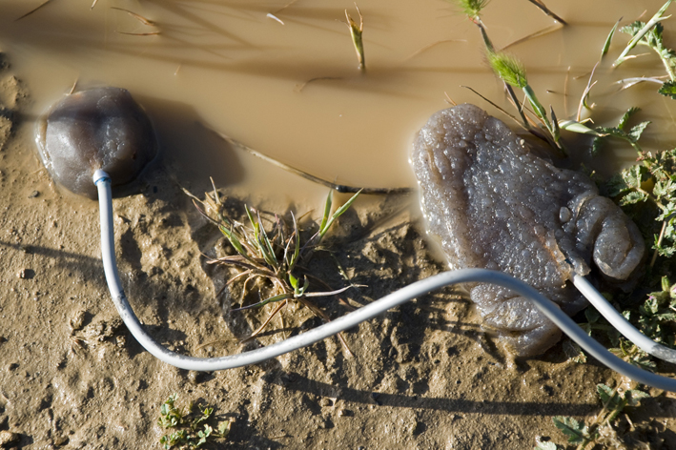
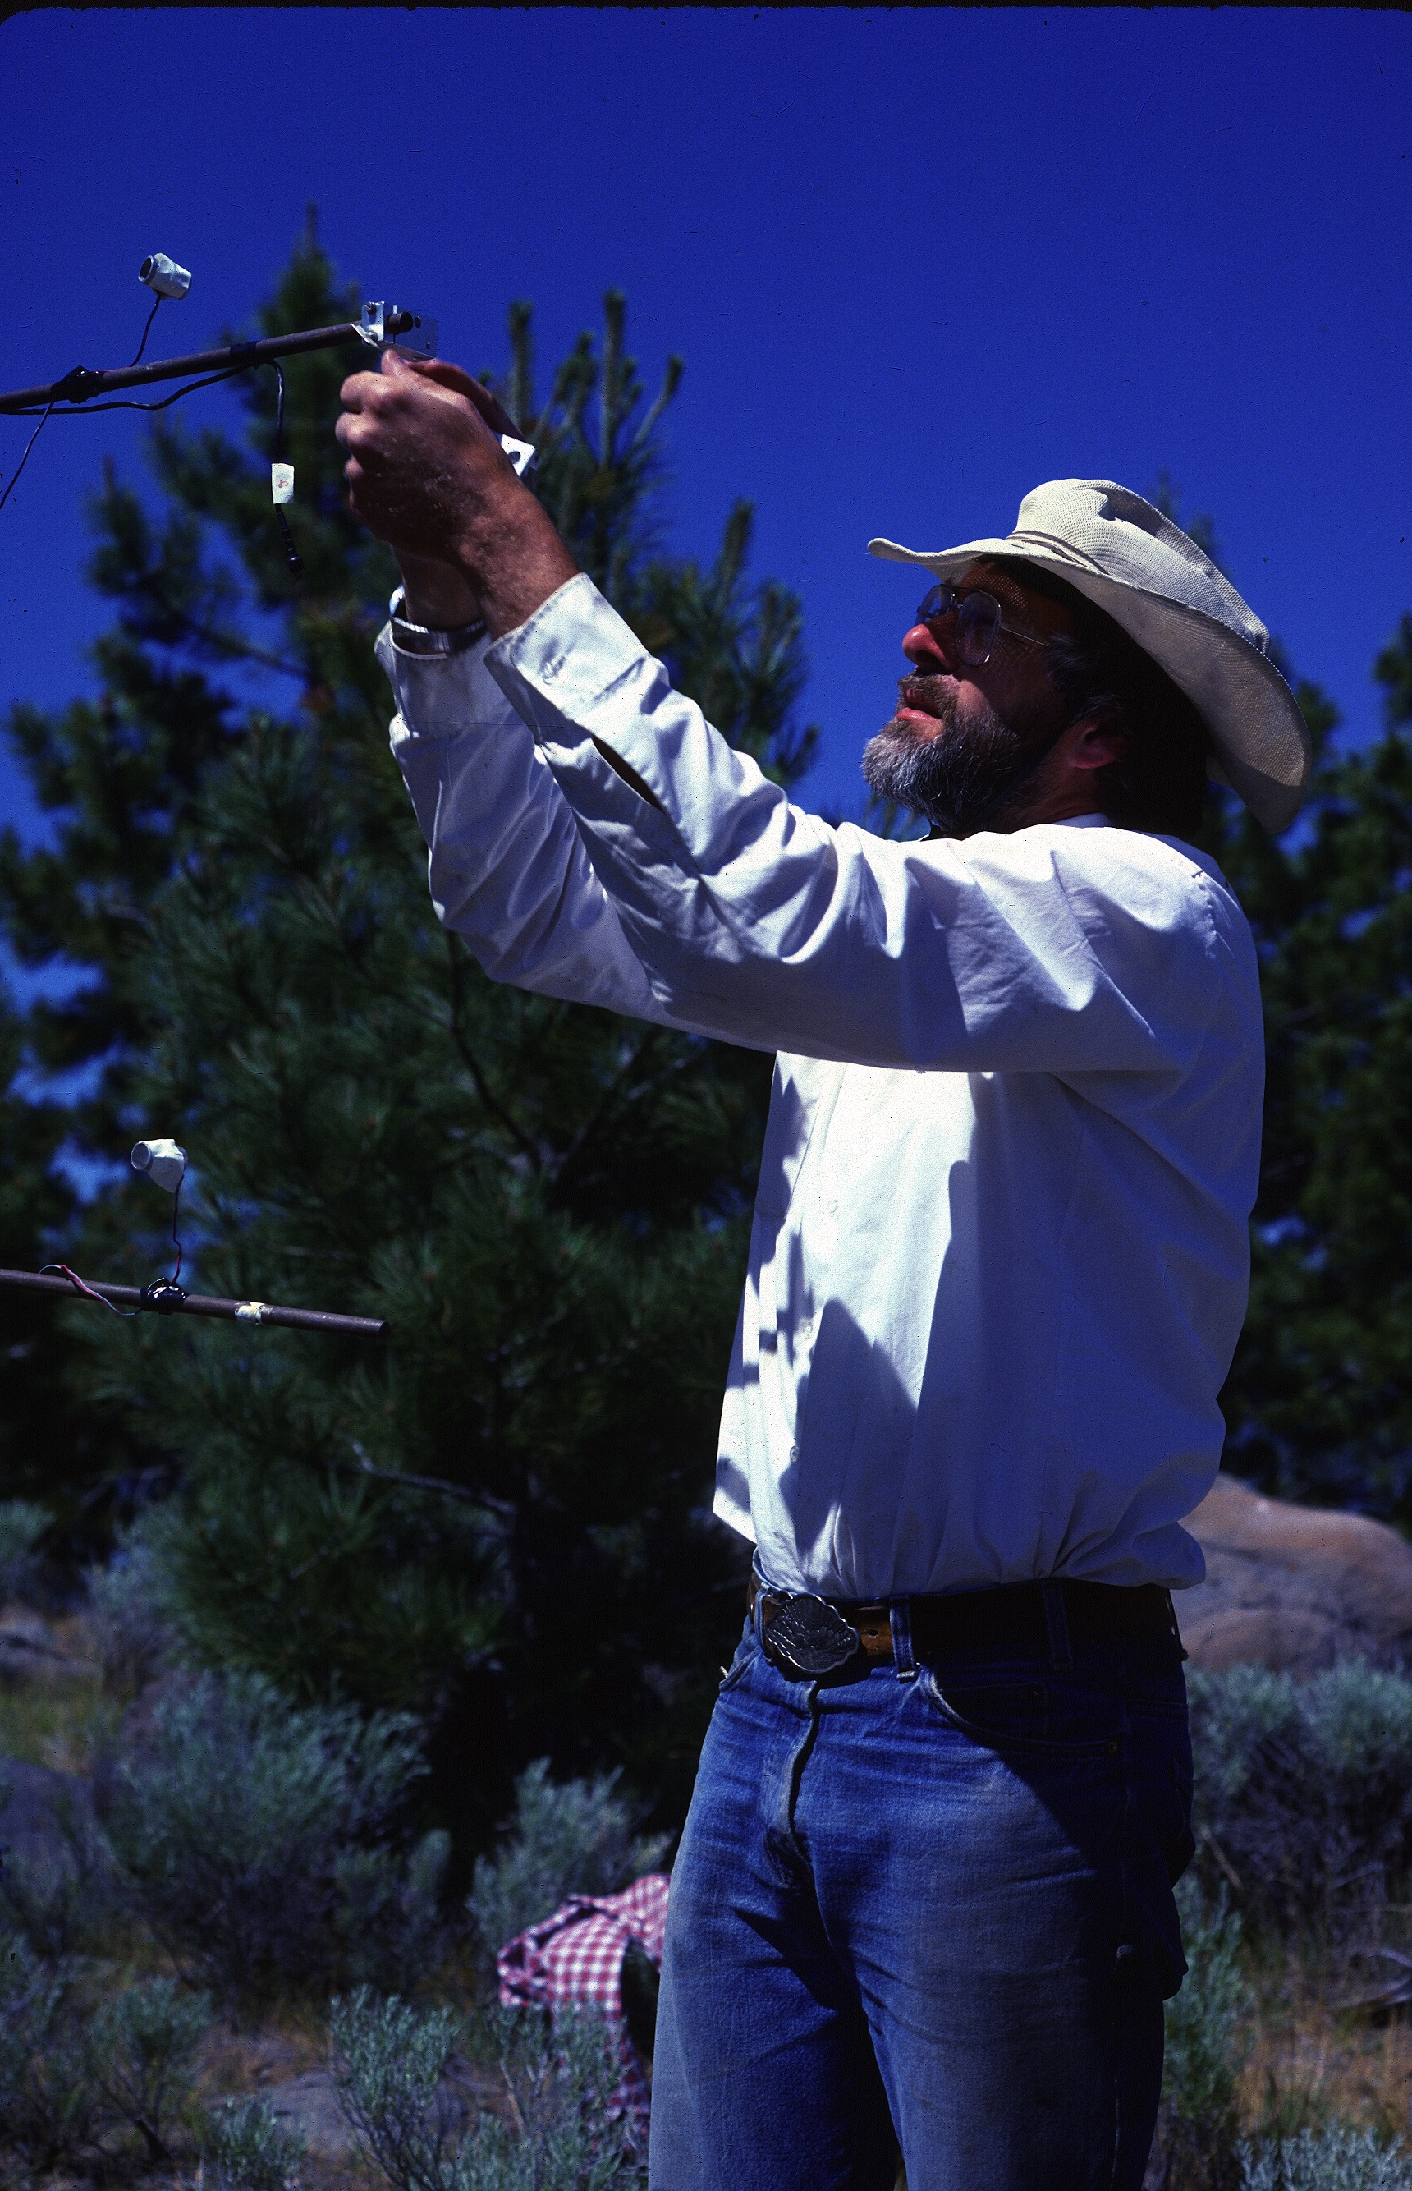
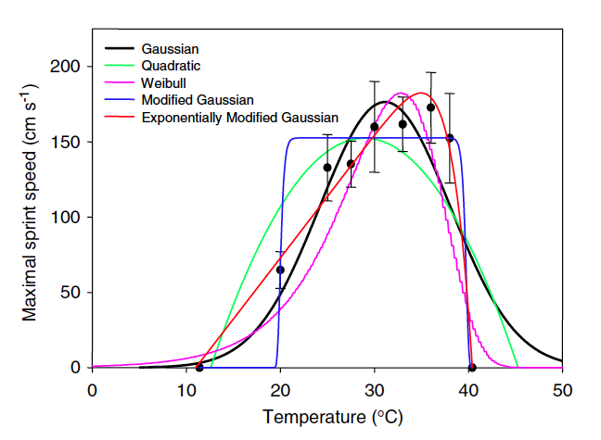
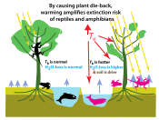
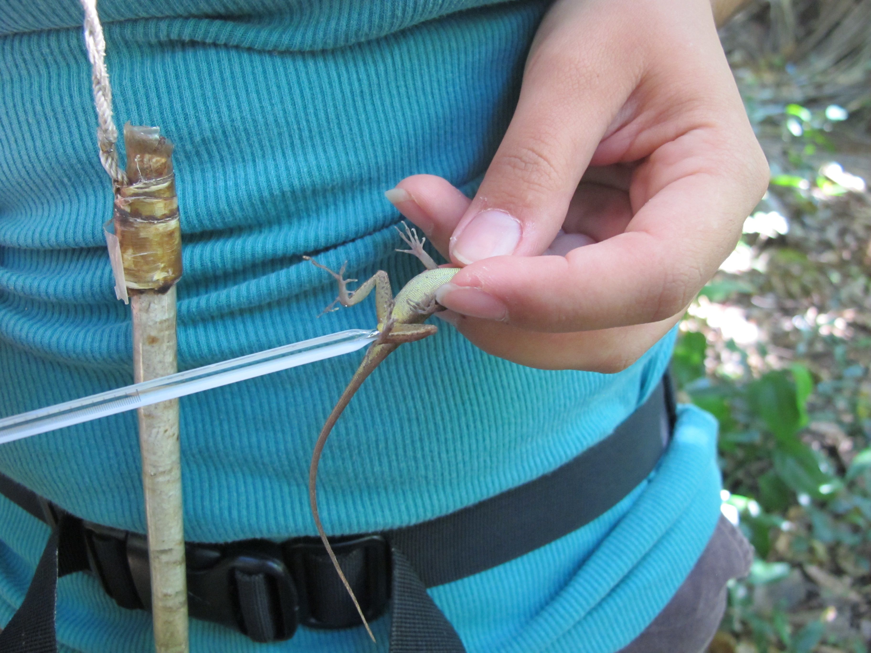
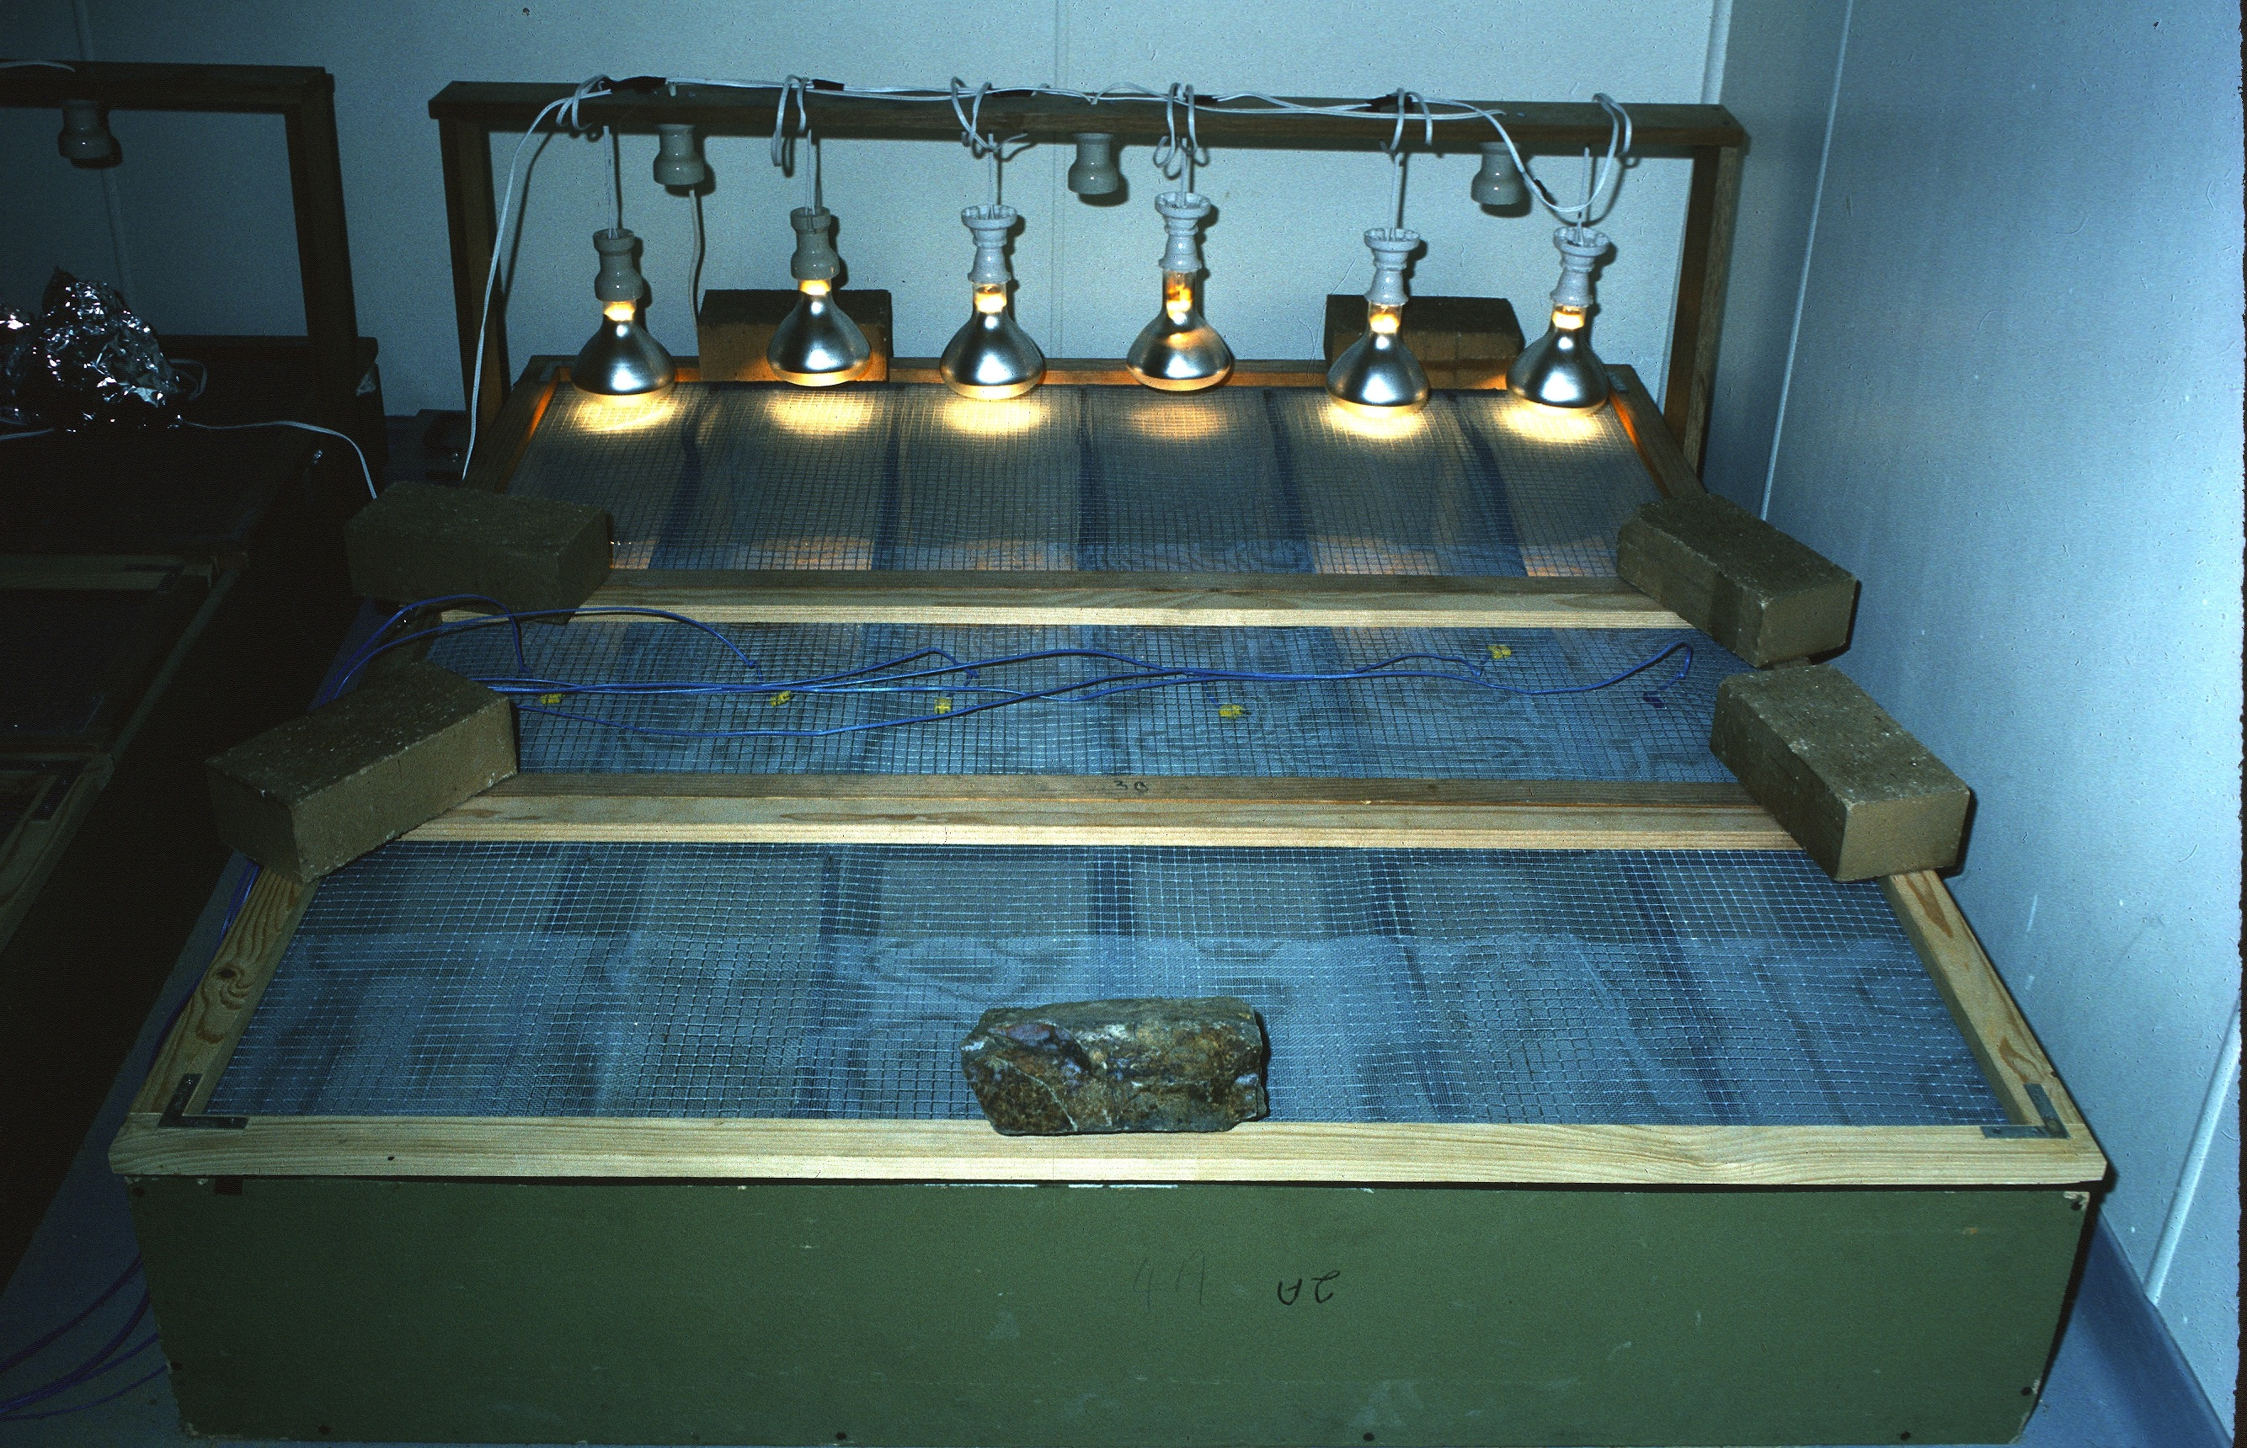
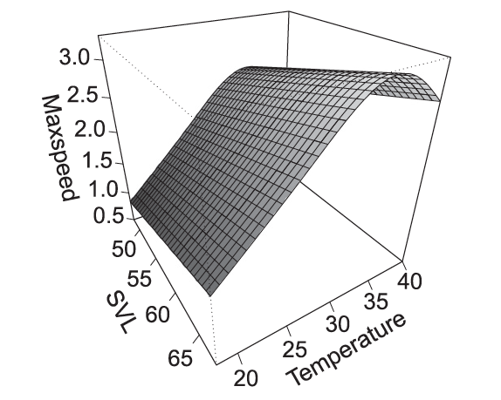
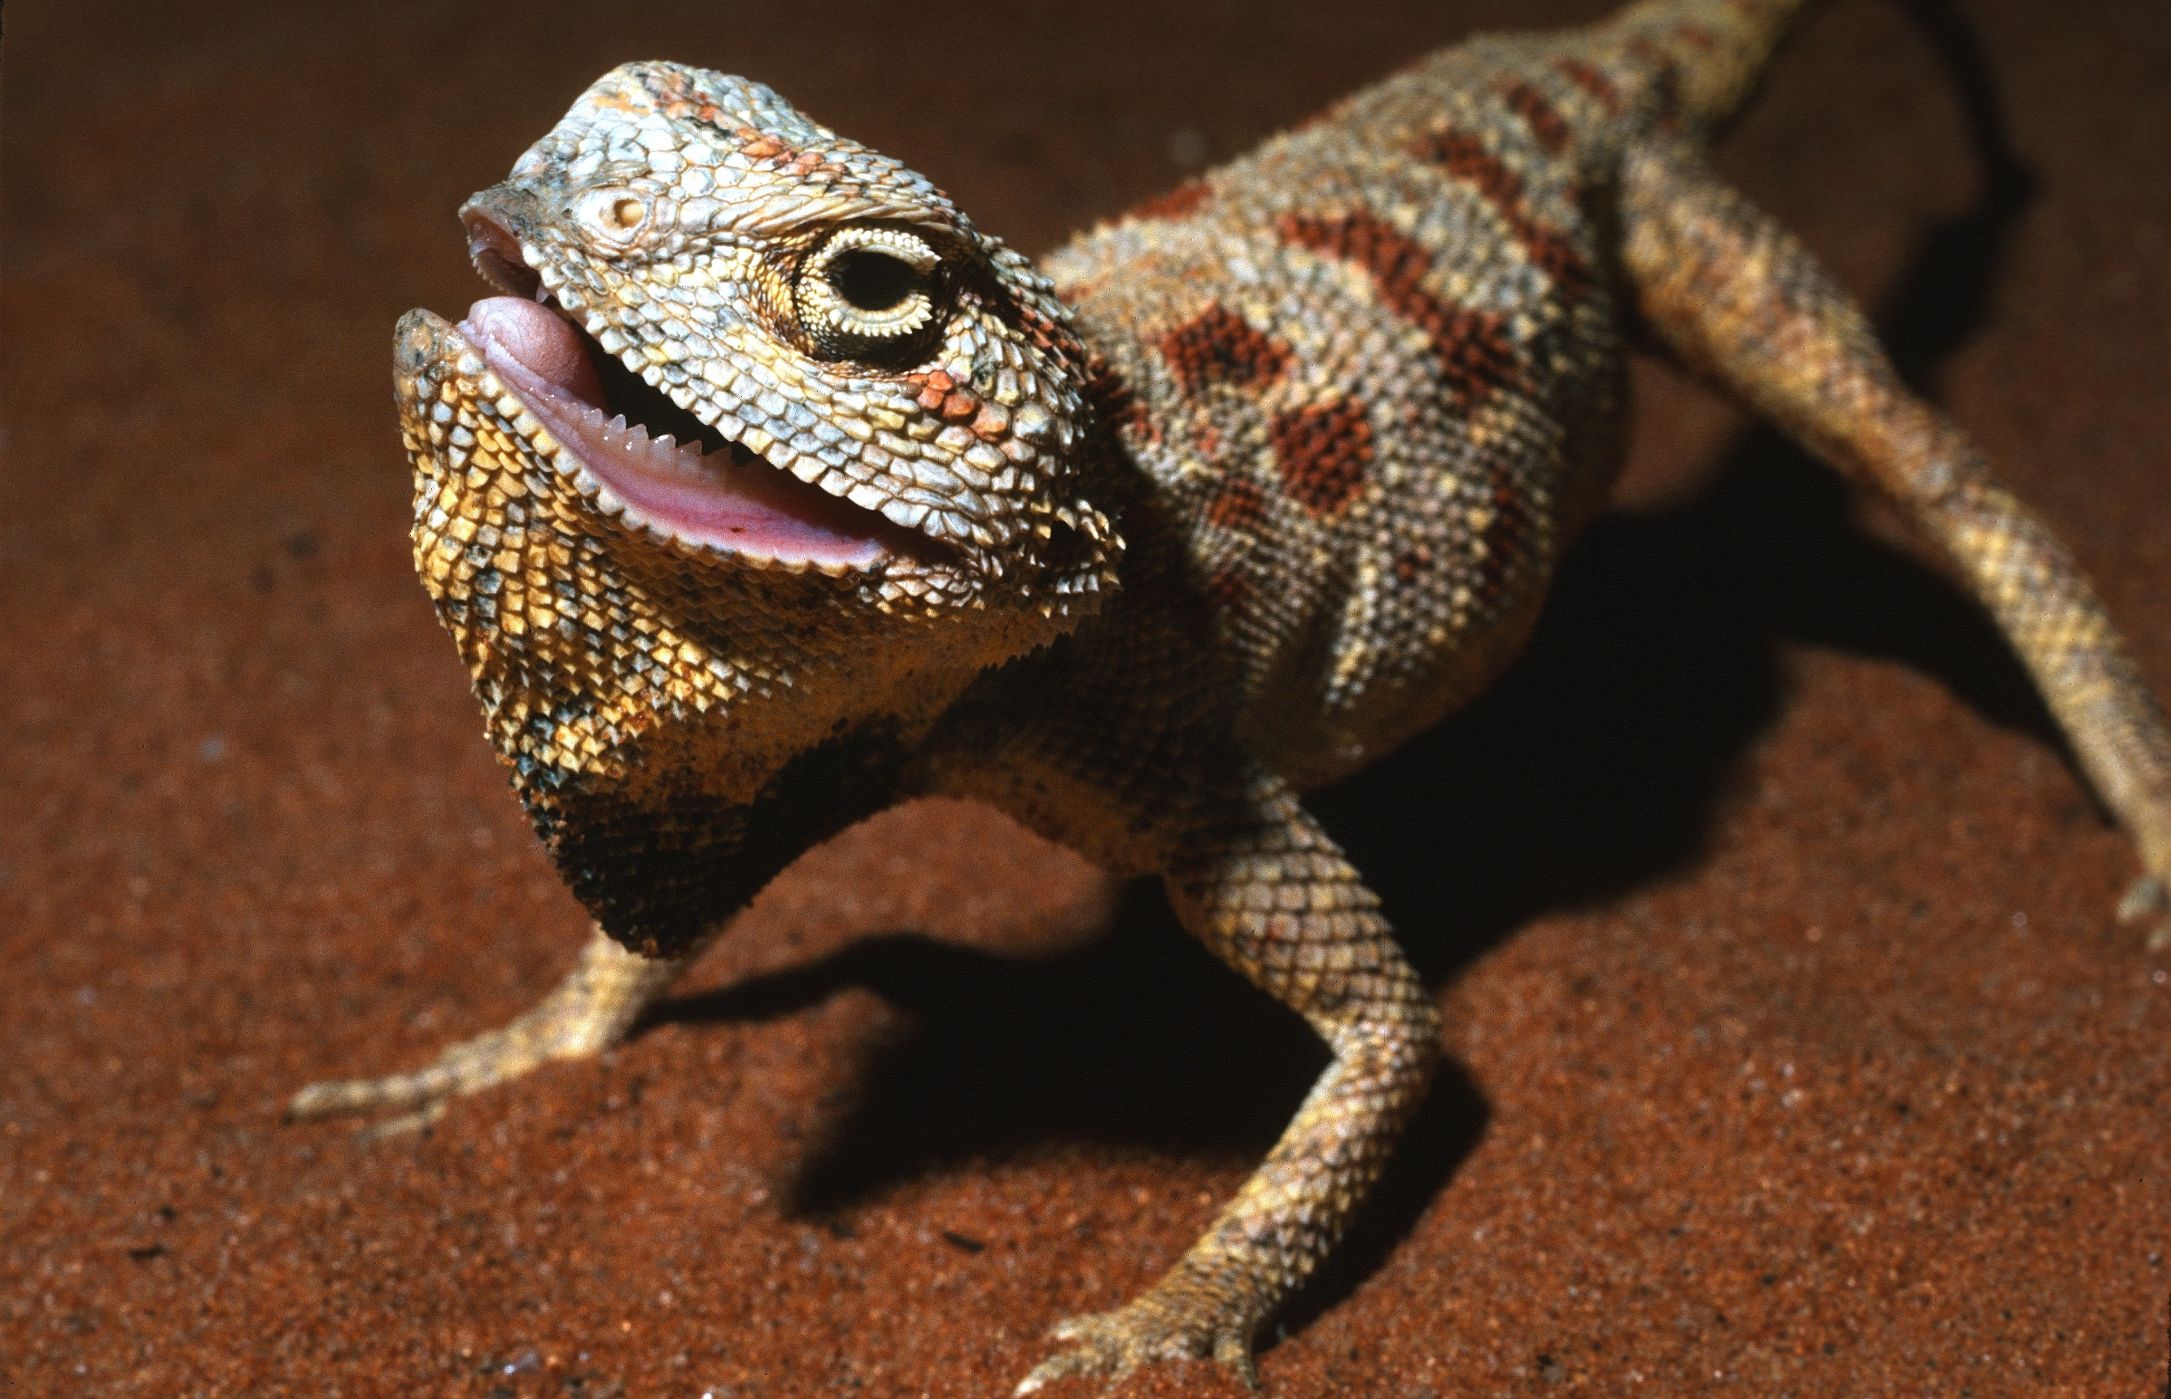
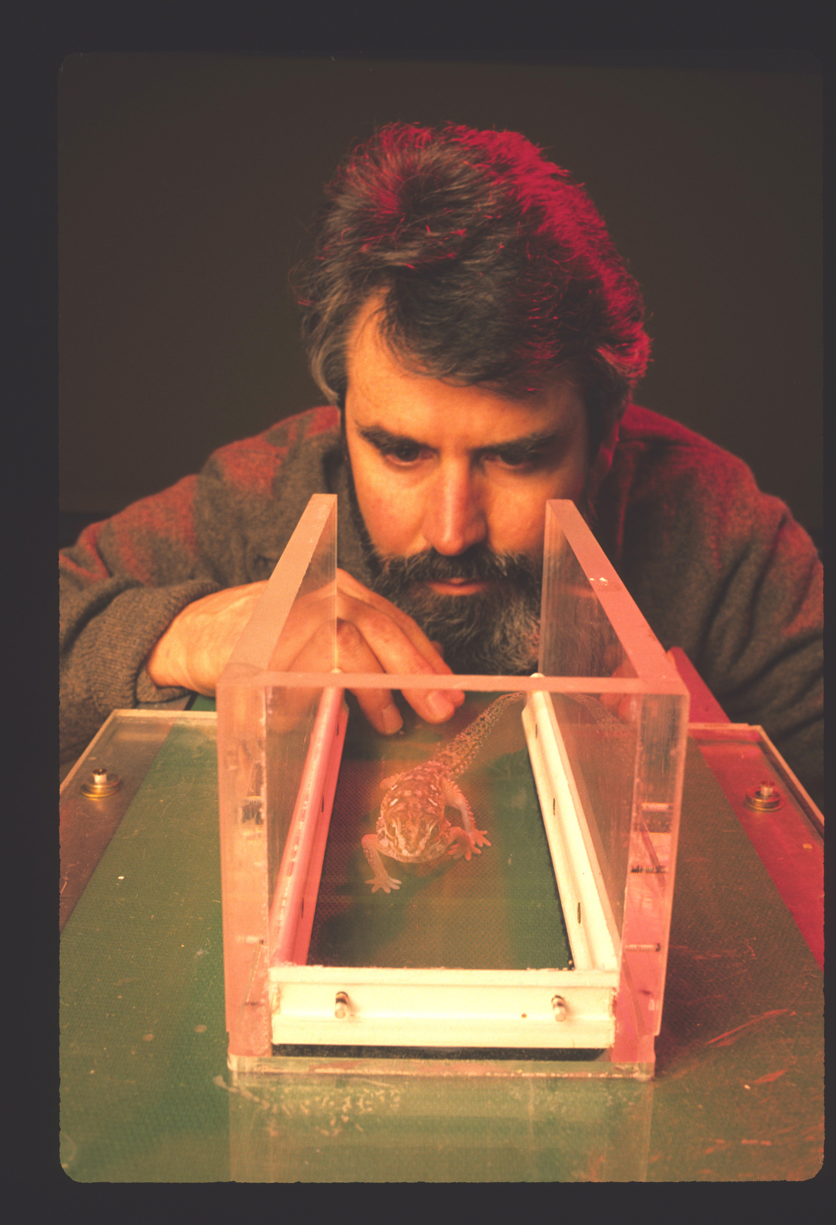
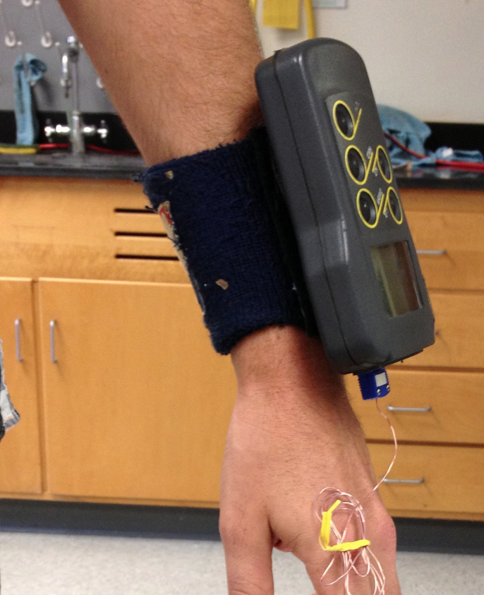
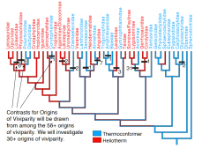
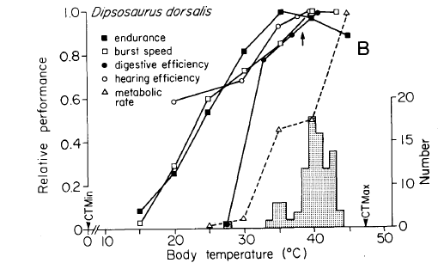
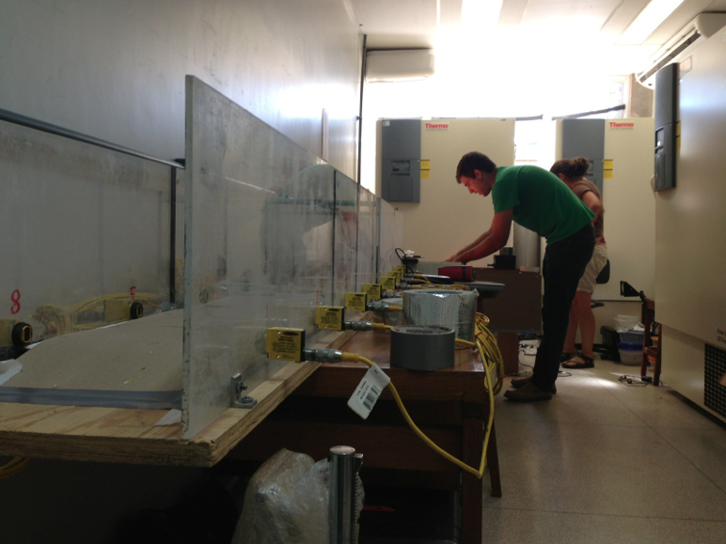
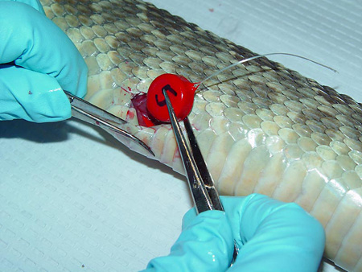
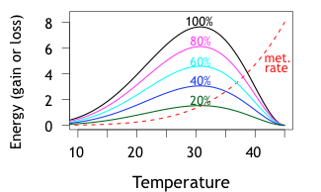
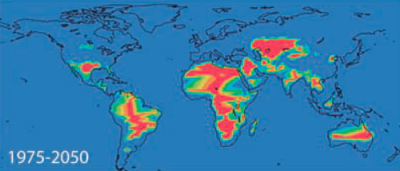
Measuring
Operative
Temperature

Slide 2
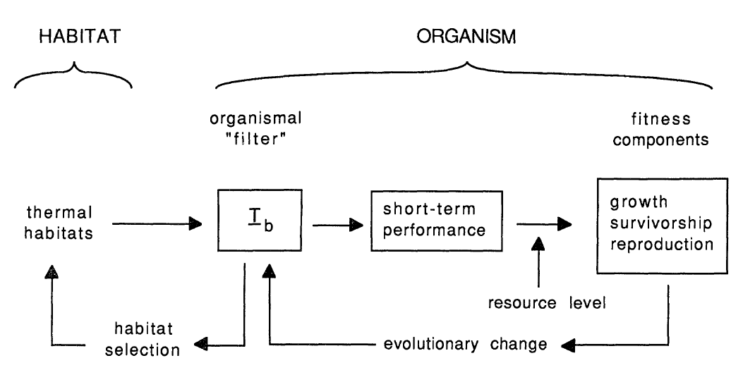
thermoregulation
morphology
thermoregulatory
behavior
T_{b}
Huey, Am Nat 1991

Slide 3
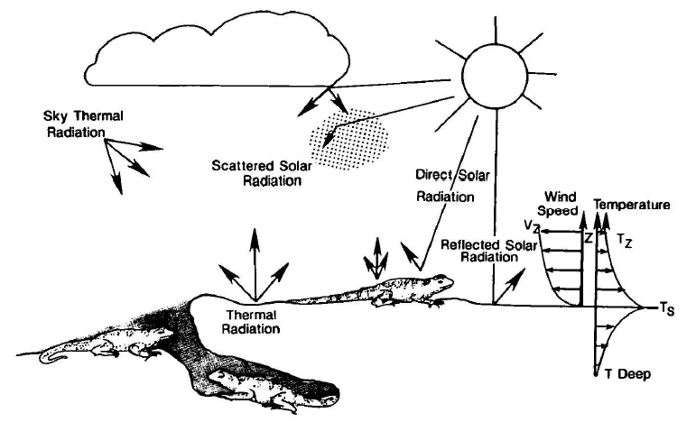
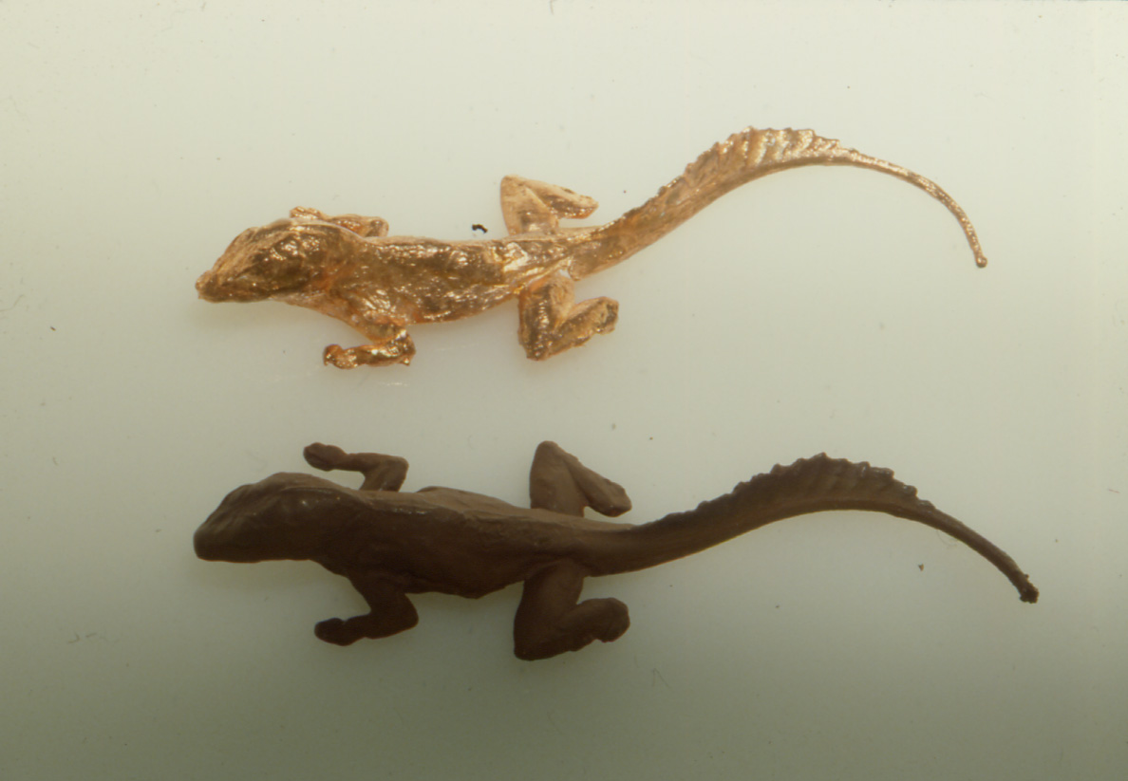
Estimating operative temperatures*, “T_{e}”
T_{e} = T_{a} + ∆T_{R}
B. Grant & W. P. Porter, 1992
courtesy Paul Hertz
* equilibrium T_{b} of a dry-skinned ectotherm at a particular spot

Slide 4
T_{e} max
(surface in sun)
hr_{restriction}
Temperature
T_{preferred}
T_{e} soil
T_{e} min
(surface in shade)
Time of day

Slide 5
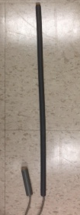
‘Simple’ models can also be made out of PVC
or copper tubing
“Lizard”
“Snake”

Slide 6
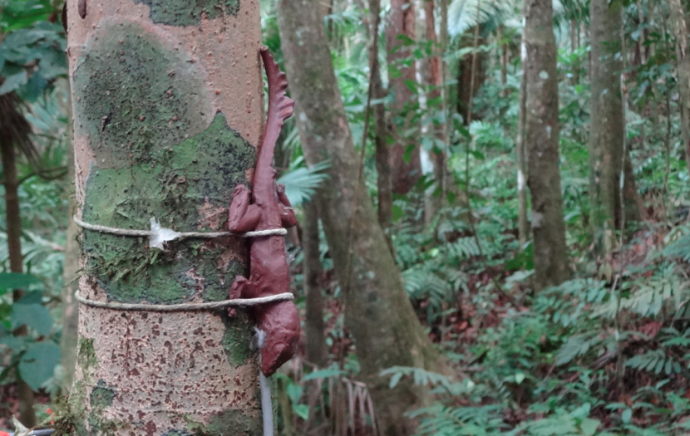
Model of Anolis gundlachi, in El Verde, Puerto Rico

Slide 7
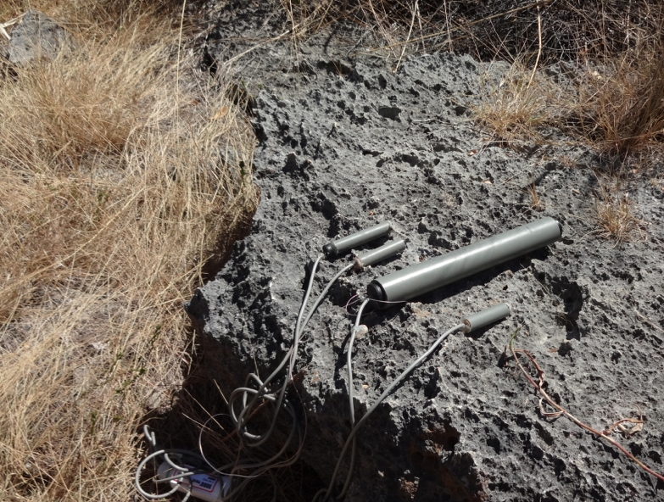
Use size appropriate for species being studied
Anolis
Ameiva

Slide 8
Image from Brian Helmuth

Slide 9
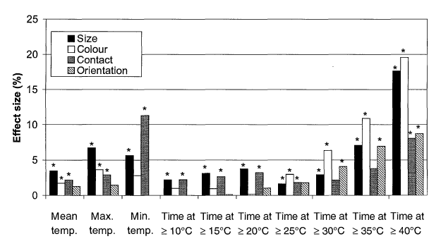
Factors that influence estimates of Te
Size !!!
Color
Contact with substrate
Orientation (to sun)
Shine & Kearney
Funct Ecol 2001

Slide 10
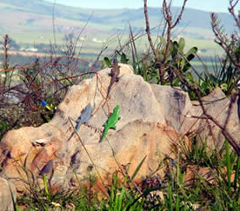
Color influences heat exchange and thus T_{e}
Cordylus & and lizard models
South Africa
http://academic.sun.ac.za/cib/news/20110509_microsite_distributions.htm

Slide 11
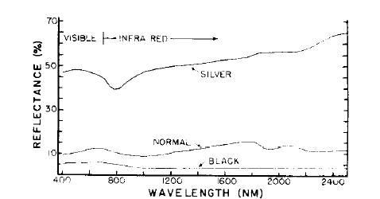
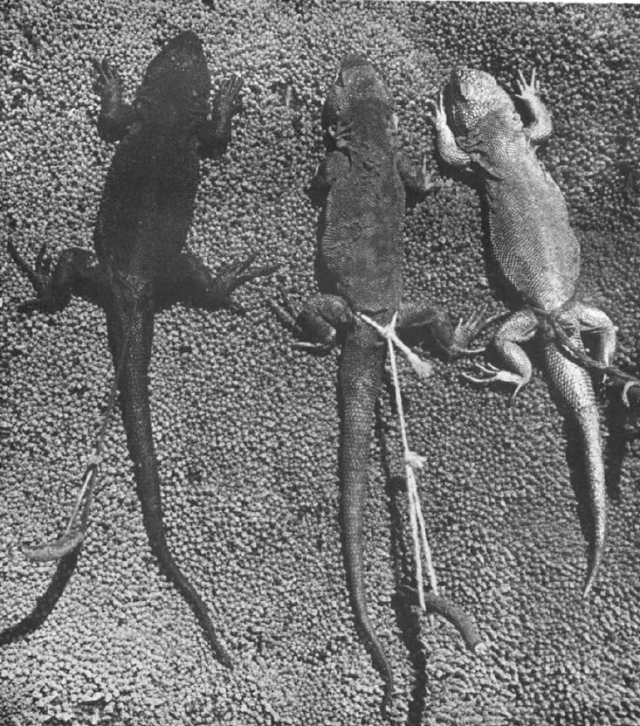
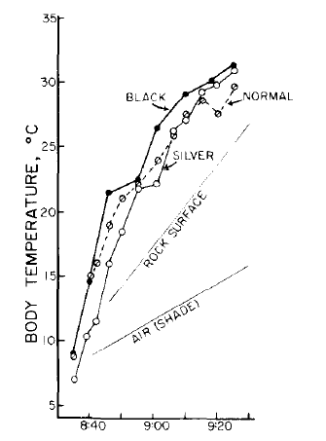
Impact of ‘skin’ color on operative temperature
Liolaemus multiformis
in Peru ,4300 m
flat-black
paint
silver
paint
Pearson, Comp Biochem Physiol 1977

Slide 12
Selecting appropriate paint color
Goal: reflectivity of paint = that of organism
Finding the reflectivity of various types of paints
Peterson et al., 1993 Table 7.1
(in Siegel & Collins, eds., Snakes: Ecology and Behavior)
Examples of reflectivity of various lizards & snakes
Porter 1967
Peterson et al. 193
Christian et al. 1996a

Slide 13
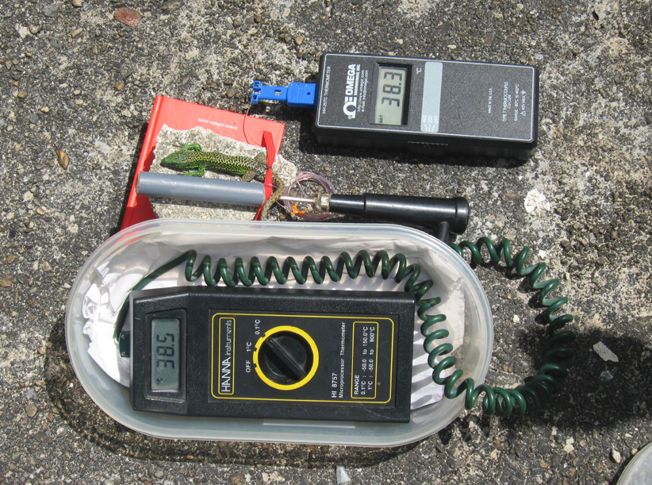
Calibrate the temperature of the model
versus that of live lizard (in nature)
Iberolacerta monticola
B. Sinervo

Slide 14
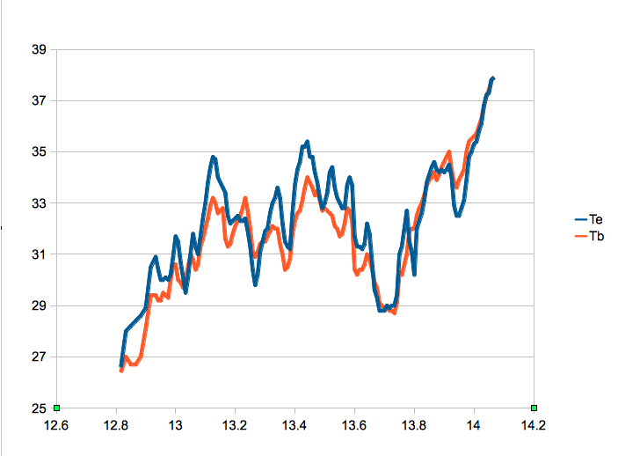
Sample results – calibration experiment
Iberolacerta monticola
B. Sinervo

Slide 15
SLIDE OF TORTOISE MODEL

Slide 16
T_{e} in warmest and in coolest microenviroments
delimit the range of possible T_{b}
also help predict when animal will be active
T_{e} max
(surface in sun)
Temperature
T_{preferred}
T_{e} soil
T_{e} min
(surface in shade)
hr_{restriction}
Time of day

Slide 17
Other Important Issues
How many models ?
Where should they be placed?
How often to record Te ?
courtesy Paul Hertz

Slide 18
Where should they be placed?
Depends on the goal of the study
In all microhabitats, if want a habitat ‘map’
In all microhabitats used by the organism,
if want organism-specific map
In most extreme microhabitats, if want to bracket
max & min T_{e}

Slide 19
How many models should be deployed?
Depends on the goal of the study
at least 2 models, if want to bracket max & min T_{e}
more if one wants to map the habitat
depends on the thermal complexity of habitat
Notes:
But how many? Depends on habitat

Slide 20
If want to predict predict when animal will be active put models in warmest and coolest spots
T_{e} max
(surface in sun)
Temperature
T_{preferred}
T_{e} soil
T_{e} min
(surface in shade)
hr_{restriction}
Time of day
Notes:
But if want a detailed thermal “map” of the habitat, need more models, as in the next slide

Slide 21
Randomly deploy models into habitat

Slide 22
Warming temperatures will restrict activity times, energy gain, and reproductive output
T_{e} max
(surface in sun)
Temperature
T_{preferred}
T_{e} soil
T_{e} min
(surface in shade)
hr_{restriction}
Time of day

Slide 23
East
West
South

Slide 24
Tortoise models
East
West
South

Slide 25
15
10
5

Slide 26
Randomly deploy models into habitat

Slide 27
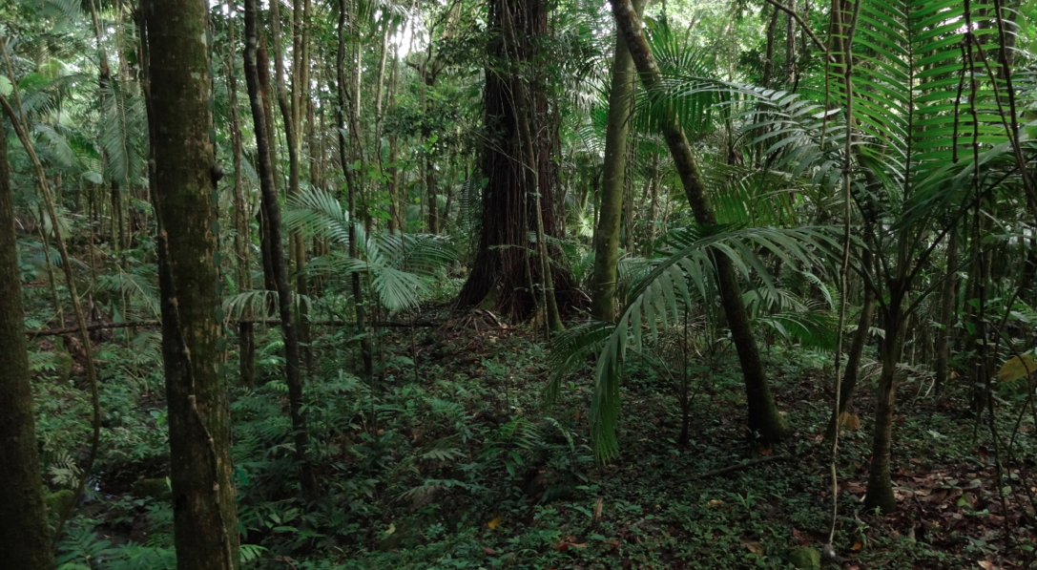
Deeply shaded forest – T_{e} variation is very small
27.9
25.2
25.9
25.3

Slide 28
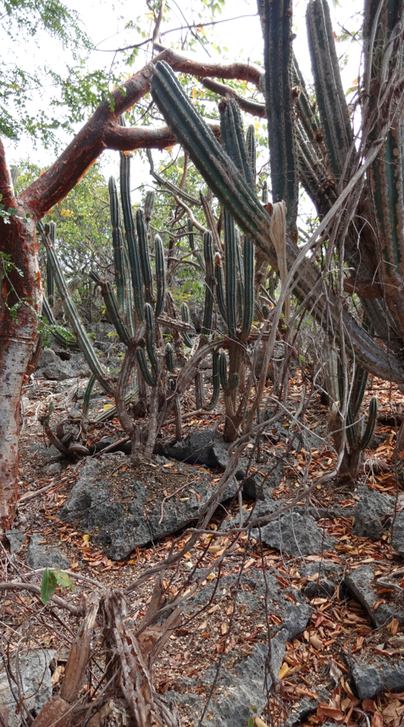
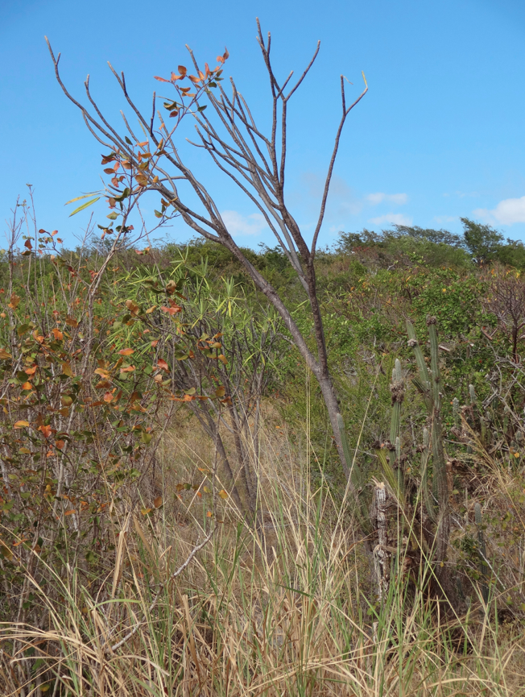
Open habitat – T_{e} variation is large

Slide 29
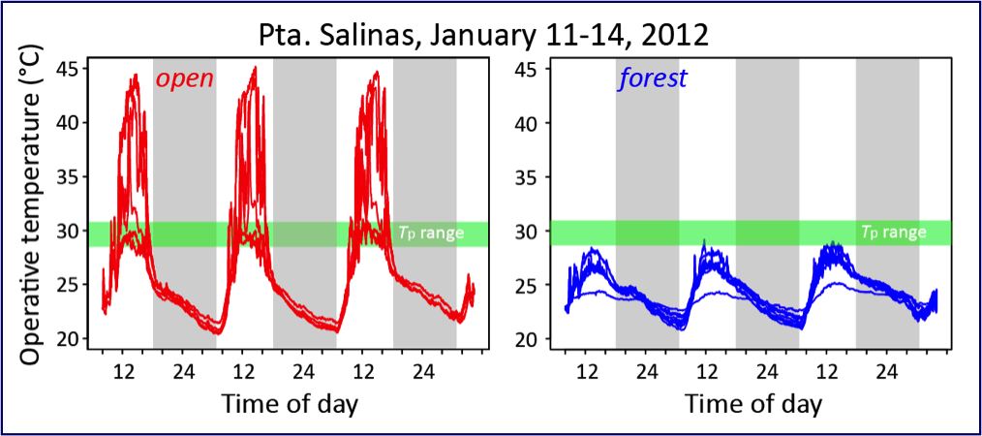

Slide 30
But how many models do you need ? (here 50)
“Pero soy flaco, y cincuinta es
demasiado trabajo. por qué no utilizar
sólo el diez?”

Slide 31
But how many models do you need ? (here 50)
compute “true” mean & SD of T_{e}

Slide 32
But how many models do you need ? (here 50)
compute “true” mean & SD of T_{e}
subsample with various N compare subsample mean & SD

Slide 33
How to estimate the number of models
Use sensitivity analysis
Find data set for similar habitat, with lots of models
subsample randomly from the full data,
compute mean & SD Te and compare with
“true” mean and SD for the full data
repeat 1000
repeat for various sizes (N) of subsamples

Slide 34
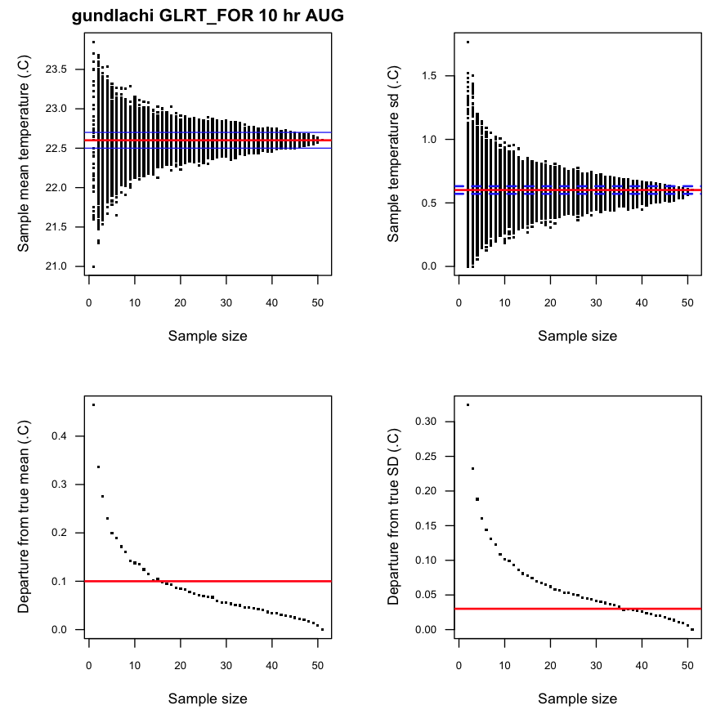
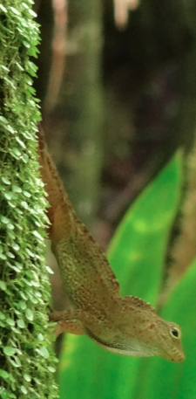
Data for Anolis gundlachi, a thermoconformer
in montane forest in Puerto Rico
data courtesy of Paul E. Hertz

Slide 35
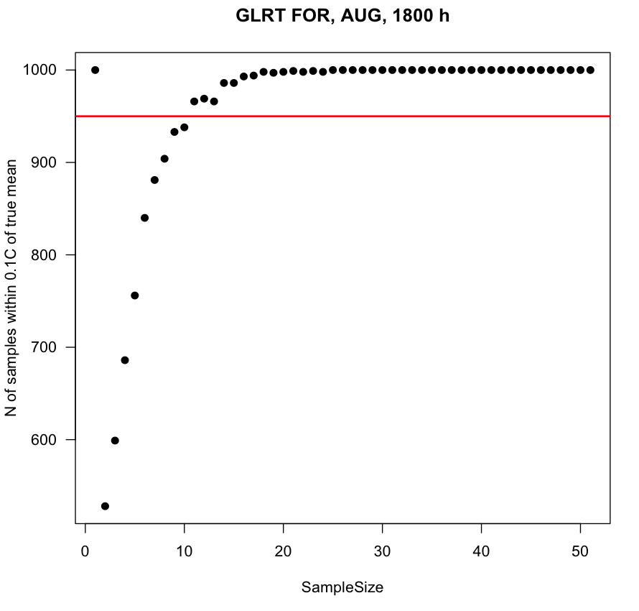
Number of samples (out of 1000) that had a mean T_{e}
within 0.1°C of true mean
Notes:
So in a shaded forest, a few models should suffice

Slide 36
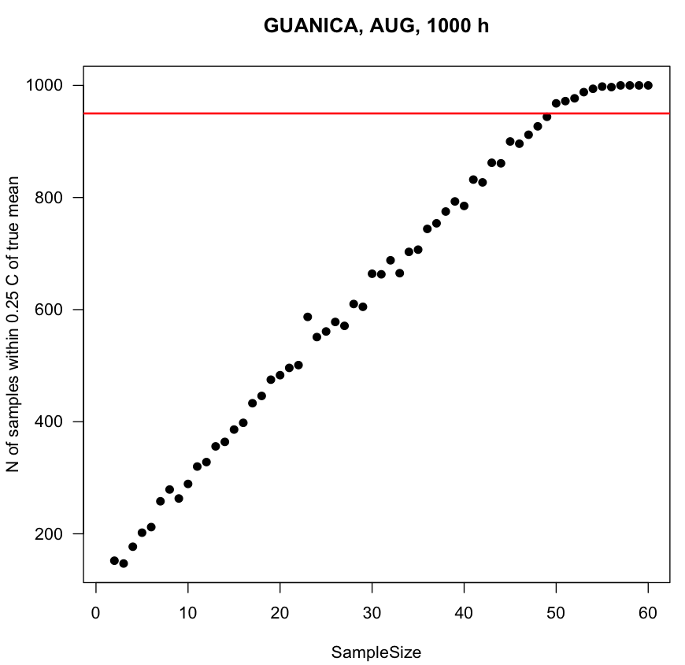
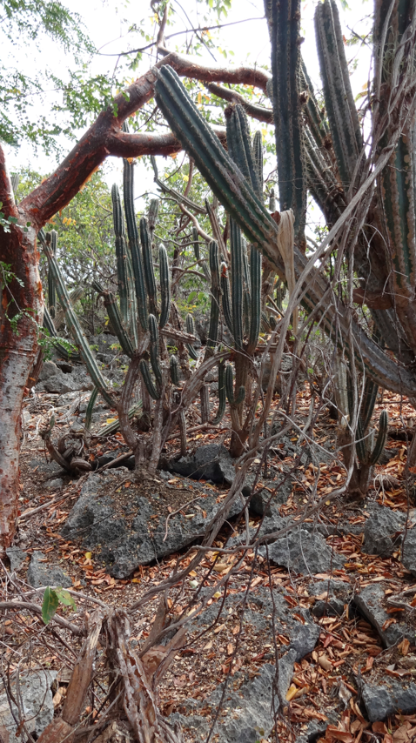
But in Guánica, a complex thermal habitat,
many more models needed to approximate true mean Te
Notes:
So in a shaded forest, a few models should suffice

Slide 37
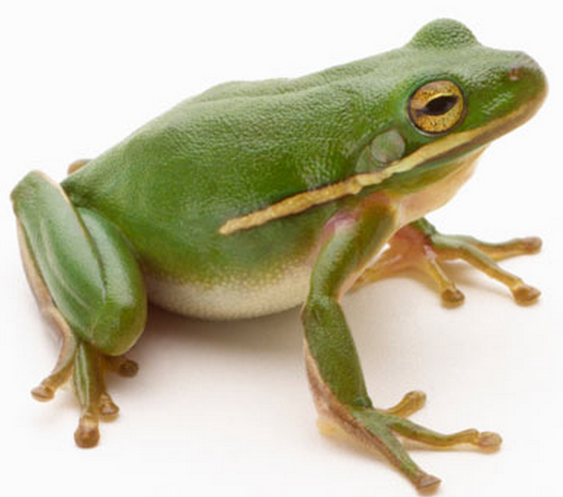
Estimating operative temperatures
wet-skinned amphibians
T_{e} = T_{a} + ∆T_{R} - ∆T_{evap}
Therefore, T_{e} frog < T_{e} lizard

Slide 38
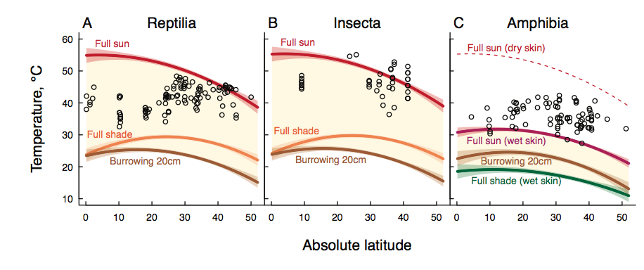
Effect of evaporation on T_{e} can be huge
CT_{max}
T_{e} at noon in summer versus latitude
Sunday et al., submitted

Slide 39
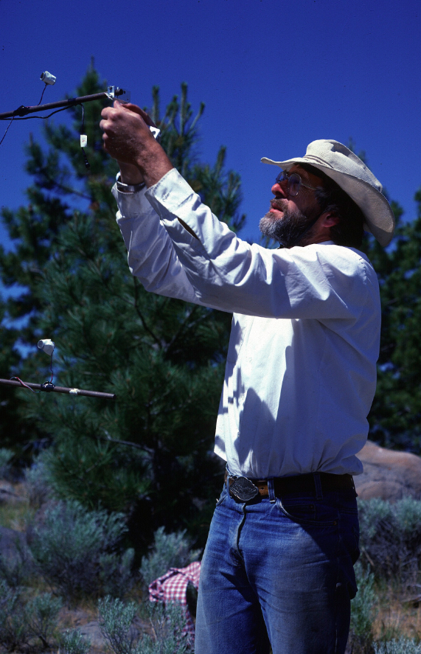
Animal data:
size
shape
color
posture
Microclimate data:
solar and IR radiation
air temperature
wind speed
humidity
[or use global climate data]
Can also calculate T_{e}
via biophysical models
Warren Porter 1984
Eagle Lake, California

Slide 40
Physical models:
detailed ‘map’ of thermal heterogeneity in habitat
very accurate, but site specific
Biophysical (mathematical) models:
can predict T_{e} anywhere, anytime
thus can do “what if” simulations
(“what if air temperature increases 3°C?”)

Slide 41
To estimate hourly T_{e} (max, min)
“Niche Mapper” software
Michael Kearney & Warren Porter
Global data set (10’ spatial grid)
monthly mean temperatures of daily maximum & minimum temperatures
relative humidities
daily average wind speed
Simulate ectotherm properties
size, shape, solar absorptivity; dry skin (lizard, insect) or wet skin (amphibian)
in full sun, full shade, or mixed; height above ground
Site data
longitude, latitude, elevation
B. Sinervo
Kearney, Shine, Porter
PNAS 2009
B. Sinervo
Notes:
http://www.cru.uea.ac.uk/cru/data
Data 1961-1990 other data sets available at above URL

Slide 42
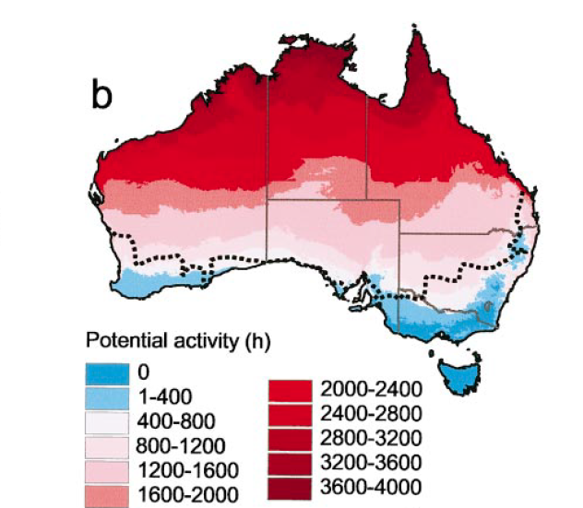
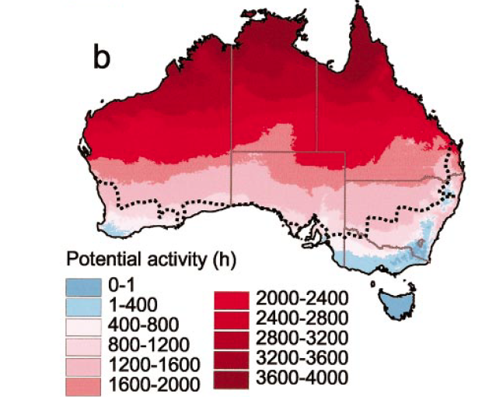
Predicted potential activity time (in hours)
of a nocturnal gecko in Australia
current day after climate warming
Kearney and Porter, Ecology 2004

Slide 43
thermoregulation
morphology
thermoregulatory
behavior
T_{b}
Huey, Am Nat 1991

