Slide 1
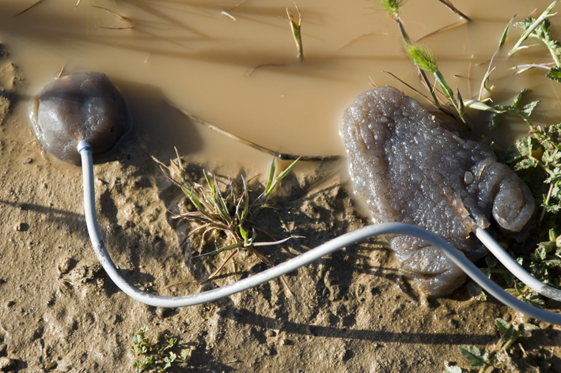
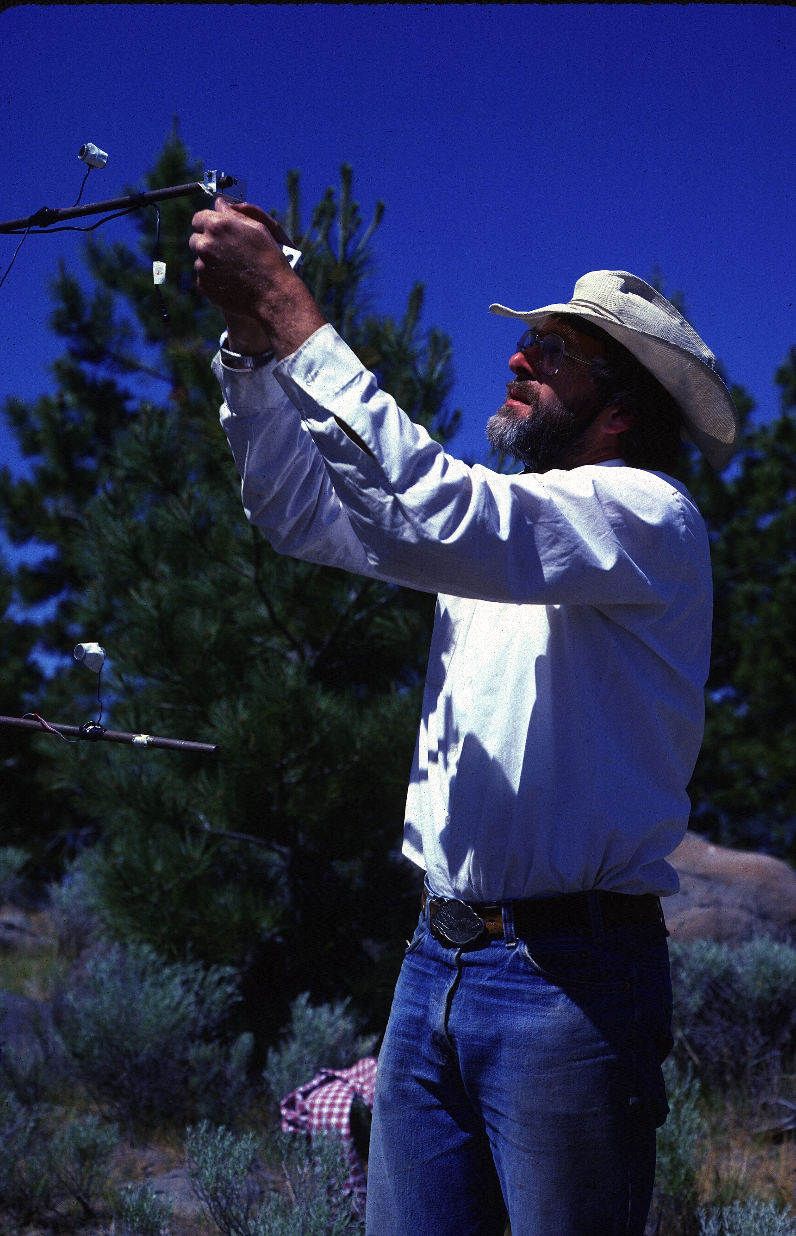

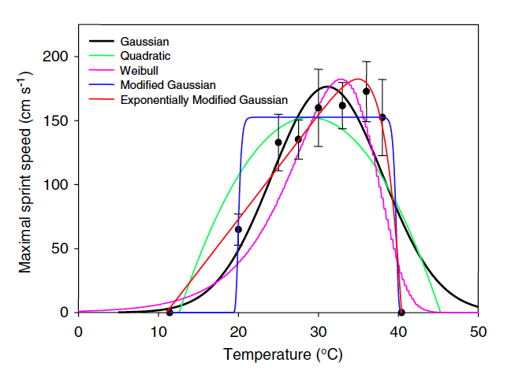
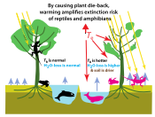
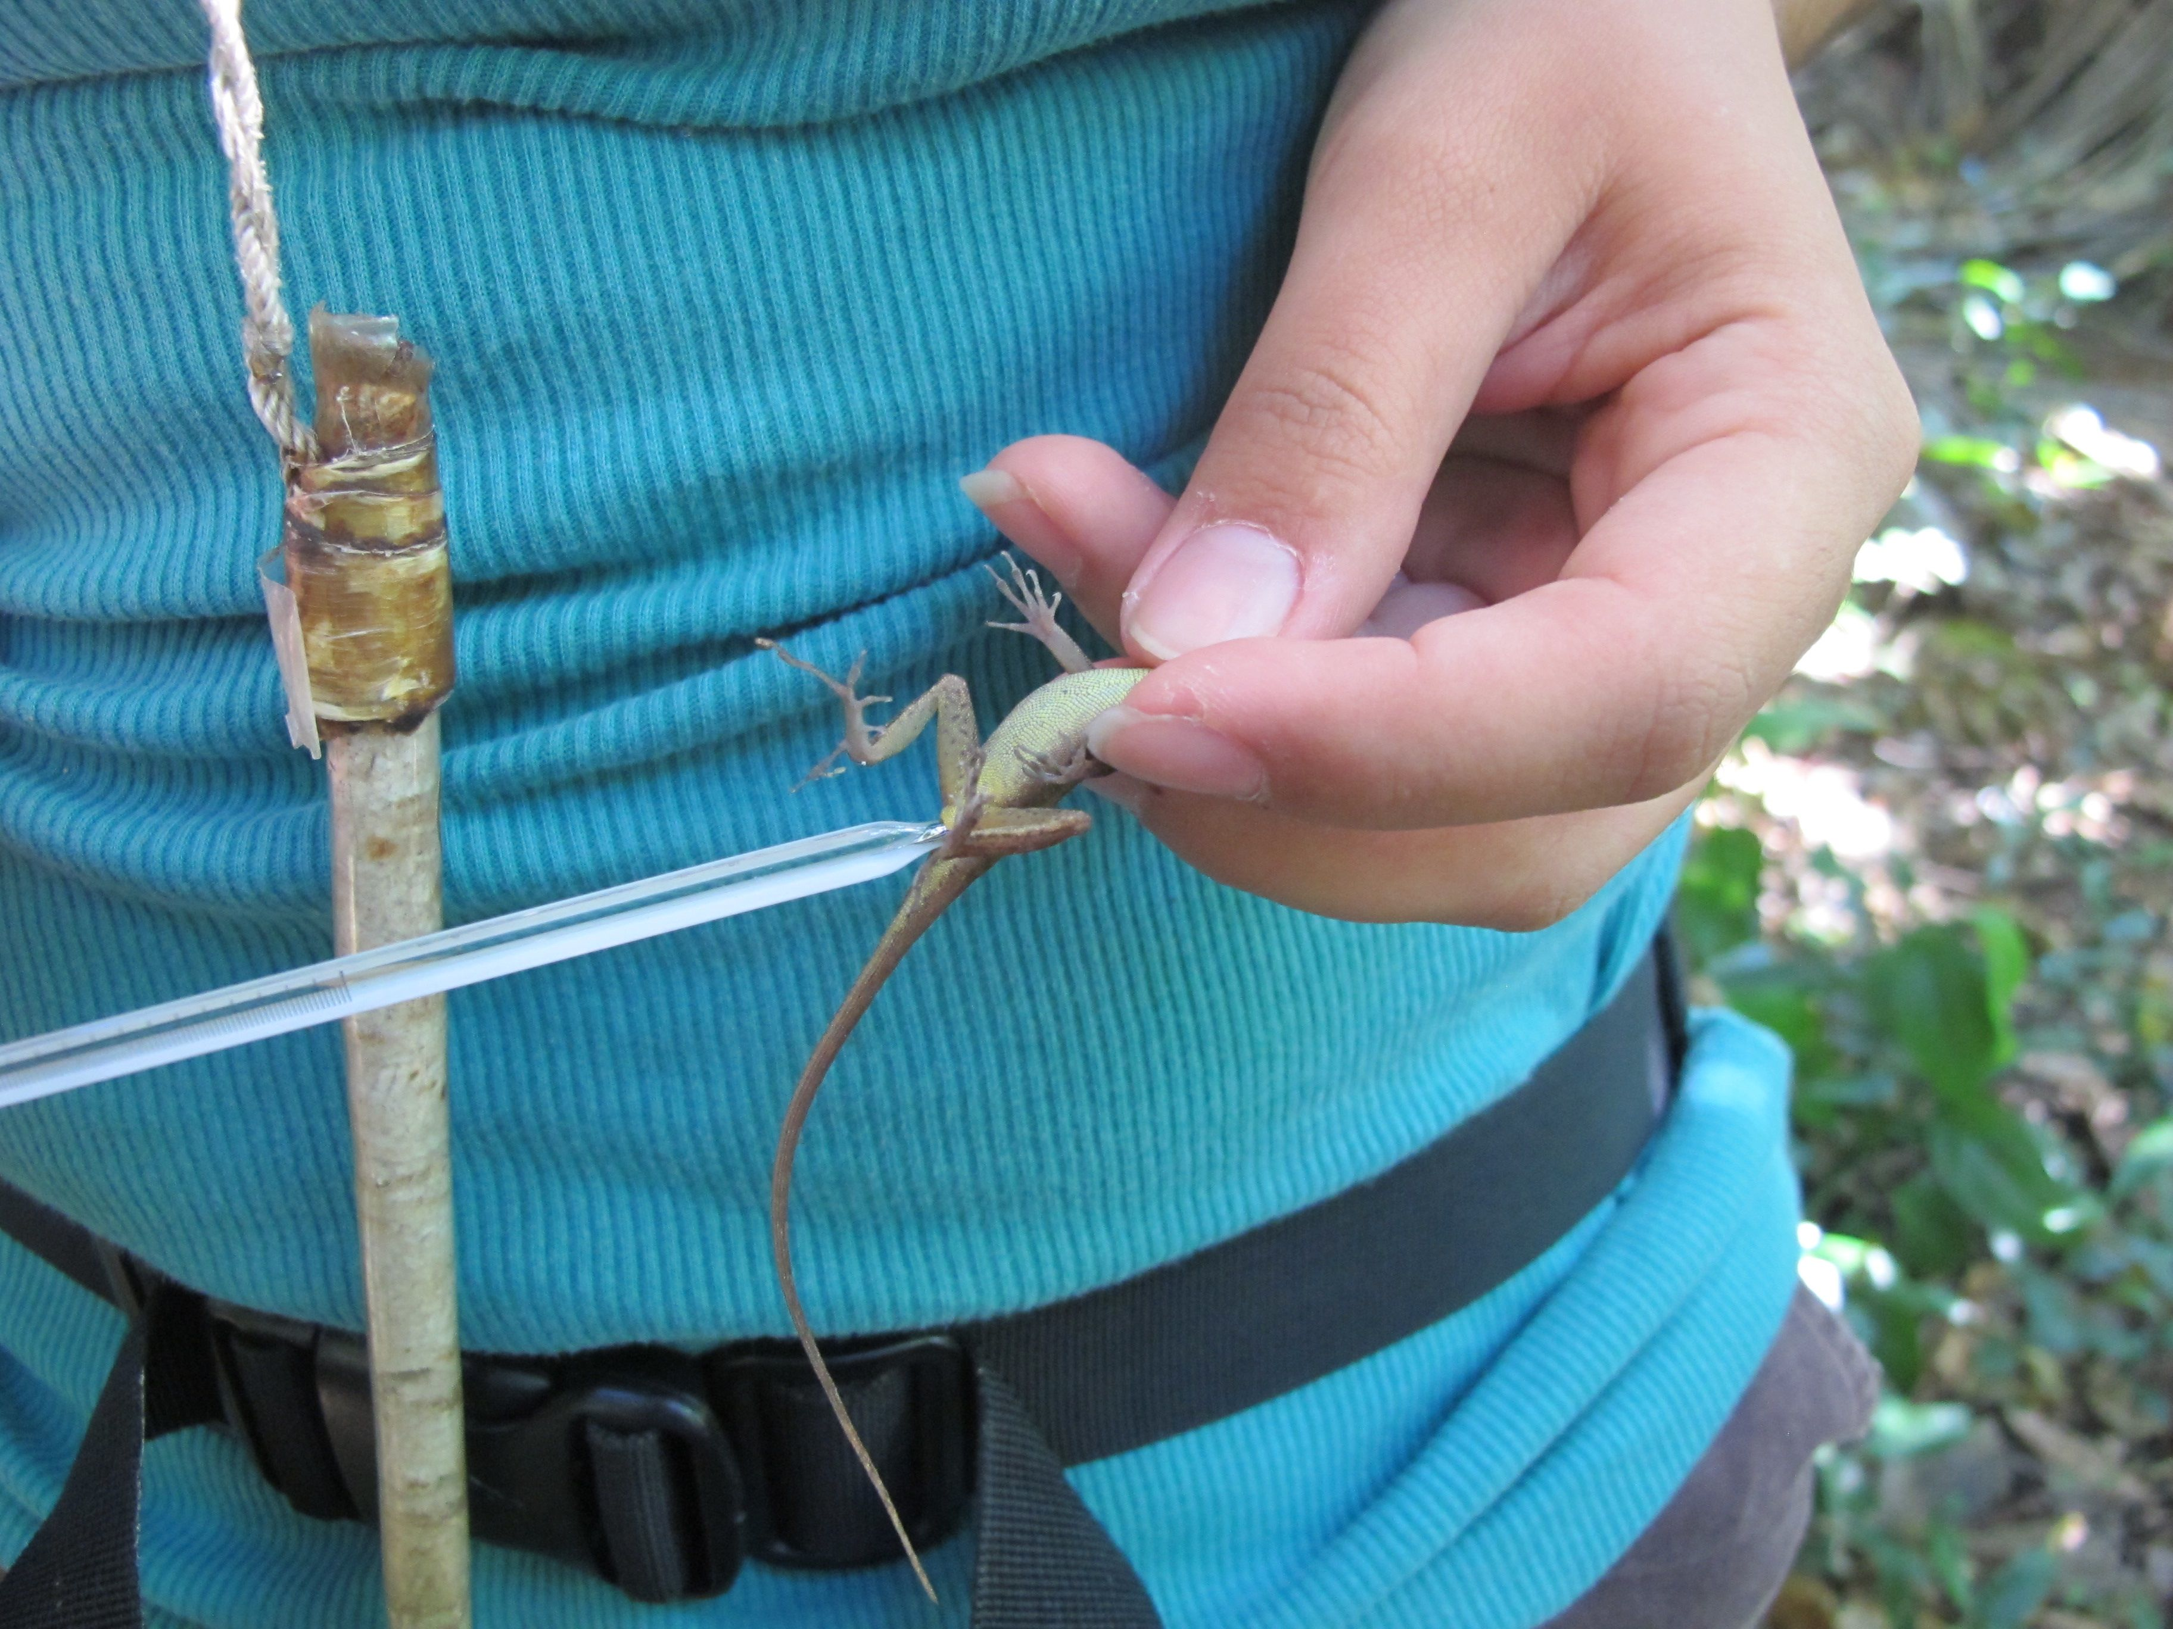
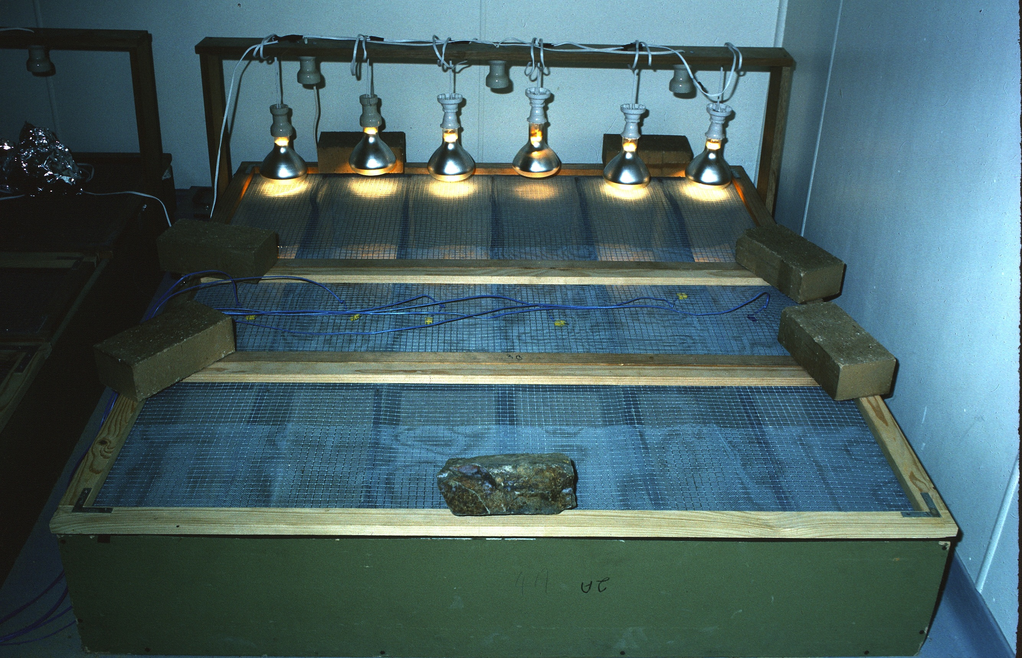
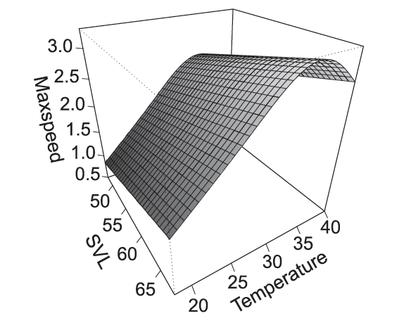
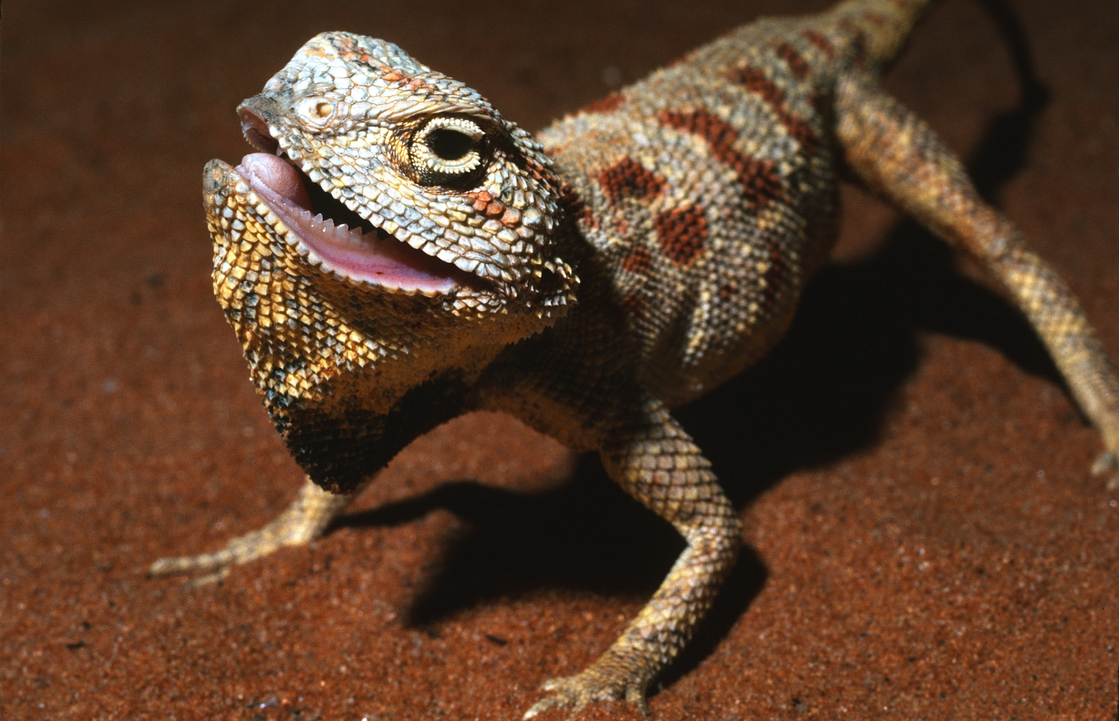
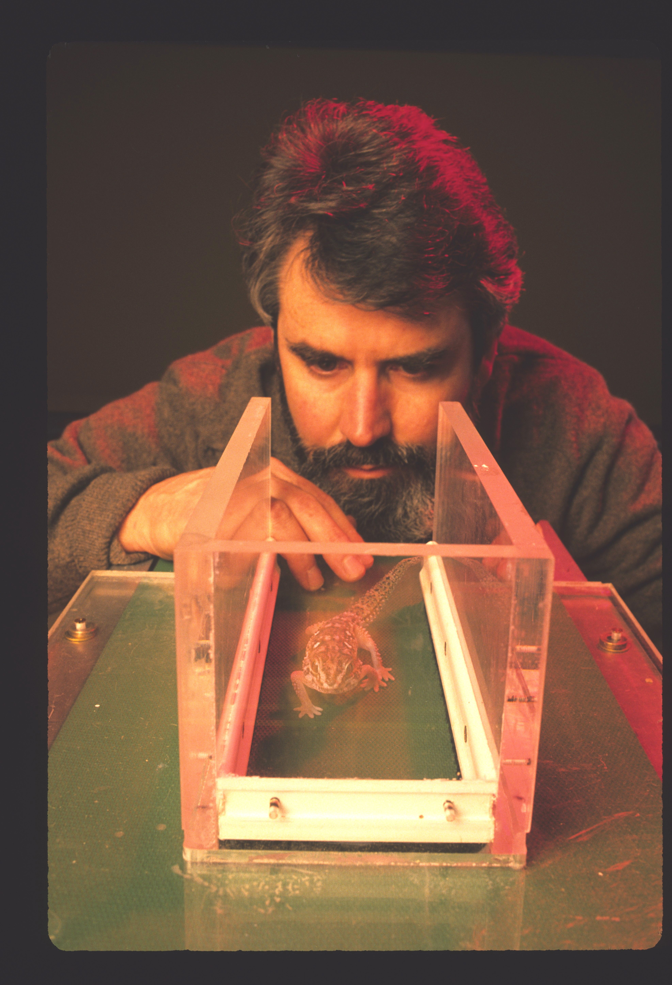
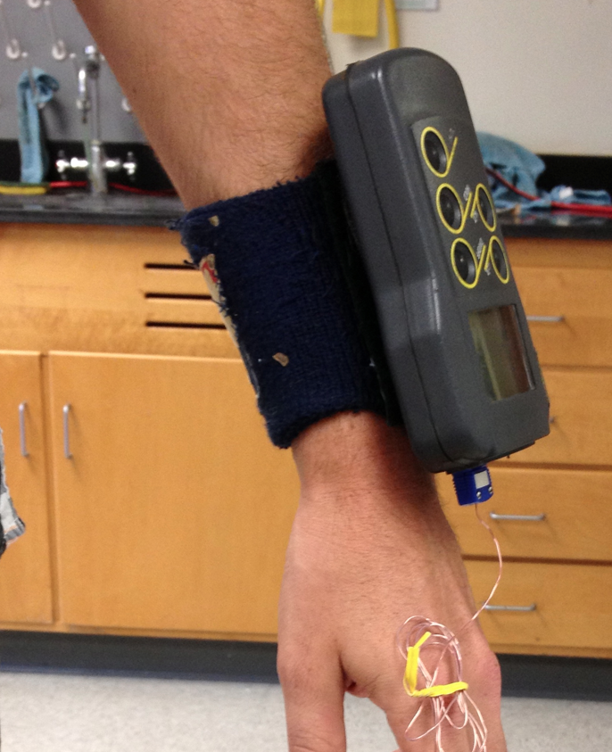
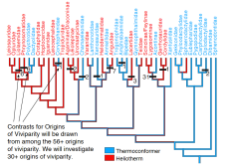
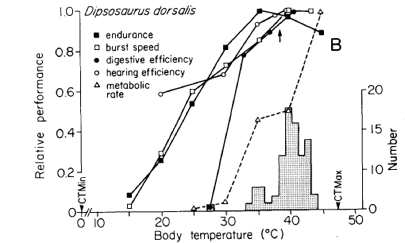
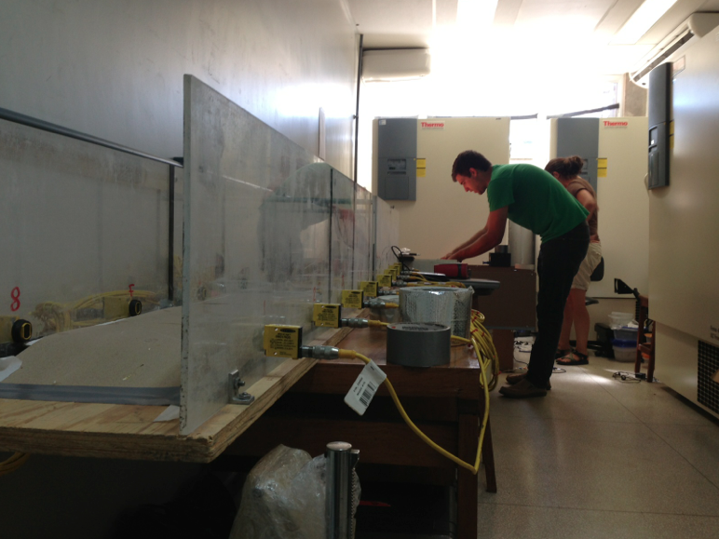
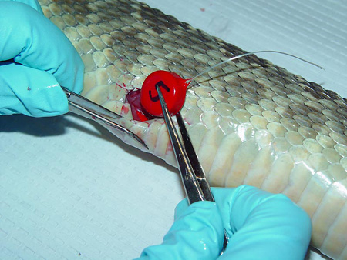
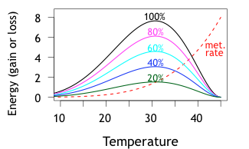
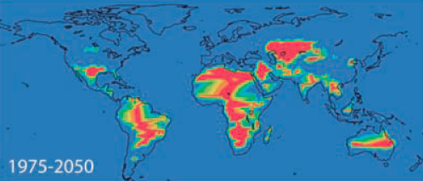
An Introduction to
Physiological Ecology

Slide 2
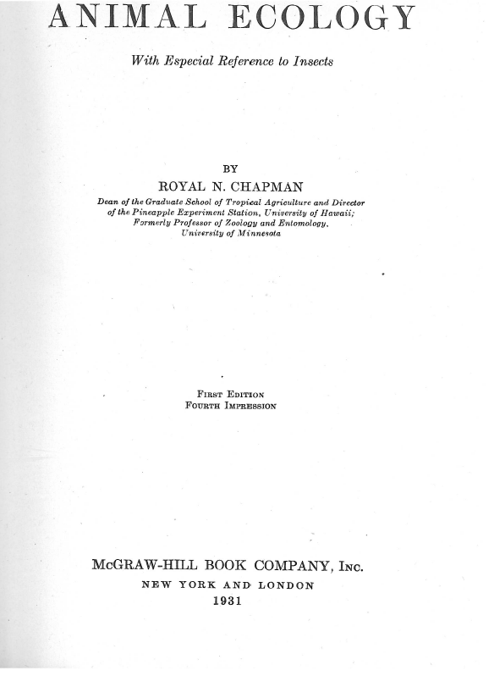

Slide 3
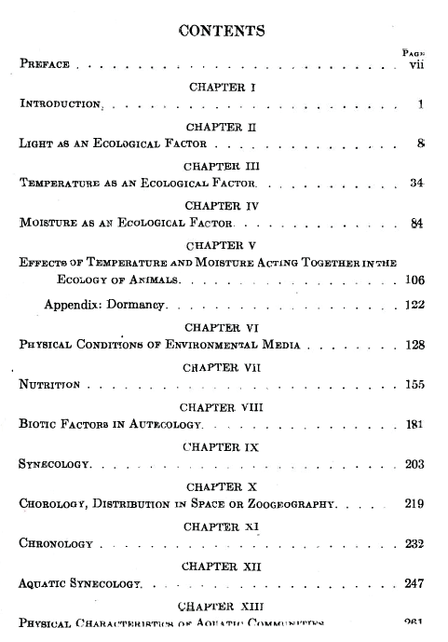
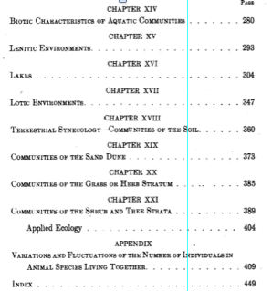

Slide 4
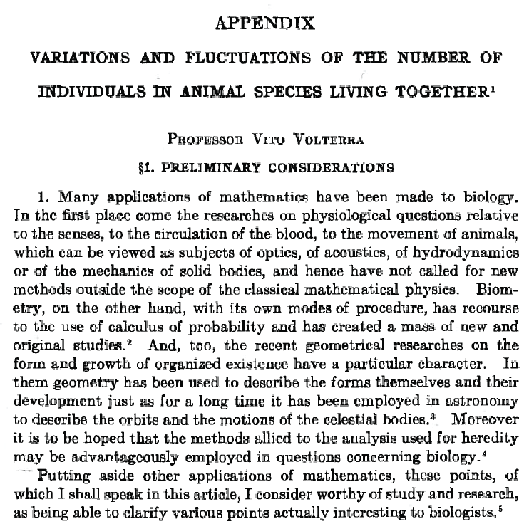

Slide 5
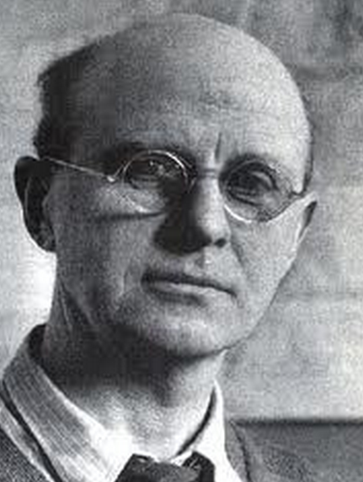

“Animals usually have appropriate
psychological reactions by which they find
a suitable habitat, so that…the ecologist
does not need to concern himself
very much with the physiological limits
which animals can endure.”
Charles Elton
Animal Ecology, 1927 P. 33
Los animales suelen tener reacciones apropiadas psicológica por las que se encuentran un hábitat adecuado, de modo que ... la ecologista no tiene por qué preocuparse mucho los límites fisiológicos? qué animales pueden soportar

Slide 6
N citations to “critical thermal maximum”
5-year intervals
Huey, Otero, Kearney, Porter., in prep.

Slide 7
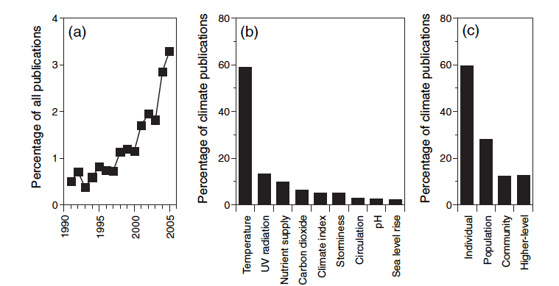
Papers on marine climate change
as a percentage of all marine ecological literature
Harley et al., Ecol Lett 2006
Notes:
However, climate change work (much physiological) is rapidly increasing in importance

Slide 8
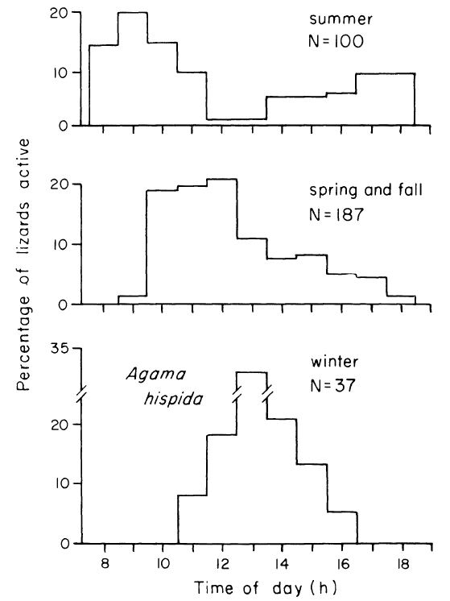
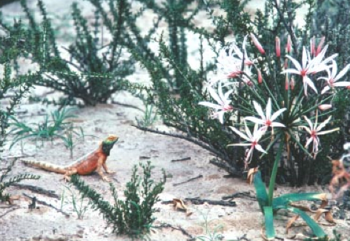
Seasonal changes
in time of activity
Agama aculeata
Huey et al., ‘79 Ecology
Notes:
But note that not acrive

Slide 9
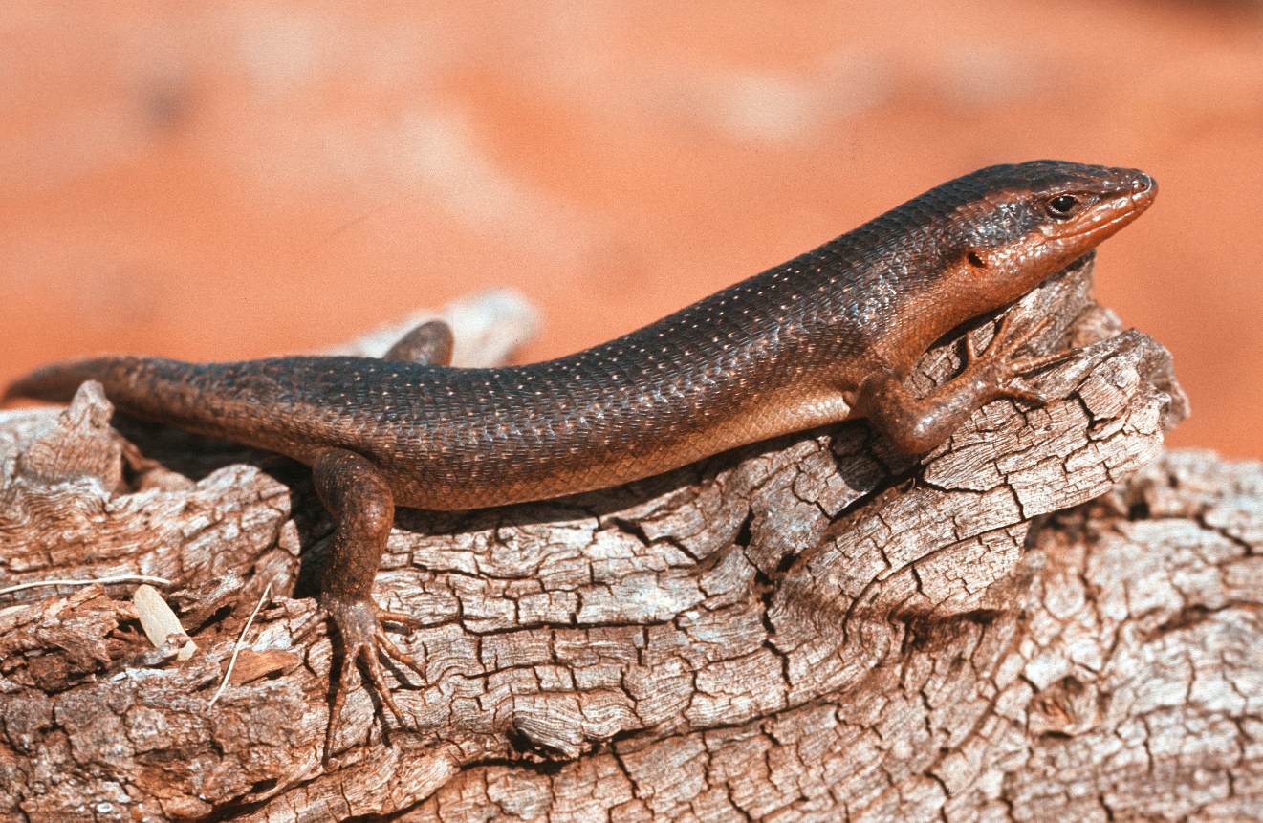
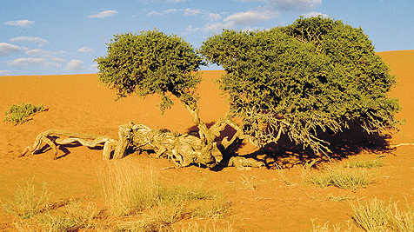
Seasonal Changes in
percentage of lizards up in trees
OR
on ground/logs
summer versus winter
Trachylepis sparsa
75%
38%
25%
62%
Huey et al., ‘79 Ecology

Slide 10
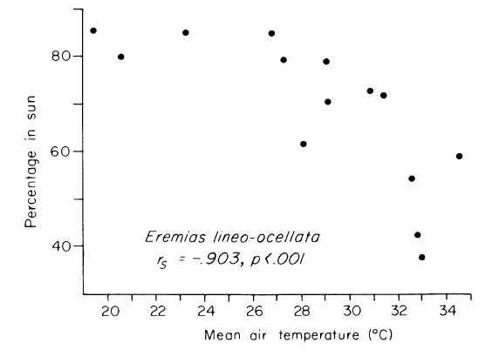
Probability that a lizard is in sun versus air temperature
Pedioplanus lineoocellata
Huey et al., ‘79 Ecology

Slide 11
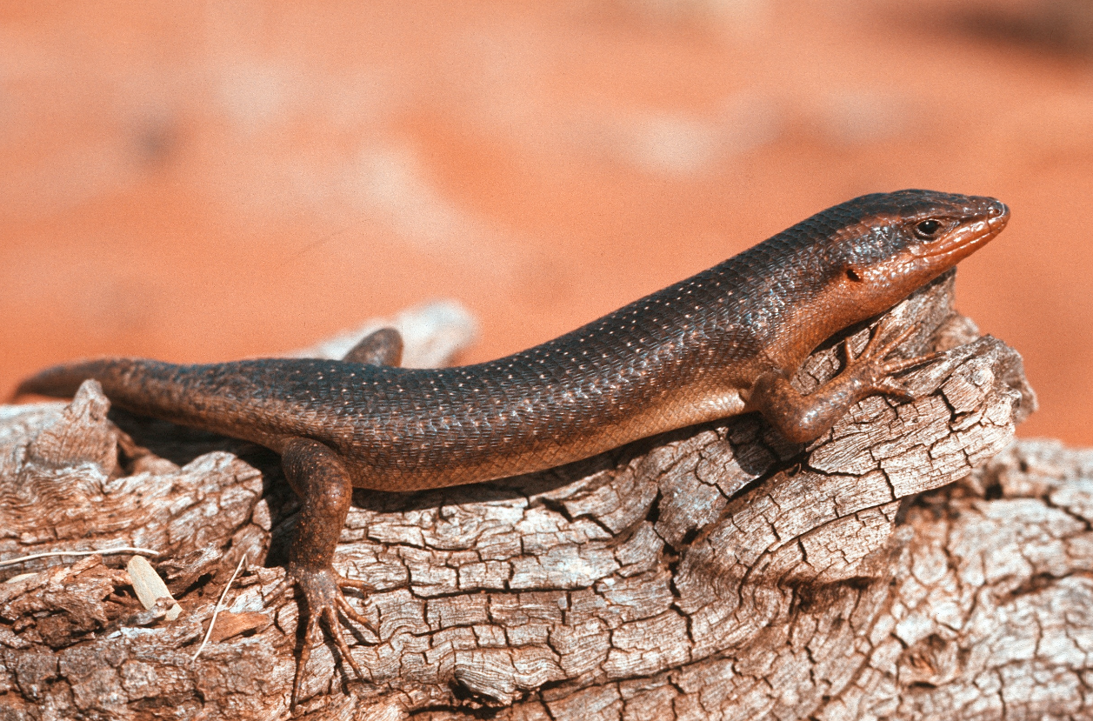

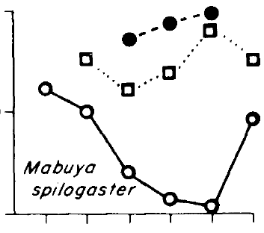
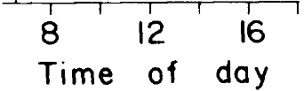
winter
spring +
fall
% in sun
summer

Slide 12
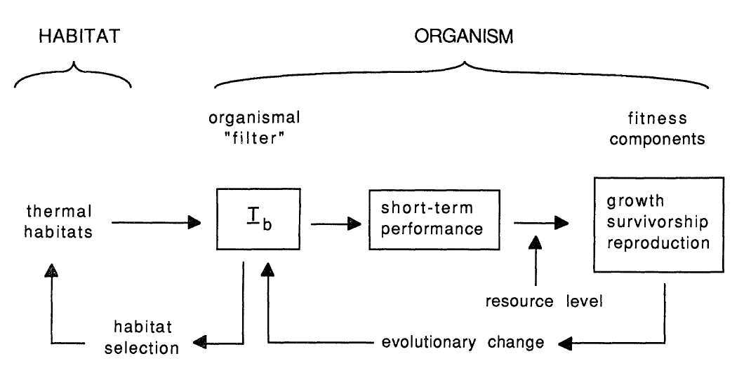
thermoregulation
morphology - size
thermoregulatory
behavior
T_{b}
Huey, Am Nat 1991

Slide 13
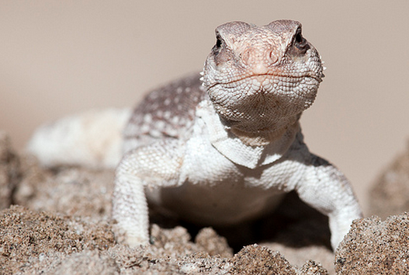
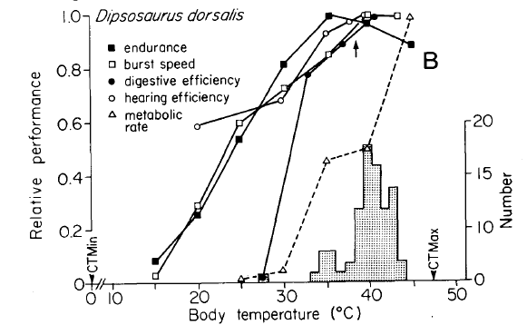
T_{p}
T_{b}
Huey, in Biology of the Reptilia 1982

Slide 14
thermoregulation
morphology
thermoregulatory
behavior
T_{b}
Huey, Am Nat 1991

Slide 15
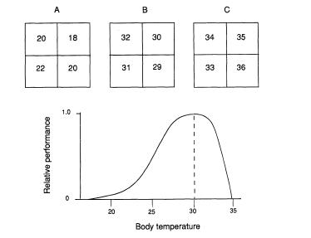
Which habitat maximizes performance?
T_{e} in patch
T_{opt}
Huey, Am Nat 1991

Slide 16
Biological Levels of Integration:
Whole organism -- sprint speed
Tissues – speed/force of muscle contraction
Cells – twitch type (fast, slow)
Molecules – activity of myosin ATPase,
myosin isoforms
Which is most appropriate?

Slide 17
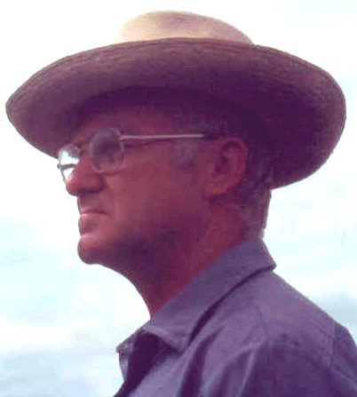
organism
tissues
cells
molecules
“...there are a number of levels of biological integration…
each level finds its explanations of mechanism in the levels below,
and its significances in the levels above it.”
George Bartholomew 1966

Slide 18
Biological Levels:
Whole organism -- acceleration, sprint speed, agility
Tissues – speed/force of muscle contraction
Cells – rate of lactate accumulation
Molecules – activity of myosin ATPase,
speed of myosin isoforms
Ecological
Mechanistic
Notes:
If interested in ecological or behavioral questions, usually whole-organism traits are most informative

Slide 19
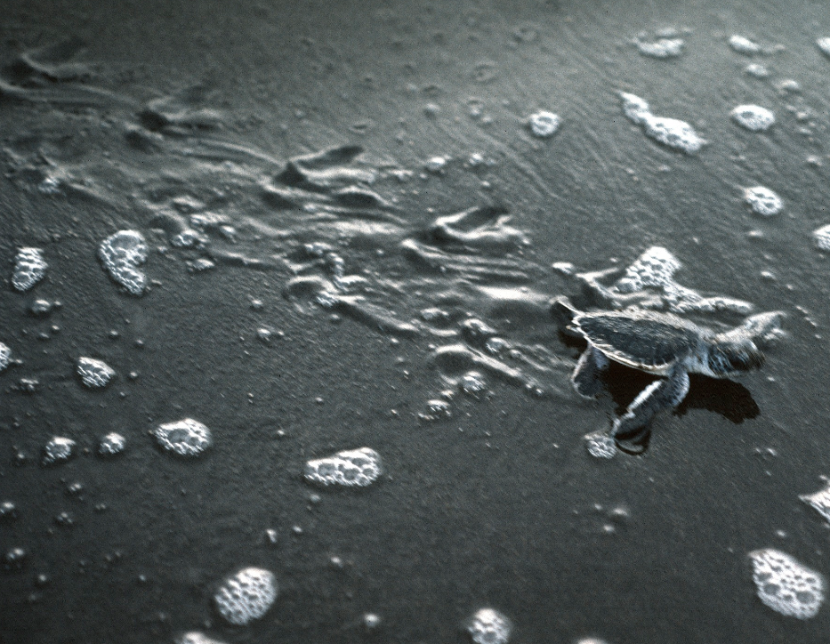
Why is locomotor performance ecologically relevant?

Slide 20
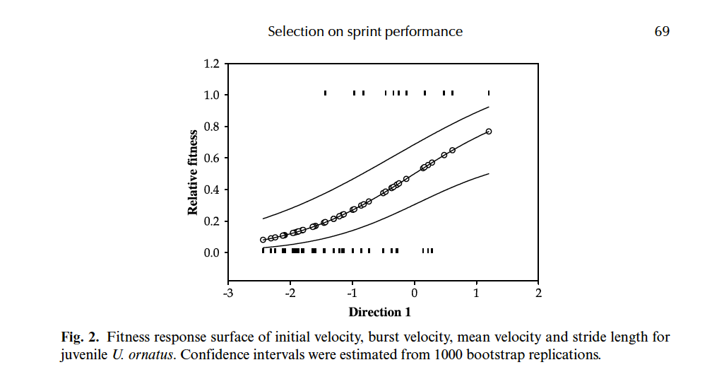
Probability of survival of individual Urosaurus ornatus
and individual locomotor performance
Miles, Evol Ecol Res 2006

Slide 21
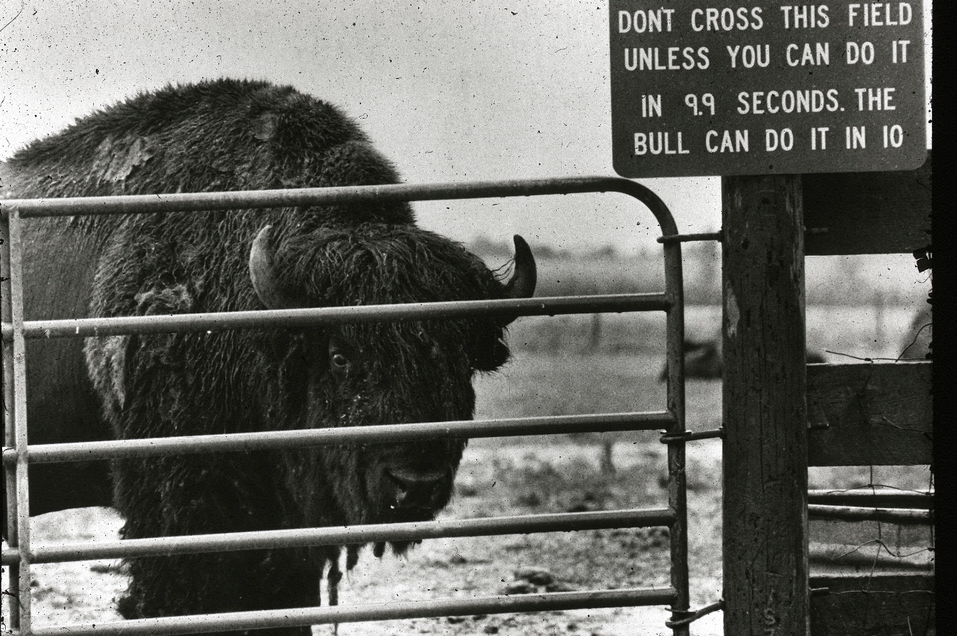
Speed and acceleration are “ecologically relevant” traits
no cruzar este campo a menos que pueda hacerlo en 9,9 segundos. El toro puede hacerlo en 10.

Slide 22
But can’t one use “performance” of cells or molecules
to predict organismal-level performance?
organism
tissues
cells
molecules
“...there are a number of levels of biological integration…
each level finds its explanations of mechanism in the levels below,
and its significances in the levels above it.”
George Bartholomew 1966

Slide 23
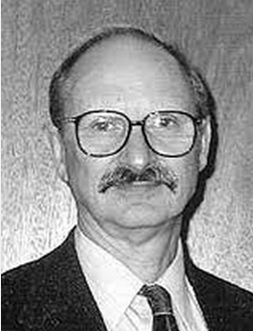
In early 1960s, Paul Licht (Michigan, Berkeley) did classic studies
of the effects of temperature on activities of enzymes
Knew different species of lizards “preferred” different T_{p} and
were active in field at different T_{b} . Does T_{p} (organism level)
predict enzyme T_{opt}?
organism
tissues
cells
molecules
Enzyme activity
Body temperature

Slide 24
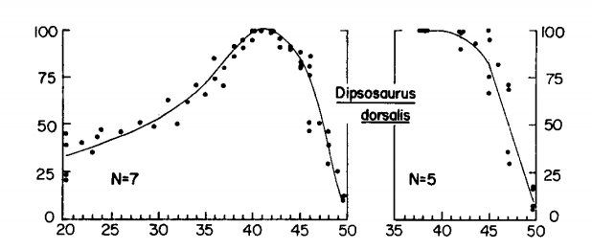
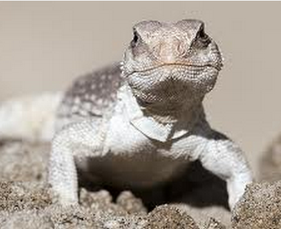

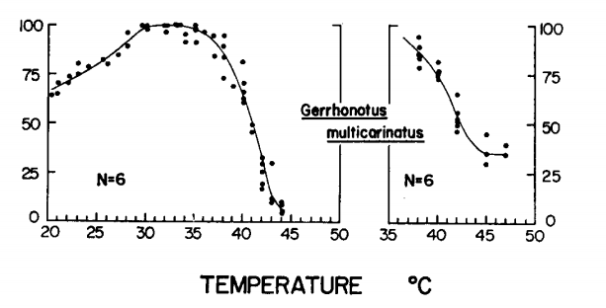
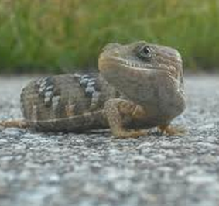
Activity of myosin ATPase (a molecular “motor”)
T_{p}
T_{p}

Slide 25
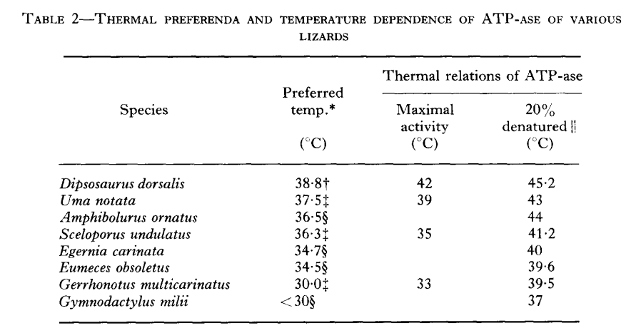
Licht, P. 1964. Comp. Biochem. Physiol.
Notes:
Observed a positive correlation – so Paul answered the question he asked.
But could he predict thermal dependence of sprint speed?

Slide 26
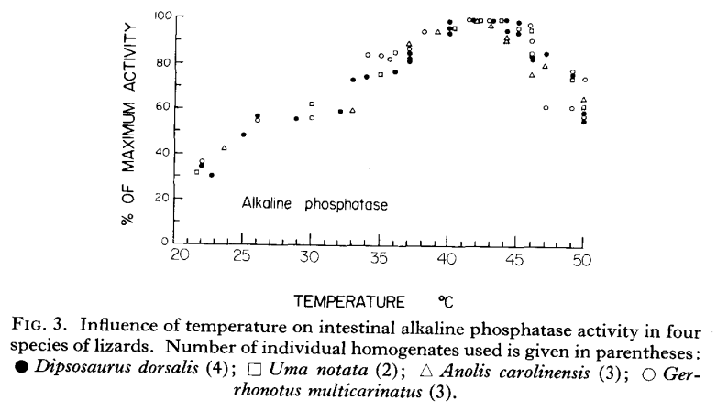
Activity of a digestive enzyme
green anole
CT_{max}
Licht, P. 1964. Comp. Biochem. Physiol.

Slide 27
Activity of a digestive enzyme
alligator lizard
CT_{max}
Licht, P. 1964. Comp. Biochem. Physiol.
Notes:
Therefore lower level data necessary to explain mechanism – how things work – but not applicable to organismal level questions
Also, the eliminate behavior, which is important.

Slide 28
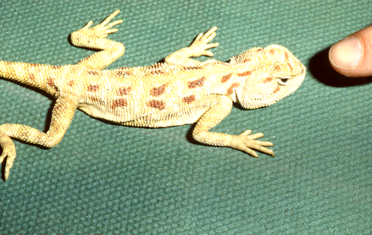
a predatory finger
a warm Trapelus savignyi

Slide 29
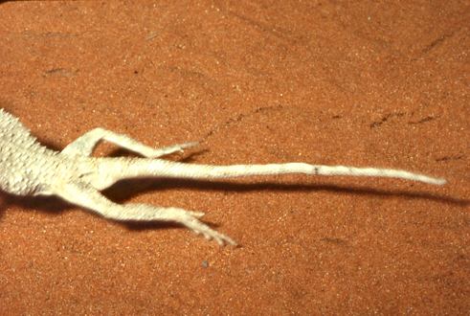

Slide 30
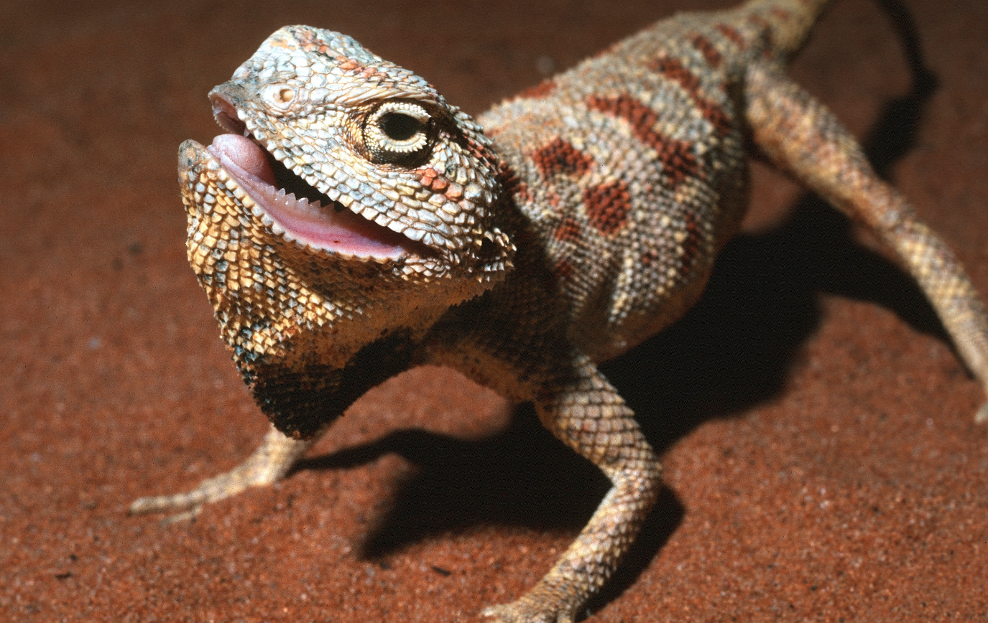
a cold Trapelus savignyi

Slide 31
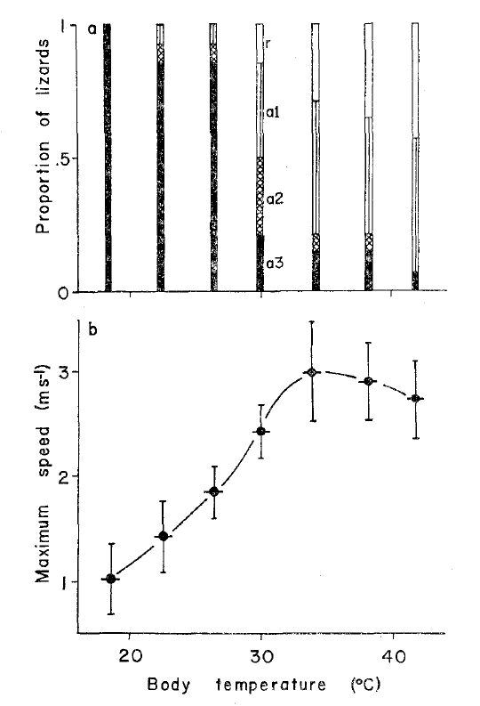
Proportion
that
refused to
run
fight !
ran away
Maximal
speed
(m/s)
Hertz, Huey, Nevo
Anim Behav 1982
Notes:
One might (or might not) have been able to predict Topt from thermal dependence of myosin ATPase
But one could never have predicted the behavioral shift
By eliminating behavior, lower level measurements are of limited utility to anyone asking ecological questions
Again, Licjht was asking mechanistic, not ecological questions.

Slide 32
Sample performance measurements
Locomotion
acceleration, speed (~ “100 m dash”)
stamina (~ “marathon”)
distance run until fatigue
Feeding, digestion
bite force
prey capture rate/success
digestive efficiency

Slide 33
thermoregulation
morphology
T_{b}
habitat
microhabitat
selection

Slide 34
high elevation
warm
cold
low elevation
warm
hot

Slide 35
most
lizards
here
most
lizards
here
Habitat selection & its
thermal consequences

Slide 36
Thermoregulation strategies
regulate time of activity
hottest
coldest
coldest
Agama aculeata
Huey et al., ‘79 Ecology
Notes:
But note that not acrive

Slide 37
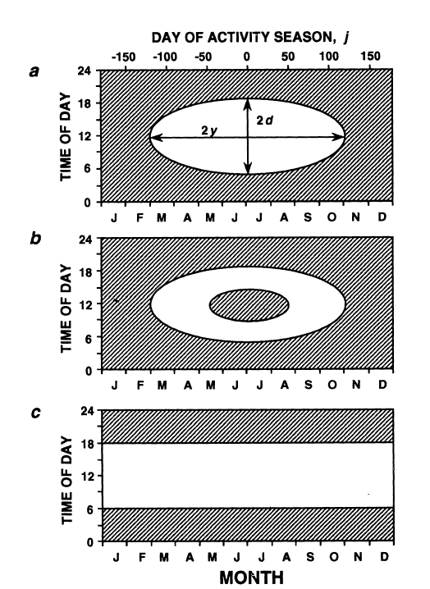
temperate
site
WINTER SUMMER WINTER
hours of restriction
desert
WINTER SUMMER WINTER
Adoph & Porter 1993 Am Nat

Slide 38

Thermoregulation strategies
regulate frequency of basking in sun
Anolis cristatellus, Puerto Rico
High elevation summer winter
% models in sun 29.3 31.3
% lizards in sun 83.5 92.2
Low elevation
% models in sun 10.1 21.0
% lizards in sun 55.9 66.7
Hertz 1992 Ecology
Notes:
Lizards are selecting perches non=randomly with respect to sun

Slide 39

A ‘classic’ thermoregulatory strategy
basking, heliothermy
radiotelemetry
basking
Huey & Slatkin 1976 QRB
redrawn from Stebbins & Barwick Copeia 1968

Slide 40



A ‘classic’ thermoconformer
does not bask
Huey & Webster 1976 Ecology

Slide 41

Punta Salinas, Puerto Rico
open habitat
forest

Slide 42



Slide 43

Anolis cristatellus are “heliotherms” (basking) in open
are “thermoconformers” in forest
basking
basking
Huey, Science, 1974

Slide 44

Huey, Science, 1974

Slide 45
thermoregulation
morphology
T_{b}
habitat
microhabitat
selection

Slide 46


Consequences of thermoregulation vs. thermoconformity
T_{b} in open and in forest habitats
Monagas Punta Salinas
Median T_{b} (°C)
Otero, Huey, Gorman in prep.

Slide 47

Consequences of thermoregulation vs. thermoconformity
female reproduction in open and in forest habitats
Otero, Huey, Gorman in prep.

Slide 48
thermoregulation
morphology -size
T_{b}

Slide 49
Body size
Temperature change and Operative temperature
Experiment:
take a small and a large lizard
move from shade to sun
monitor Tb over time
T?
small
T_{b}
T_{a}
Time

Slide 50
Body size
Temperature change and Operative temperature
Experiment:
take a small and a large lizard
move from shade to sun
monitor Tb over time
T_{e}
small
T_{b}
“temperature
excess”
T_{a}
Time
½ time

Slide 51

Insects – data of Willmer & Unwin, 1981 Oecologia
½ time

Slide 52

Insects – data of Willmer & Unwin, 1981 Oecologia

Slide 53

Voluntary heating rates of lizards in nature
(from telemetry studies)
Huey, Kearney, Otero, Porter, in prep.

Slide 54

But big ectotherms never reach T_{e}
(because of thermal inertia and day length)
Stevenson, 1985 Am Nat

Slide 55
Heating rate in lab
“shade” to “sun”
Heating rate in nature
“shade” to sun
T_{b}
T_{b}
0 2 4 6
1000 1200 1400 1600
Elapsed time in hours
Time of dia

Slide 56
r
Climate change
thermoregulation
morphology -size
T_{b}
habitat
microhabitat
selection
Range
Extinction
Range
Expansion
Adaptation

