Slide 1




Vulnerability of tropical ectotherms
to climate change
Or, are tropical lizards toast?
  Graphic: Barry Sinervo

Slide 2
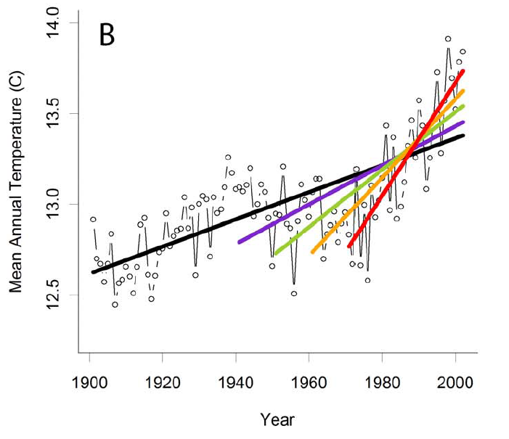
Girvetz et al., 2009 PLoS ONE

Slide 3
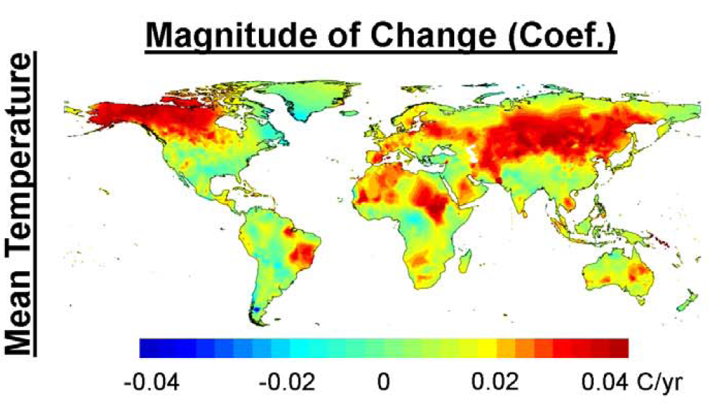
mean annual rate of warming (‘50 to ‘02)
is fastest at
mid- to high latitudes in the N Hemisphere
Girvetz et al., 2009 PLoS ONE

Slide 4
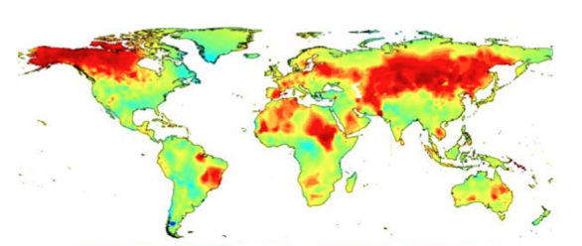
Predicted biological consequences?
“…we expect these changes to be concentrated
in areas where temperature changes are largest
(that is, at higher latitudes and altitudes) and for
changes to be less evident elsewhere.”
Root, Price, Hall, Schneider, Rosenzweig & Pounds
Nature 2003

Slide 5
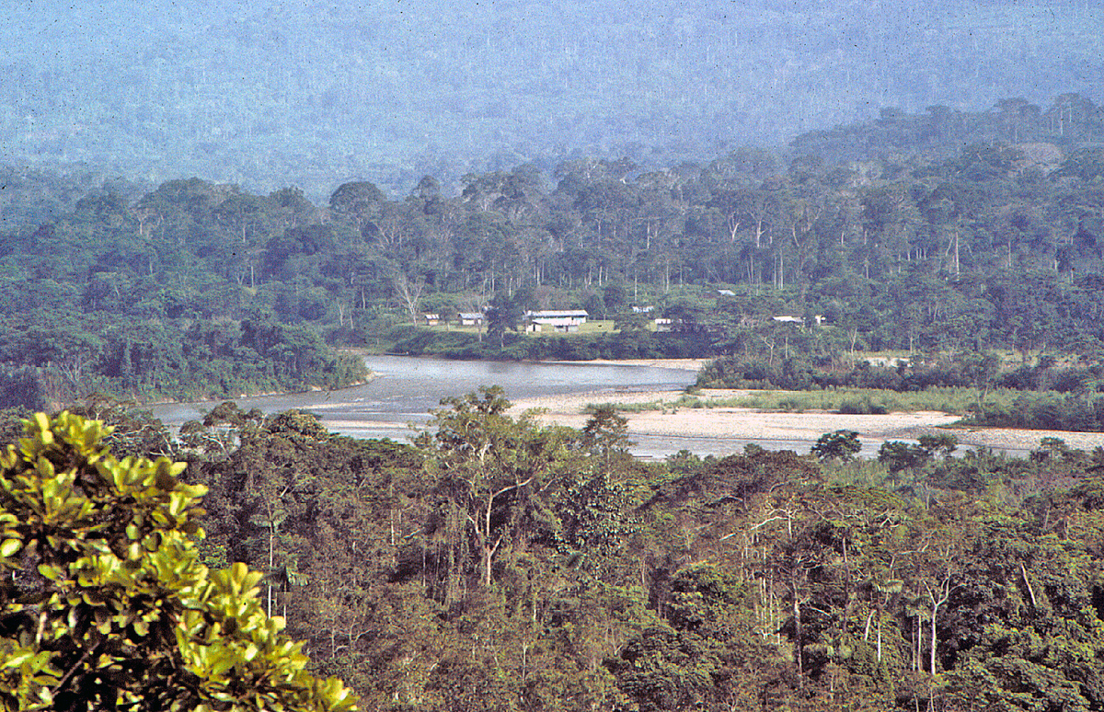
lowland Amazonian Ecuador
courtesy L. Vitt

Slide 6
Species richness (and endemism) in reptiles & amphibians
modified from Kier et al., PNAS 2009

Slide 7
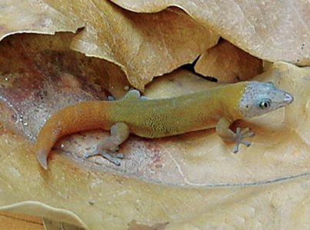
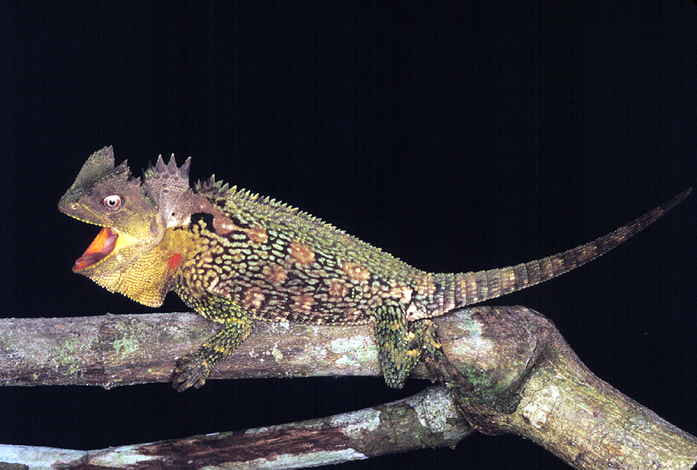
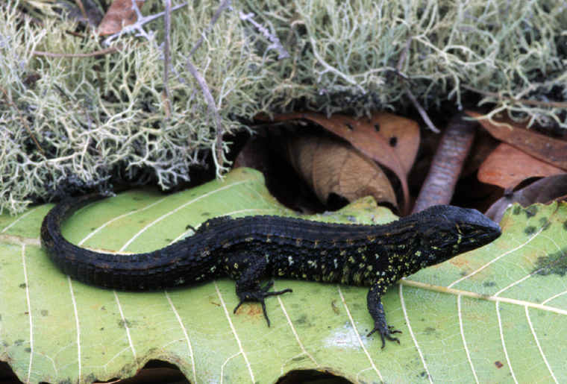
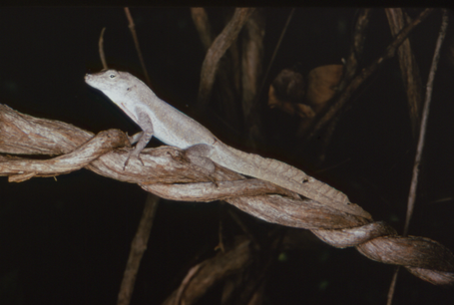
Enyalioides palpebralis
Amazon
Sphaerodactylus
Cuba
Neusticurus ecpleopus
Amazonia
Anolis cristatellus
Puerto Rico

Slide 8
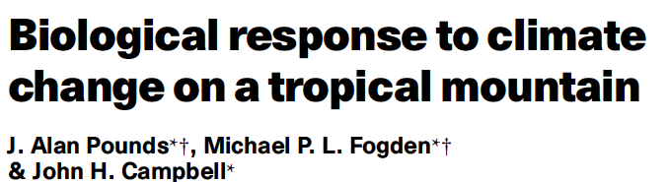
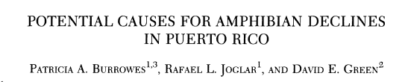
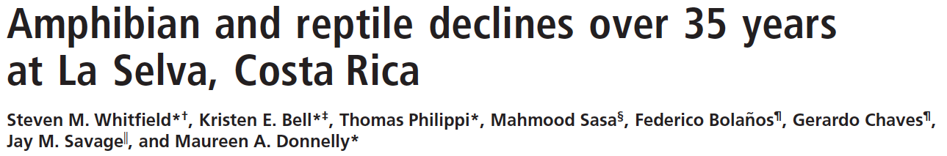

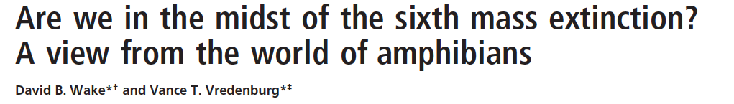
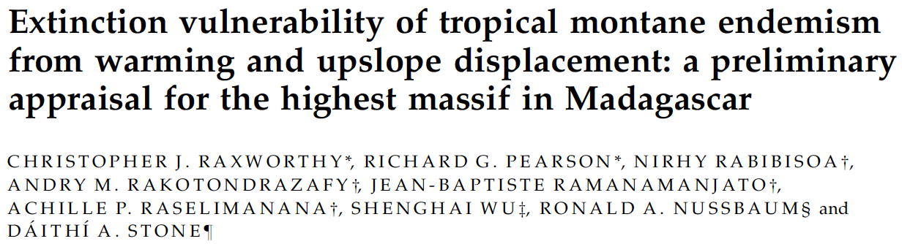
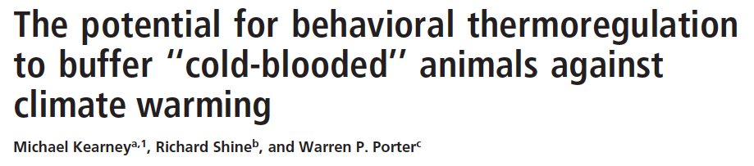
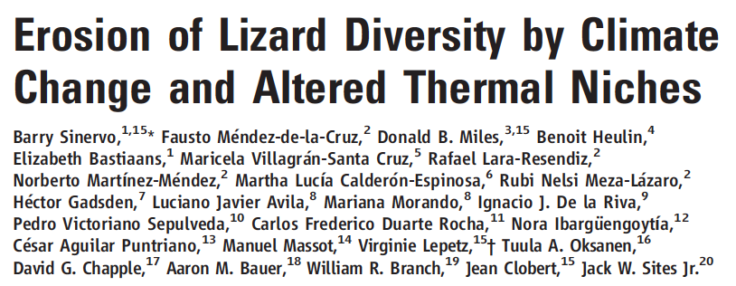
‘Early’ papers noting that tropical (terrestrial) ectotherm might be at risk
‘99
‘04
‘07
‘08
‘09

Slide 9
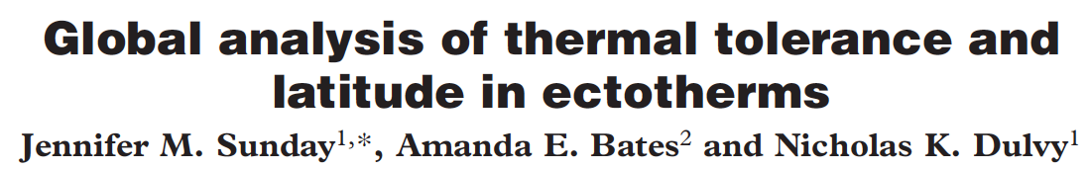
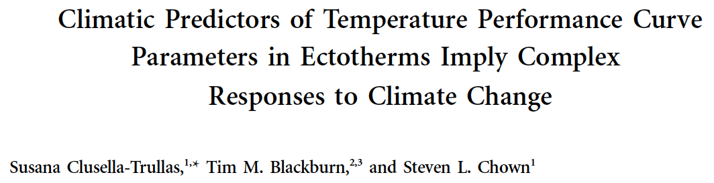
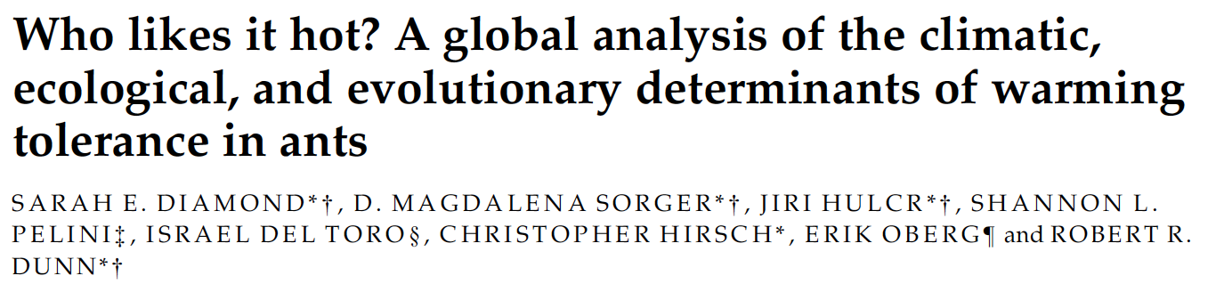
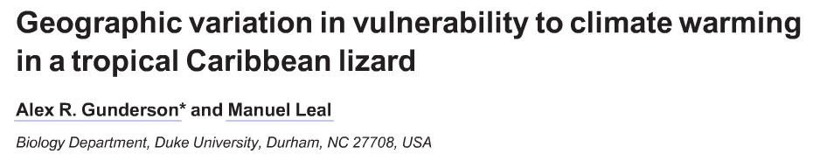
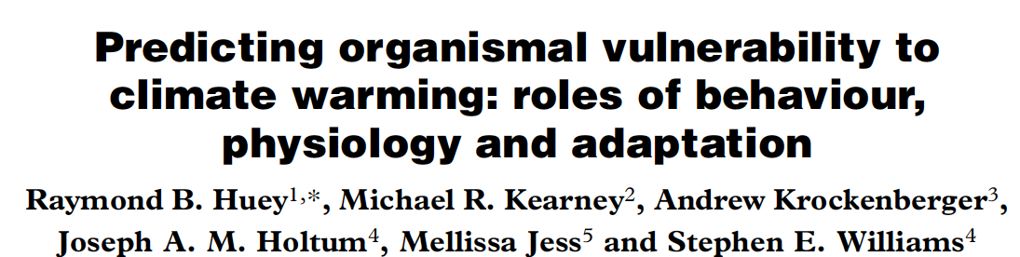
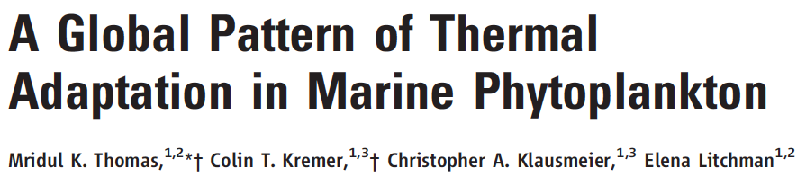


‘10
‘11
‘12
‘13

Slide 10
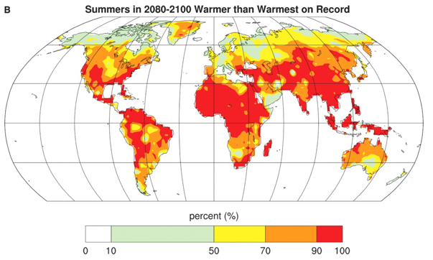
Probability mean growing-season temperatures
(at the next century’s end) will exceed
the warmest temperatures ever recorded
during the last century (1900-2006) !
Battisti & Naylor, Science 2009

Slide 11
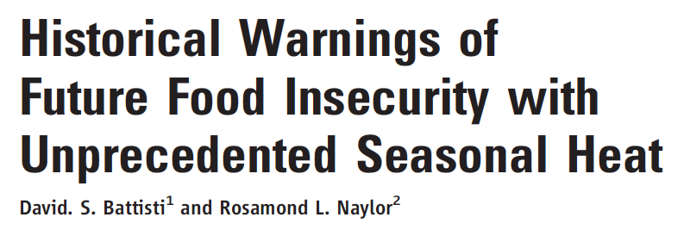
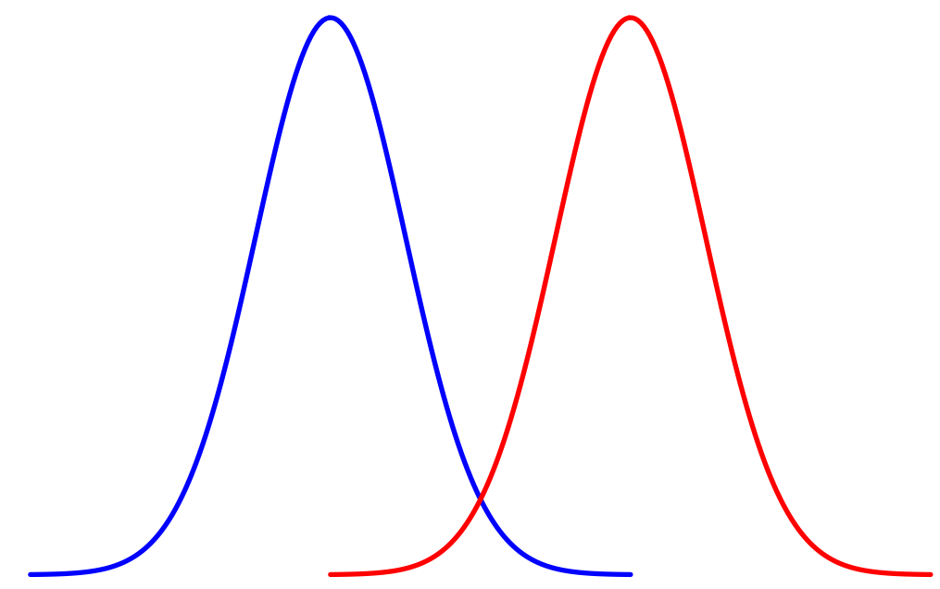
Probability
summer temp
1900-2000
summer temp
2080-2100

Slide 12
If an organism is physiologically sensitive to temperature
Biological factors making ectotherms vulnerable to climate warming
If an organism is unable to use behaviors to
buffer or evade warming?
If “environmental” temperatures are already warm
relative to the an organism’s optimal temperature
Where do ectotherms with those traits live?

Slide 13
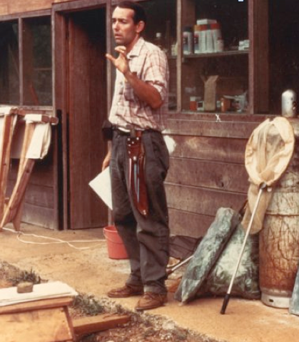
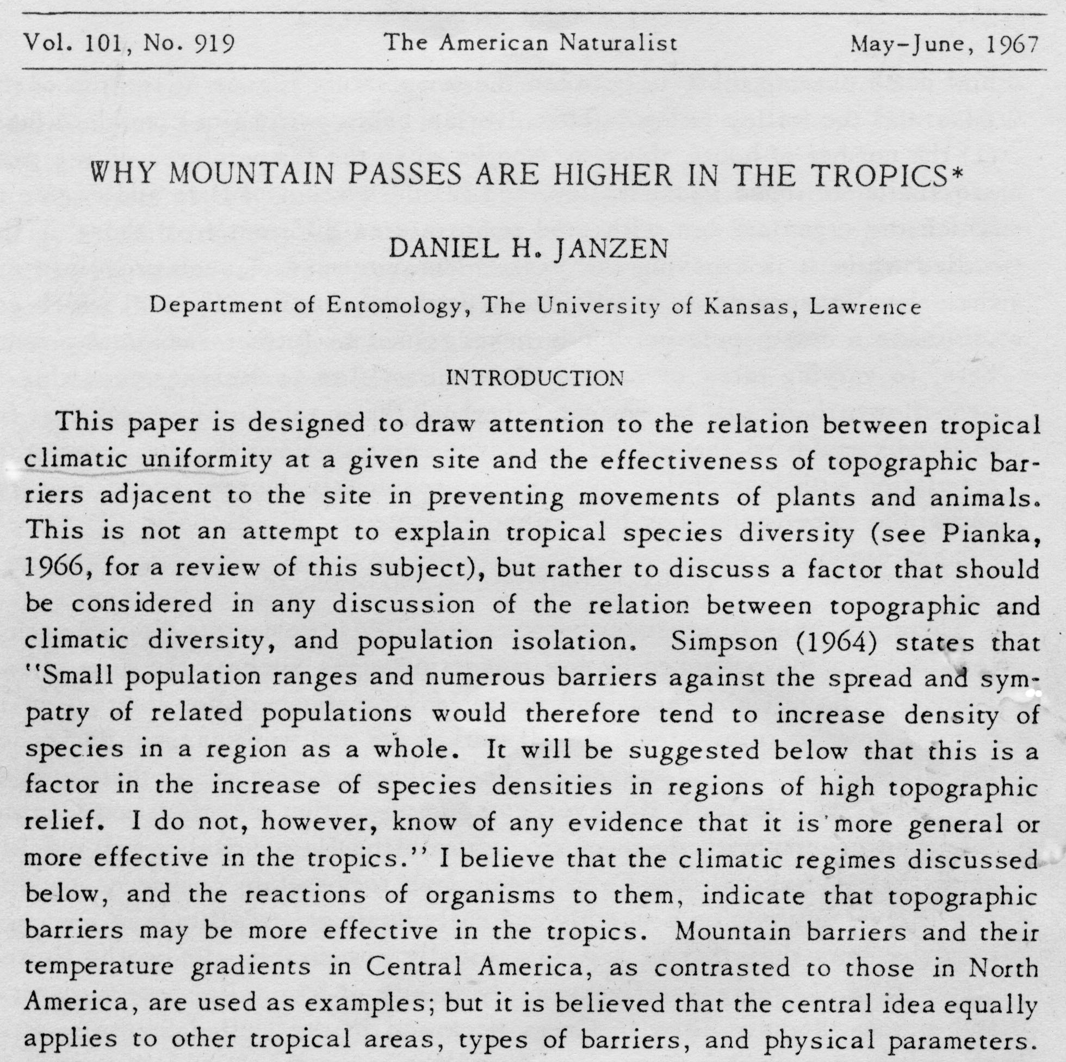
Dan Janzen lecturing 1967

Slide 14
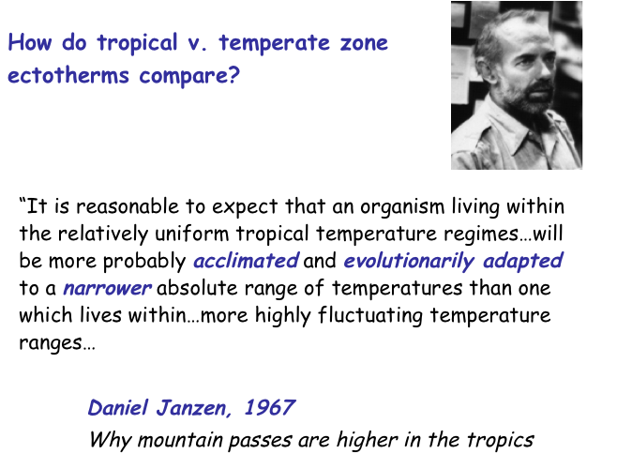

Slide 15
…it is the temperature gradient across a mountain
range which determines its effectiveness as a barrier,
rather than the absolute height…”

Slide 16
Tropical ectotherms are thermal specialists
Janzen 1967
Generalist (temperate zone)
Specialist (tropics)
Relative fitness
Body temperature
Body temperature
Notes:
Blue=environm temp 1
Green+an increse
red=even more
SPECIALISTS HAVE NARROWER THERMAL TOLERANCE
HIGH LAT SP, MORE GENERALSITS

Slide 17
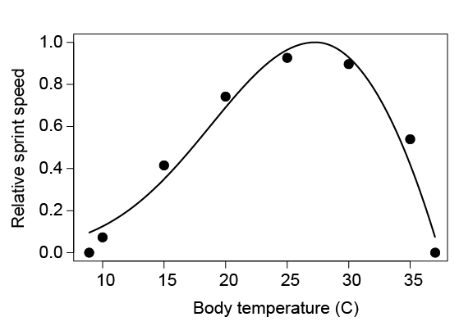
Huey et al. 2009, PRSB

Slide 18
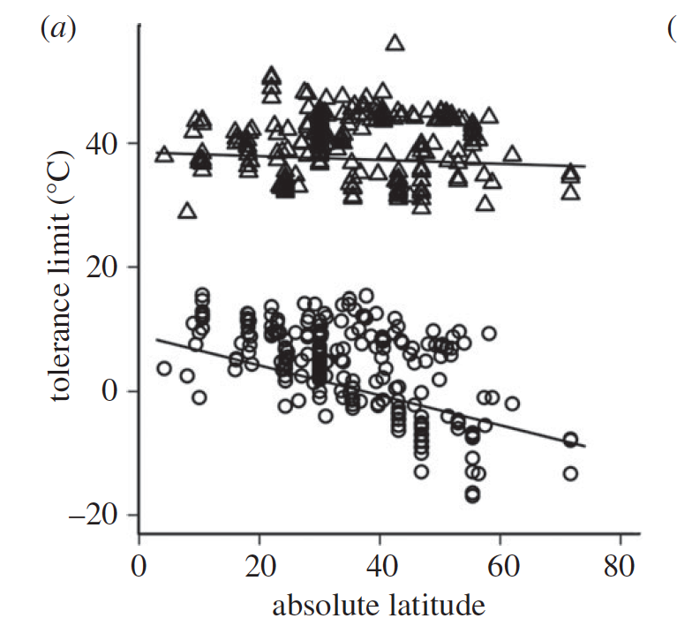
Thermal tolerance breadth of terrestrial ectotherms increases with latitude
Sunday, Bates, Dulvy, 2010 - Proc Roy Soc B

Slide 19
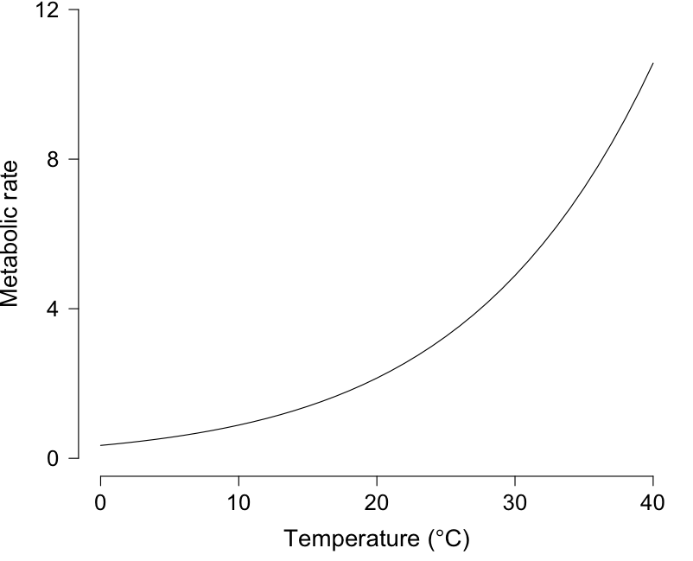
Sensitivity of metabolic rate to temperature change
Increases with temperature

Slide 20
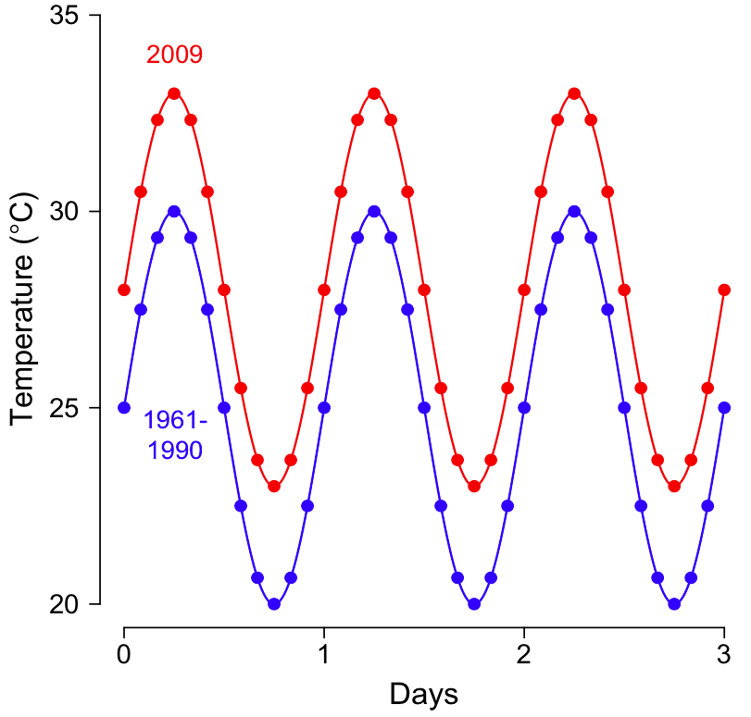
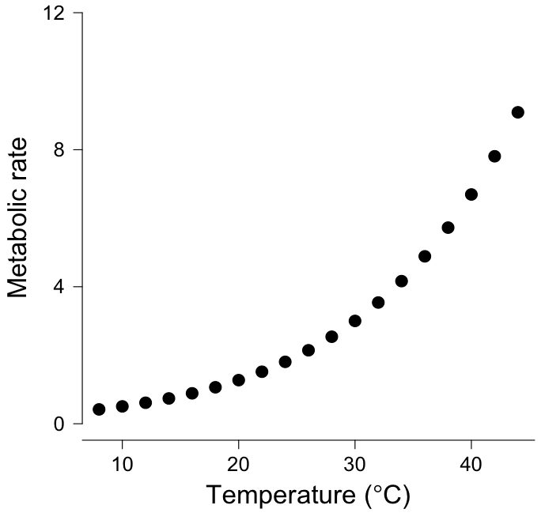
map observed temperature change to
predicted change in metabolism

Slide 21
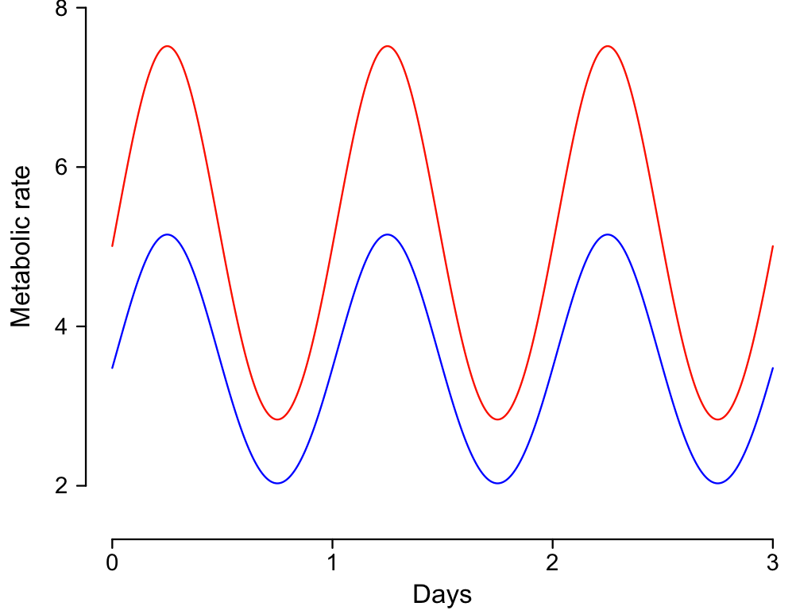
Goal:
map observed temperature change to
predicted physiological change

Slide 22
Methods -- weather data
Obtained hourly temperature records for 22,423 stations
(NOAA isd-lite data)
Selected stations with data covering 1961 to 31 Dec. 2009
with all seasons represented
with records at least every 6 hours
Final analysis included 3186 weather stations
Stations grouped into 5° x 5° cells, averaged, and area corrected
Dillon, Wang, Huey 2010 Nature

Slide 23
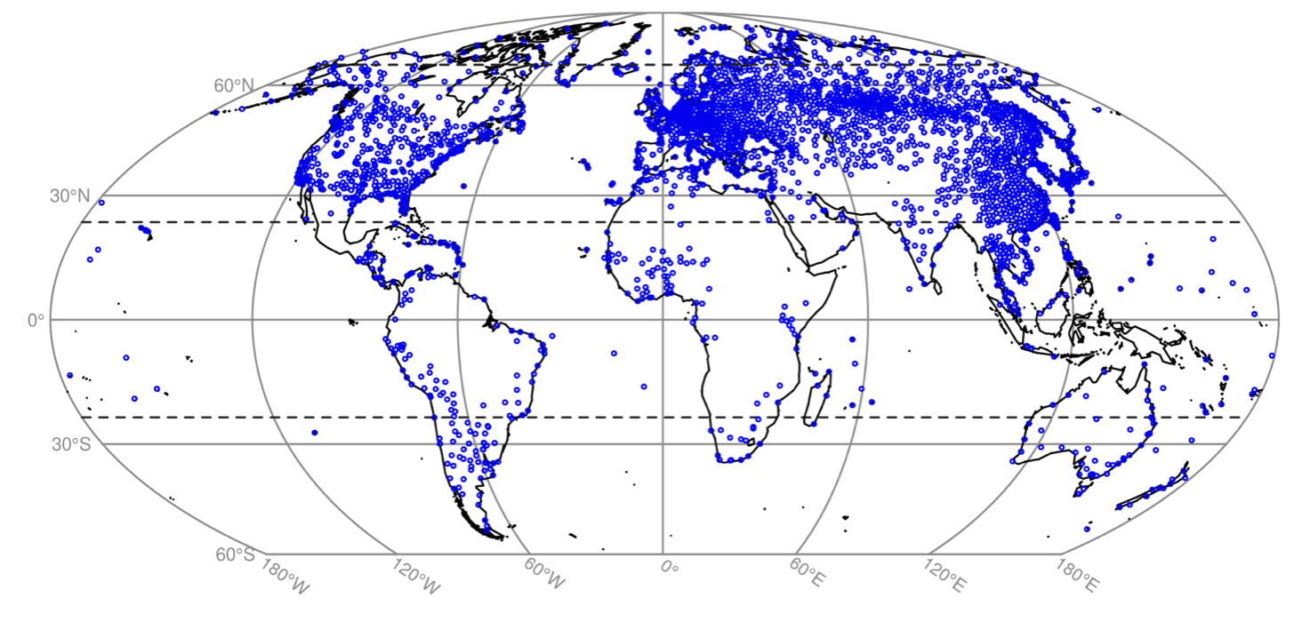
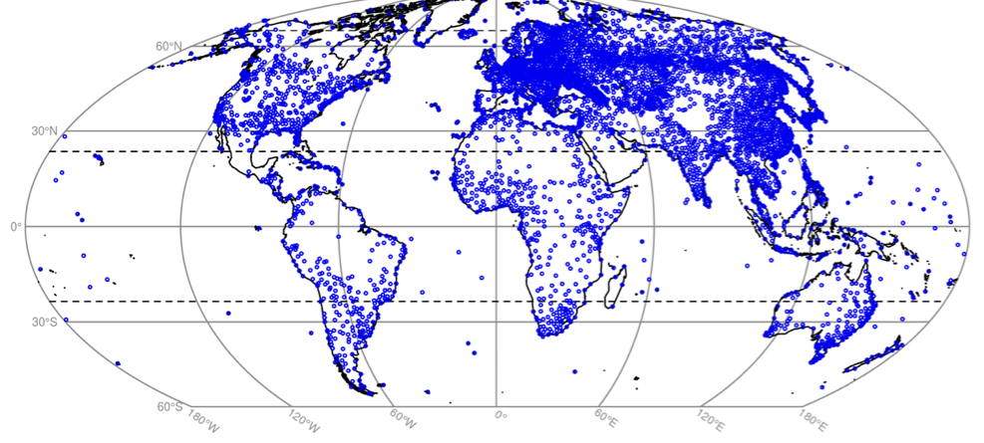
Main data set = 3186 stations
5561 stations

Slide 24
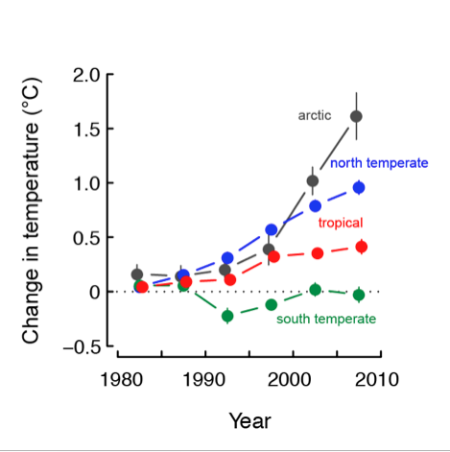
Observed temperature change
in different latitudinal regions
Dillon, Wang, Huey 2010 Nature

Slide 25
“Fundamental” Equation From
the Metabolic Theory of Ecology
metabolic rate = b_{o} m^{3/4} e^{-E/kT}
b_{o} = taxon-specific normalization constant
m = mass
E = activation energy (0.63)
k = Boltzmann’s constant
T = absolute temperature (Kelvin)
Gillooly, Brown, West,Savage, & Charnov, 2001, Science

Slide 26
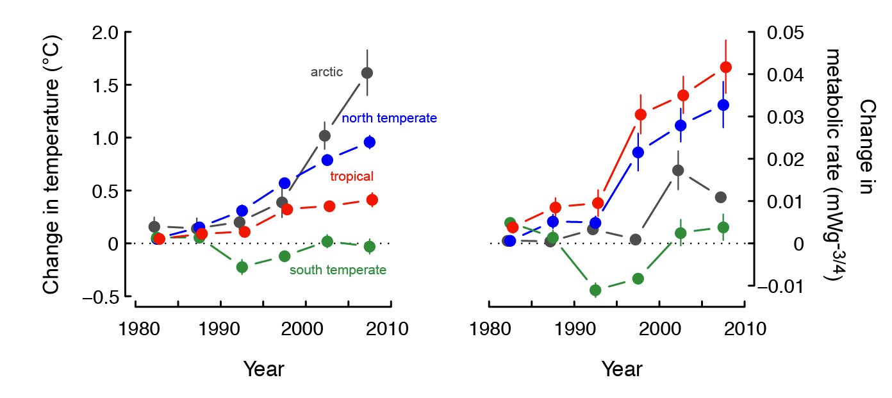
Observed change
in ambient temperature
Predicted change
in metabolic rate

Slide 27
Observed change
in ambient temperature
Predicted change
in metabolic rate

Slide 28
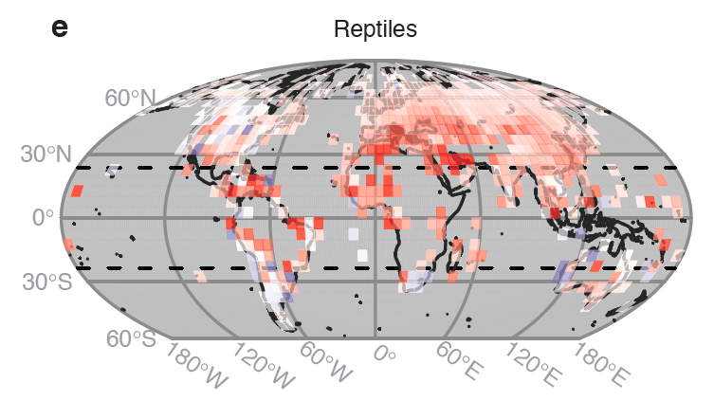
metabolic rate = b_{o} m^{3/4} e^{-E/kT}
Notes:
WHAT IS THE CAUSE?

Slide 29
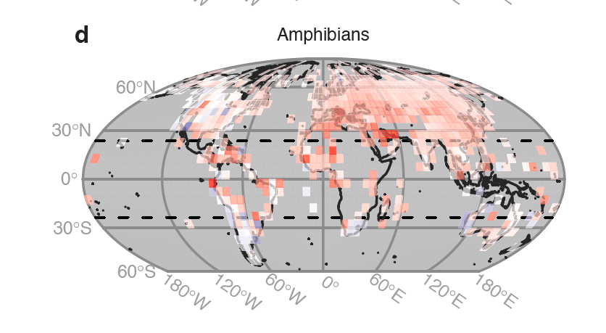
metabolic rate = b_{o} m^{3/4} e^{-E/kT}

Slide 30
If an organism is physiologically sensitive to temperature
Biological factors making ectotherms vulnerable to climate warming
If an organism is unable to use behaviors to
buffer or evade warming?
If “environmental” temperatures are already warm
relative to the an organism’s optimal temperature

Slide 31
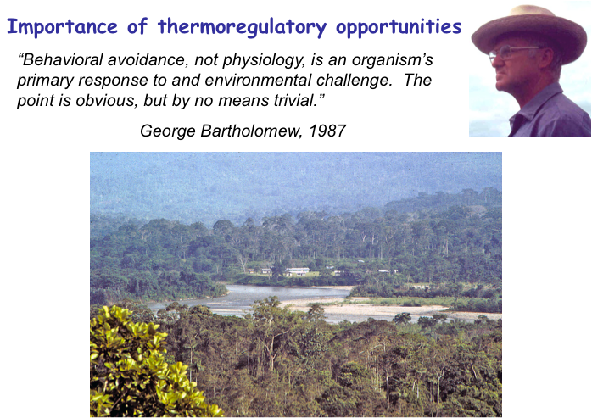
“Behavioral avoidance, not physiology, is an organism’s
Primary response to an environmental challenge. The
point is obvious, but by no means trivial.”
George Bartholomew, 1987

Slide 32
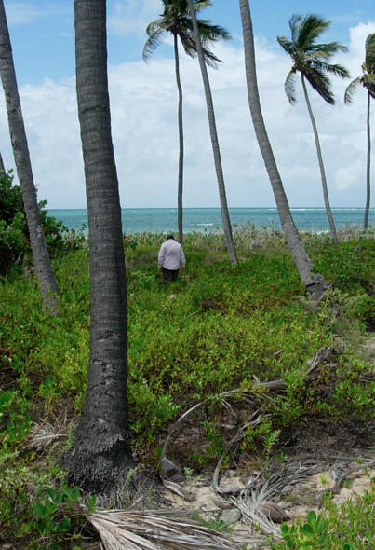
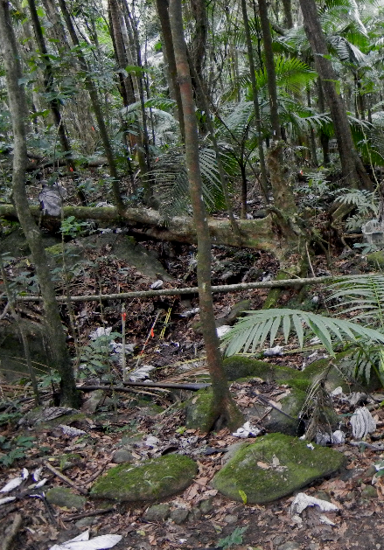
Open habitat –
heterogeneous temperatures
Closed forest –
homogeneous temperatures

Slide 33
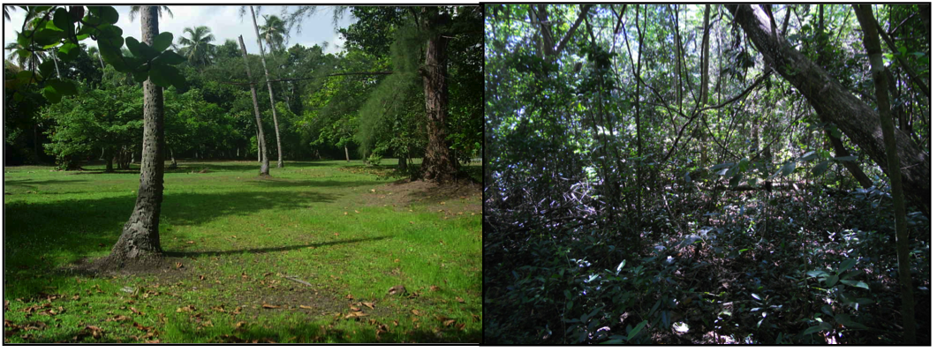
Punta Salinas, P.R
open habitat
forest

Slide 34
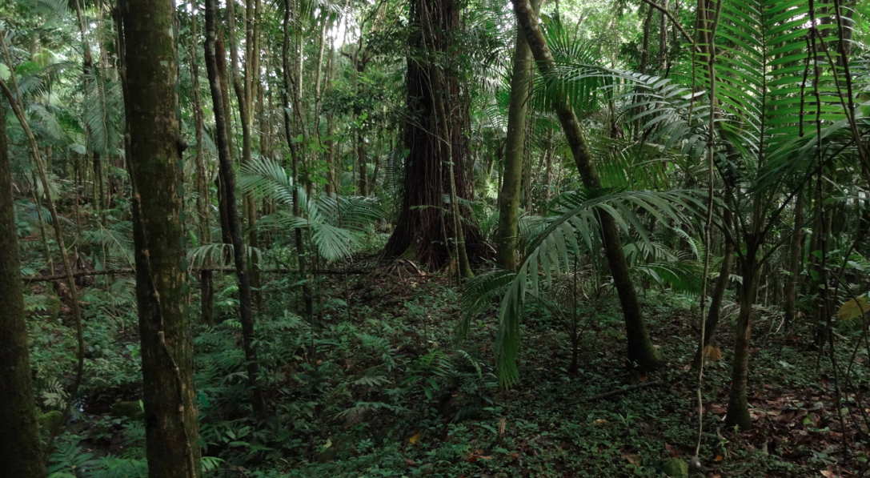
Deeply shaded forest – T_{e} variation is very small
27.9
25.2
25.9
25.3

Slide 35
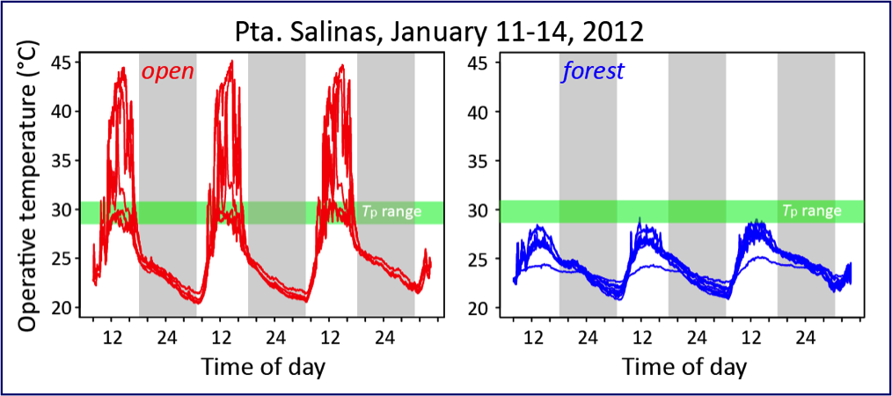

Slide 36
Forest dwelling, non-basking lizards are common in tropics
Site | N non-bask | N bask
Amazonas | 11 | 5
Caatinga | 2 | 8
Cuyabeno | 14 | 4
Nicaragua | 7 | 1
Para | 13 | 4
Porto Walter | 16 | 3
Rio Ituxi | 14 | 3
Rondonia | 16 | 6
mean field T_{b} 28.6°C 35.0°C
Vitt data, in Huey et al., 2009 Proc Roy Soc B
Vitt data, in Huey et al., 2009 Proc Roy Soc B
Notes:
36

Slide 37
If an organism is physiologically sensitive to temperature
Biological factors making ectotherms vulnerable to climate warming
If an organism is unable to use behaviors to
buffer or evade warming?
If “environmental” temperatures are already warm
relative to the an organism’s optimal temperature
Notes:
NEED TO KNOW HOW warming will influence operative or equilib temps of animals and plants, not just of mean annual air temperature
Need to know what kinds of animals and plants are most sensitive
And need to know where they live. Will argue that they occur mainly in lowland tropical forests.

Slide 38
Tewksbury, Huey, Deutsch
2008 Science

Slide 39
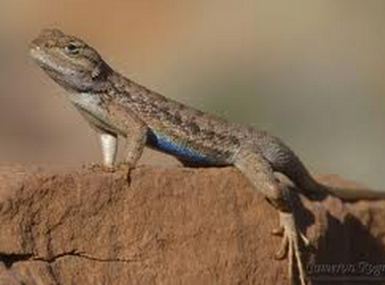
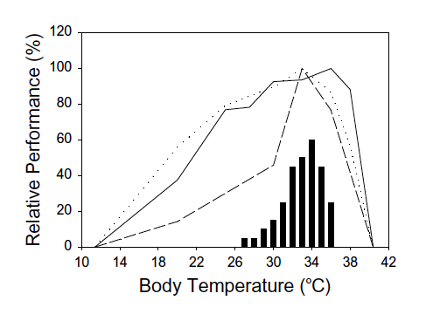
Sceloporus undulatus
speed
stamina
digestion
Angilletta et al., J. Thermal Biol. ‘02

Slide 40
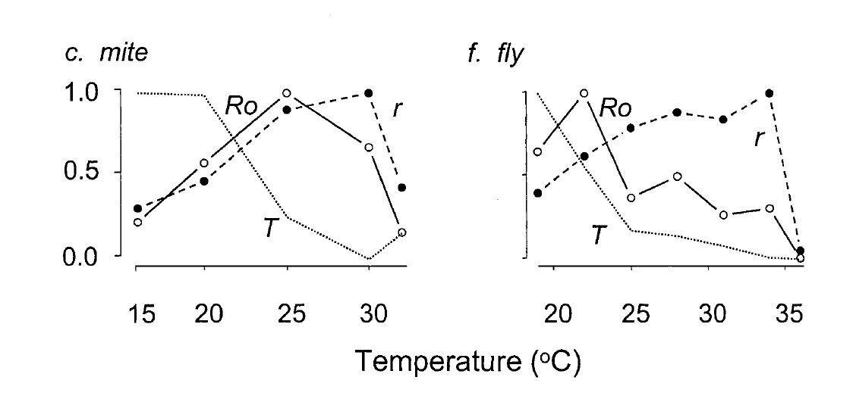
r = intrinsic rate of increase (population)
R_{o} = net reproductive rate (N female offspring/female)
T = generation time
Huey & Berrigan, Am Nat 2001

Slide 41
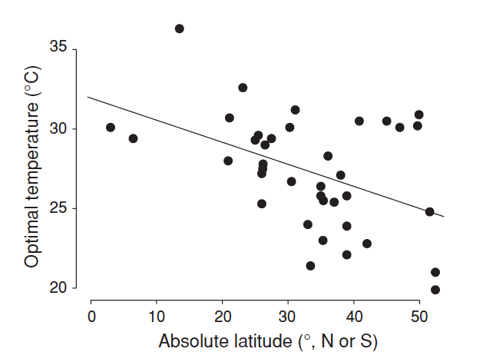
Optimal temperature (r, intrinsic rate of increase) of insects
Huey, 2010 in Low Temperature Biology of Insects

Slide 42
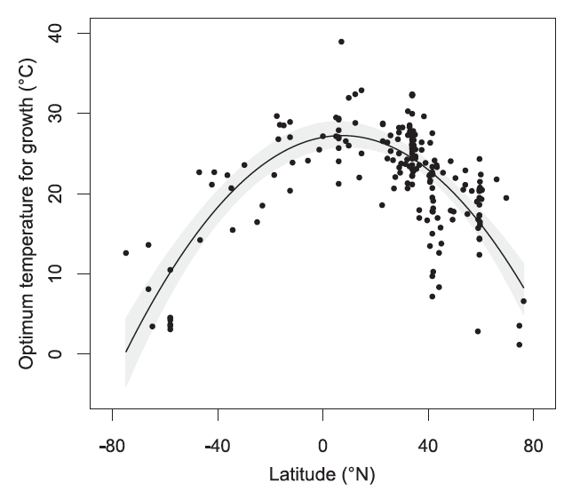
Expectation: tropical ectotherms should be warm adapted
marine phytoplankton
Thomas et al., Science 2012

Slide 44



Acyrthosiphon pisum
temperate zone aphid
Clavigralla shadabi
tropical coreid
Deutsch et al., 2008, PNAS

Slide 45

Deutsch et al. ‘08 PNAS

Slide 46

Projected changes in insect population growth rates (r)
+
_
+
-0.2
-0.1
0
0.1
0.2
growth reduced
growth increased
Deutsch et al., 2008, PNAS

Slide 47

open, bask
CT_{max}
forest, non-bask
optimal sprint
temperature
Huey et al., 2009 Proc Roy Soc B

Slide 48

2) Tropical lizards (at least forest species) are NOT heat tolerant !
data from Huey et al., 2009 Proc Roy Soc B

Slide 49

Lizards
CT_{max} –
T _{qt mean}
Huey et al., 2009 Proc Roy Soc B

Slide 50

Ants
CT_{max} –
T _{qt mean}
Diamond et al., 2012 Glob Change Biol

Slide 51

Lizards + Snakes
CT_{max} –
T _{qt mean}
Clusella-Trullas et al., 2011 Am Nat

Slide 52
CT_{max} –
T _{qt mean}

Slide 53
Expectation: tropical ectotherms should be warm adapted
marine phytoplankton
Thomas et al., Science 2012

Slide 54

Predicted geographic changes in phytoplankton diversity
by end of this century
+
-
Thomas et al., Science 2012

Slide 55
Warming temperatures will restrict activity times, energy
gain, and reproductive output
T_{e} max
(surface in sun)
Temperature
T_{preferred}
T_{e} soil
T_{e} min
(surface in shade)
hr_{restriction}
Time of day

Slide 56
Warming temperatures will restrict activity times, energy
gain, and reproductive output
before warming after warming
Temperature
h_{restriction}
h_{restriction}
Time of day
Time of day

Slide 57
Extinction predictions for lizards: tropics may be an extinction hell hole”
But we have as yet NO EXTINCTION/Te Validation studies underway

Slide 58
3) Environmental (“operative”) temperatures in sun in tropics are much
higher than upper heat tolerances of lizards
Thermal
danger zone
Thermal
safety zone
Sunday, Bates, Colwell, Dulvy, Longino, Kearney, Huey submitted

Slide 59


“Escape” to the higher altitude is feasible for tropical organisms
(if mountains are nearby)
But escape to higher latitude is not in the tropics
minus 6.0°C per ever km increase
In elevation
Temperature (°C)
Elevation (km)
Dillon et al., UCB 2006
from SOM in Colwell et al., Science 2008

Slide 60

What we need?
Data (CT, T_{p}, T_{opt}, T_{b}, acclimation)
on tropical forest ectotherms –
especially non-Anolis
Data on Southern Hemisphere reptiles
(most current data lizards from NH,
where seasonality greater)

