Slide 1
The potential impacts of climate change on extinctions of Blunt Nosed Leopard Lizards
Joseph Stewart, UN Reno
Robert D. Cooper, UCSC
Mike Westphal, BLM
Scott Butterfield, TNC
Barry Sinervo, UC Santa Cruz

Slide 2
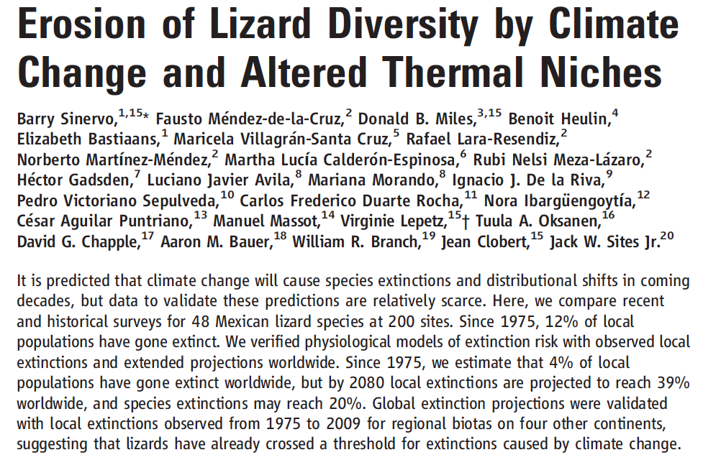

Slide 3
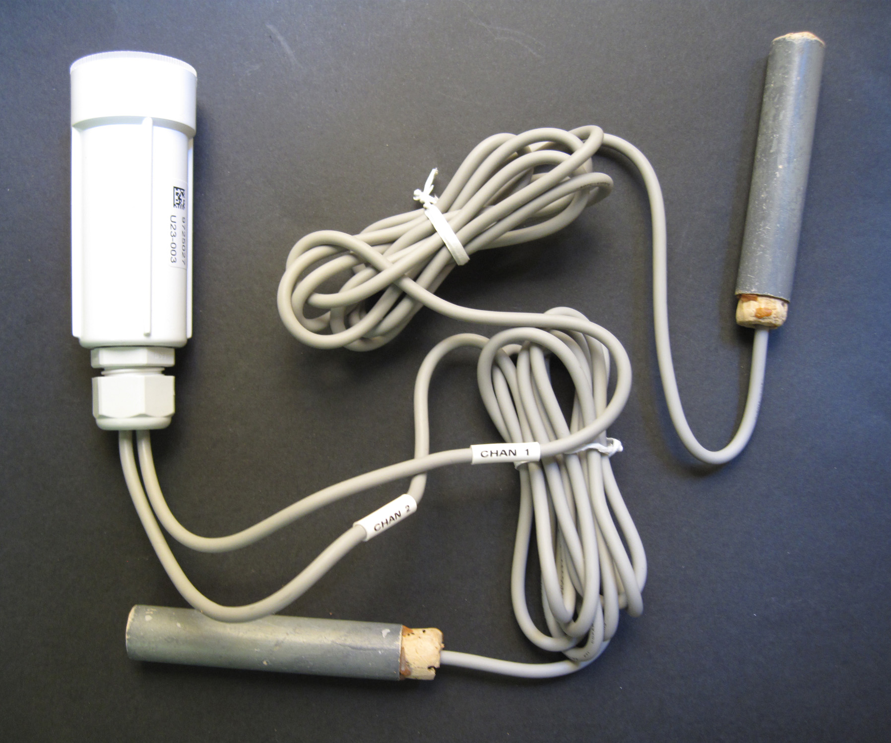
Glossary
Tb lizard body temperature in the field
Tp preferred lizard body temperature in lab
Tmax – Maximum daily air temperature
Te – Operative environmental temperature (the temperature a lizard could achieve if it were in a particular place in the environment)

Slide 4
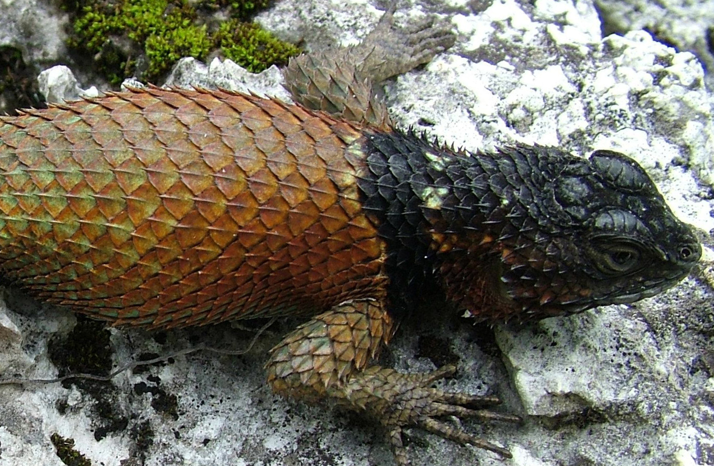
Operative Model Temperatures
Yucatan Ground truth (Dec 2008-Apr 2009) used in Sinervo et al. 2010
Deploy lizard models hooked up to Hobotemps
This estimates Operative Model Temperatures (Bakken 1994)

Slide 5
Measure the number of hours T_{e} > T_{preferred} at two extinct and two persistent sites in the Yucatan (Sinervo et al. 2010)
Linear relationship can be used to predict h_{restriction}: h_{r}[T_{e} >T_{preferred}] = slope × (T_{max} – T_{preferred}) + intercept
T_{max} – T_{preferred}

Slide 6
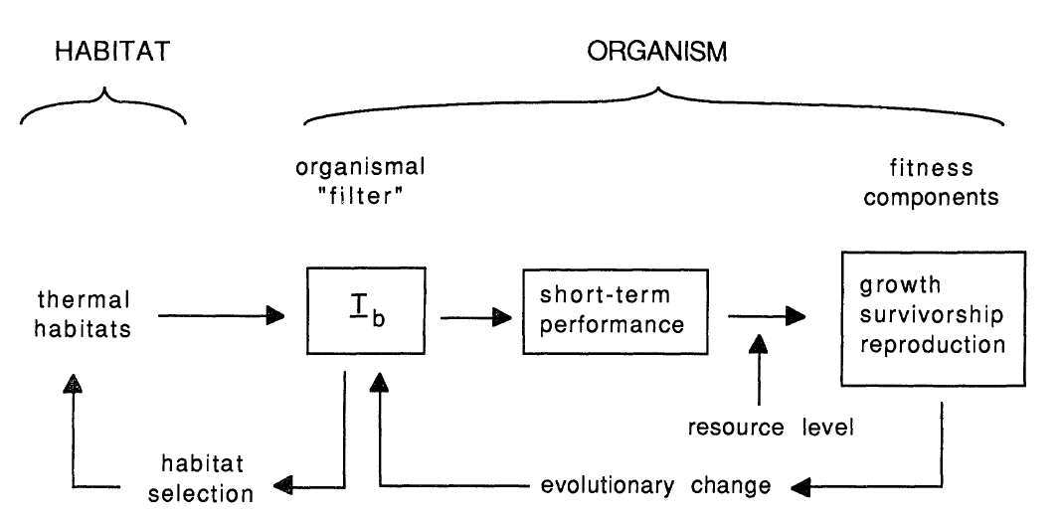
r
Climate change
thermoregulation
morphology -size
T_{b}
habitat
microhabitat
selection
Range
Extinction
Range
Expansion
Adaptation

Slide 7
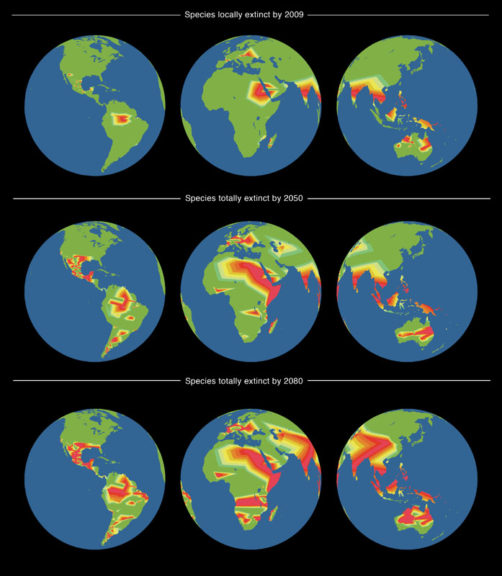
By the numbers:
2009
4% local extinction
R² = 0.72 in a global validation with 8 other families
2050
6% species extinction
100% in some areas
2080
20% species extinction
100% in many areas

Slide 8
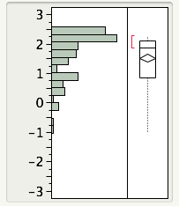
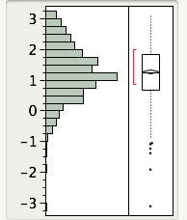
BNLL vs LNLL distributional limits defined by hours of restriction, h_{r}
BNLL hottest site is 2.6 h
LNLL hottest site is 3.1 h
The shape of the distribution of hr for BNLL is a severe liability: many populations on the valley floor are close to climate forcing extinction limits.
Room for BNLL
Adaptation c.f.,
LNLL h_{r} limits?
Only a small fraction of LNLL are near the upper limit so few are at risk of extinction.
The ancestral LNLL Tolerates hotter spots than the BNLL and the
LNLL has a higher Tb in the field: 38.9 for LNLL vs 39 C for BNLL

Slide 9
We ran two physiological scenarios
The BNLL shows regional Tb adaptation:
T_{b} = 38.0 C and hours of restriction (h_{r}) in the hottest site in the central valley is the current limit (h_{r,critical}=2.6)
The BNLL could potentially achieve limits seen in the LNLL (which is found at hotter sites)
T_{b} = 38.9 C and hours of restriction (h_{r}) in the hottest site of the LNLL also sets the current limit for BNLL (e.g., assume BNLL h_{r,critical}=3.1)

Slide 10
Methods
Deploy data loggers hooked up to 4 BNLL models (2 sizes: gravid female and sub-adult) at
In vegetation, full sun, holes
Data collected from September – November during hot to cool weather
Download Tmax data from adjacent Weather Stations 10-30 km distant
Regress h_{r} on (T_{max} – T_{b})
Use WorldClim.org Tmax surfaces to compute h_{r} at each known location (Herpnet.org)
When h_{r} > h_{r,critical} population assumed to go extinct

Slide 11
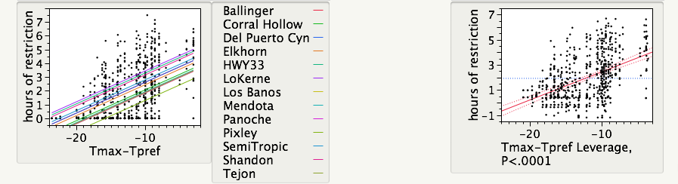
The fit for T_{e} across sites and pooled higher Tmax increases hours of restriction for foraging
We used the pooled relationship on the right, ignoring population variation (which is likely driven by proximity of the weather station to the study plots)

Slide 12
Scenario 1: BNLL has no plasticity in Behavioral Thermoregulation
Scenario 1: BNLL can achieve ancestral thermal adaptation seen in LNLL

Slide 13
Scenario 1: BNLL can achieve ancestral thermal adaptation seen in LNLL

Slide 14
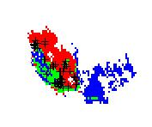
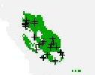
MAXENT confirms extinction risk
Lost – Red, Persist – Green
Colinization -- Blue
Current
The BNLL cannot expand to blue
Because the LNLL is there

Slide 15
Conclusions
The populations on the floor of the Central Valley are at grave risk of extinction in the next 100 years

Slide 16
Future models and refinements
In collaboration with Cam Barrows (UCR) use Habitat Niche models that factor in vegetation
In collaboration with Dave Germano (CSU Bakersfield) use data on demography to develop a Population Viability Model, coupled to temperature and precipitation changes.
Use Regional Climate Models developed for CA by Lisa Sloan (UCSC) and also refined estimates by Bruno Sanso that remove the biases of current IPCC climate surfaces (e.g., for CA, IPCC poorly predicts observed decreases to summer monsoon rains and winter rains). This may explain extinctions in the center of BNLL range

Slide 17
Precipitation impacts recruitment!
So extended droughts can drive rapid future extinctions
Data from Germano and Williams 2005

Slide 18
Funding
Thanks to the BLM and TNC for funding
And to NSF Macrosystems

